Slide 1

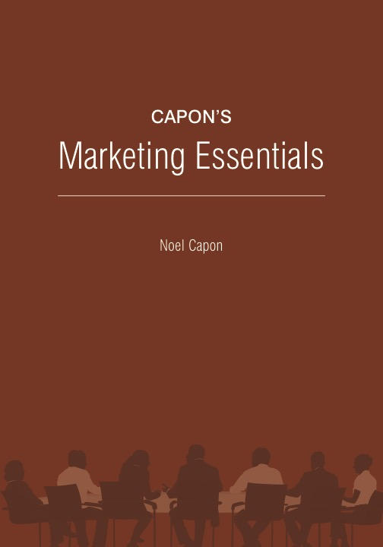




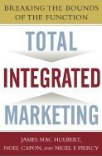
www.wessexlearning.com
Managing Markets Strategically
Professor Noel Capon
R.C. Kopf Professor of International Marketing
Columbia Business School
New York, NY

Slide 2
Managing Markets Strategically
www.wessexlearning.com
Section 1: Marketing and the Firm
Chapter 1: Introduction to Managing Marketing
Chapter 2: The Value of Customers
Section 2: Fundamental Insights for Strategic Marketing
Transition to Strategic Marketing
Section 3: Strategic Marketing
Section 4: Implementing the Market Strategy

Slide 3
www.wessexlearning.com
Chapter 1
Introduction to
Managing Marketing

Slide 4
Chapter Roadmap
www.wessexlearning.com
What Does Marketing Mean Today?
Focus on 3 Fundamentals
Marketing as a Philosophy
Six Marketing Imperatives
Four Core
Marketing Principles
Internal Firm Orientation
External Firm Orientation
Determine, recommend which markets to address
Identify, target market segments
Set strategic direction, positioning
Design market offer
Secure functional support
Monitor, control
Selectivity, Concentration
Customer Value
Differential Advantage
Integration

Slide 5
What Does Marketing Mean Today?
www.wessexlearning.com
Marketing’s critical role in today’s business environment is to maximize shareholder value.
Success in today’s marketing requires the firm to deliver customer value.
Marketing as a philosophy provides guidance on how the firm should focus on attracting, retaining, growing customers.

Slide 6
What Does Marketing Mean Today?
www.wessexlearning.com
Marketing plays a critical role in business:
Maximizing shareholder value
Leading the firm’s efforts to attract, retain, grow customers
Deciding how to successfully deliver customer value
Figuring out how to beat competitors
Guiding the entire organization to become externally oriented

Slide 7
Who Is This Guy?
www.wessexlearning.com

Slide 8

Who Is This Guy?
www.wessexlearning.com
John Wooden
Sport: Basketball
Position: Coach
Organization: UCLA

Slide 9
Who Is This Guy?
www.wessexlearning.com
John Wooden’s Performance
Won 10 NCAA (National Collegiate Athletic Association championships
1963–64 1969–70
1964–65 1970–71
1966–67 1971–72
1967–68 1972–73
1968–69 1974–75
4 Perfect Seasons (30–0)
Career Won/Loss Record 885–203

Slide 10
Who Is This Guy?
www.wessexlearning.com
Basis for John Wooden’s Success
Get the Fundamentals Right
• Dribbling
• Passing
• Shooting

Slide 11
The Core Marketing Challenge
www.wessexlearning.com
Get the Fundamentals Right
• Marketing as a philosophy
• Six marketing imperatives
• Four marketing principles

Slide 12
The Fundamental Business Model
www.wessexlearning.com
Shareholder Value
Organizational Survival, Growth
Current, Potential Profits
Competitors
Attract, Retain, Grow Customers
Competitors
Customer Value
Company

Slide 13
Marketing as a Philosophy
www.wessexlearning.com
Internal Firm Orientation
Marketing as a Philosophy
Marketing is the guiding force
for the entire organization
External Firm Orientation

Slide 14
Marketing as a Philosophy
www.wessexlearning.com
Internal and External Orientations
Internal
Orientation
External
Orientation
• Operations
• Sales
• Finance
• Technology
• Customers
• Competitors
• Complementers
• Suppliers
• Environmental forces

Slide 15
Marketing as a Philosophy
www.wessexlearning.com
External Orientation
Internal
Orientation
External
Orientation
• Do you treat customers as assets?
• Are you responsive to customer requests?
• Are you clearly focused on beating competitors?
• How quickly do you react to environmental changes?
• How well do your functions and business units work together to deliver customer value?

Slide 16
External Orientation Philosophy
www.wessexlearning.com
The externally oriented firm:
Welcomes change
Internalizes marketing as a philosophy
Strives to reduce inter-functional boundaries

Slide 17
Marketing as a Philosophy
www.wessexlearning.com
External Orientation
The extent to which the firm focuses attention on markets, customers, competitors, complementers, the environment in general.

Slide 18
Marketing as a Philosophy
www.wessexlearning.com

Slide 19
Marketing as a Philosophy
www.wessexlearning.com
Lower prices
Reduce unit costs
Volume increases

Slide 20
Marketing and Shareholder Value: Class Discussion
www.wessexlearning.com
Can you identify some firms in Asia, Europe, U.S., that do an exceptionally good job of delivering shareholder value?

Slide 21
The Core Marketing Challenge
www.wessexlearning.com
Get the Fundamentals Right
• Marketing as a philosophy
• Six marketing imperatives
• Four marketing principles

Slide 22
Six Marketing Imperatives
www.wessexlearning.com
Determine, recommend which markets to address
Identify, target market segments
Set strategic direction, positioning
Design market offer
Secure functional support
Monitor, control
Six Marketing Imperatives

Slide 23
Six Marketing Imperatives
www.wessexlearning.com
Session Roadmap A
• Imperative 1: Determine, recommend which markets to address
• Imperative 2: Identify, target market segments
• Imperative 3: Set strategic direction, positioning
• Imperative 4: Design the market offer
• Imperative 5: Secure support from other functions
• Imperative 6: Monitor, control

Slide 24

Imperative 1: Determine, Recommend
Which Markets to Address
www.wessexlearning.com
Investment Choices
• Where shall we invest?
• current businesses/markets
• new businesses/markets
• How much/when shall we invest?
• From which businesses/markets shall we:
• disinvest?
• withdraw?
• Roles for marketing
• Identify opportunities
• advise on proposed strategic actions

Slide 25
Six Marketing Imperatives
www.wessexlearning.com
Session Roadmap A
• Imperative 1: Determine, recommend which markets to address
• Imperative 2: Identify, target market segments
• Imperative 3: Set strategic direction, positioning
• Imperative 4: Design the market offer
• Imperative 5: Secure support from other functions
• Imperative 6: Monitor, control

Slide 26
Imperative 2: Identify, Target Market Segments
www.wessexlearning.com
Target market segment
Two very different marketing tasks
• Creative, analytic
• Decision focused

Slide 27
Imperative 2: Identify, Target Market Segments
www.wessexlearning.com
Illustration: Segments in the Car Rental Market

Slide 28
Six Marketing Imperatives
www.wessexlearning.com
Session Roadmap A
• Imperative 1: Determine, recommend which markets to address
• Imperative 2: Identify, target market segments
• Imperative 3: Set strategic direction, positioning
• Imperative 4: Design the market offer
• Imperative 5: Secure support from other functions
• Imperative 6: Monitor, control

Slide 29
Imperative 3: Set Strategic Direction, Positioning
www.wessexlearning.com
• Set performance objectives
• Craft the positioning statement
• Address markets in different development stages
• Make critical branding decisions
• Do we have a profitable business model?

Slide 30
Imperative 3: Set Strategic Direction, Positioning
www.wessexlearning.com
Illustration
Customer targets Site managers
Project investors
Competitor targets Traditional cement producers
Value proposition Site manager: consistent delivery within 30 minutes of CEMEX receiving an order (versus the 3-hour standard)
Project investors: project completed 3 months sooner: additional rental revenues earned = $20 million; profits = $5 million
Reason to believe A global positioning satellite system on each truck, computer software that combines truck positions with plant output, customer orders to calculate optimal destinations; make en route redirections

Slide 31
Imperative 3: Set Strategic Direction, Positioning
www.wessexlearning.com
Illustration: The Classic Life Cycle

Slide 32
Six Marketing Imperatives
www.wessexlearning.com
Session Roadmap A
• Imperative 1: Determine, recommend which markets to address
• Imperative 2: Identify, target market segments
• Imperative 3: Set strategic direction, positioning
• Imperative 4: Design the market offer
• Imperative 5: Secure support from other functions
• Imperative 6: Monitor, control

Slide 33
Imperative 4: Design the Market Offer
www.wessexlearning.com
• Execute the value proposition
• Design the marketing mix
• Product
• Promotion
• Distribution
• Price
• Variations by market segment
• Implications for other functions

Slide 34

Imperative 4: Design the Market Offer
www.wessexlearning.com
Waterford Crystal

Slide 35

Implications for Other Functions
www.wessexlearning.com
Marketing
Other Functions

Slide 36
Six Marketing Imperatives
www.wessexlearning.com
Session Roadmap A
• Imperative 1: Determine, recommend which markets to address
• Imperative 2: Identify, target market segments
• Imperative 3: Set strategic direction, positioning
• Imperative 4: Design the market offer
• Imperative 5: Secure support from other functions
• Imperative 6: Monitor, control

Slide 37
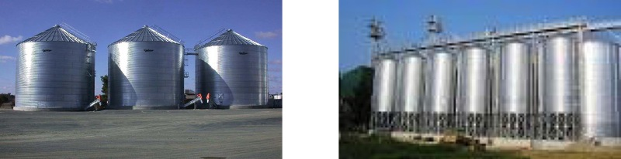
Imperative 5: Secure Support from Other Functions
www.wessexlearning.com
Individual Silos
Integrated Storage

Slide 38
Imperative 5: Secure Support from Other Functions
www.wessexlearning.com
• Support for design – designing an offer that meets customer needs
• Support for implementation – getting buy-in from within the company, or ‘internal marketing’
• Organizational levers – where the firm will place its resources to execute the market offer

Slide 39
Six Marketing Imperatives
www.wessexlearning.com
Session Roadmap A
• Imperative 1: Determine, recommend which markets to address
• Imperative 2: Identify, target market segments
• Imperative 3: Set strategic direction, positioning
• Imperative 4: Design the market offer
• Imperative 5: Secure support from other functions
• Imperative 6: Monitor, control

Slide 40
Imperative 6: Monitor, Control
www.wessexlearning.com
• Are we achieving market/financial performance objectives?
• Are functional areas implementing the market offer?
• Are our objectives, strategies, implementation plans in sync with the environment?

Slide 41
Imperative 6: Monitor, Control
www.wessexlearning.com
Steering Control
Postaction Control

Slide 42
Six Marketing Imperatives
www.wessexlearning.com
Session Roadmap A
• Imperative 1: Determine , recommend which markets to address
• Imperative 2: Identify, target market segments
• Imperative 3: Set strategic direction and positioning
• Imperative 4: Design the market offer
• Imperative 5: Secure support from other functions
• Imperative 6: Monitor, control

Slide 43
The Core Marketing Challenge
www.wessexlearning.com
Get the Fundamentals Right
• Marketing as a philosophy
• Six marketing imperatives
• Four marketing principles

Slide 44
Four Core Marketing Principles
www.wessexlearning.com
Four Core
Marketing Principles
Selectivity, Concentration
Customer Value
Differential Advantage
Integration

Slide 45
Four Marketing Principles
www.wessexlearning.com
Session Roadmap B
• Principle 1: Selectivity, Concentration
• Principle 2: Customer Value
• Principle 3: Differential Advantage
• Principle 4: Integration

Slide 46


Principle 1: Selectivity, Concentration
www.wessexlearning.com
• Selectivity
• Concentration
• Concentrate resources against those targets

Slide 47
Four Marketing Principles
www.wessexlearning.com
Session Roadmap B
• Principle 1: Selectivity, Concentration
• Principle 2: Customer Value
• Principle 3: Differential Advantage
• Principle 4: Integration

Slide 48
Principle 2: Customer Value
www.wessexlearning.com
The firm must focus on providing value to customers
• Customers do not want your products!
• Customer value should drive product and investment decisions.
• Market/financial performance relates directly to delivering customer value.

Slide 49
Four Marketing Principles
www.wessexlearning.com
Session Roadmap B
• Principle 1: Selectivity, Concentration
• Principle 2: Customer Value
• Principle 3: Differential Advantage
• Principle 4: Integration

Slide 50
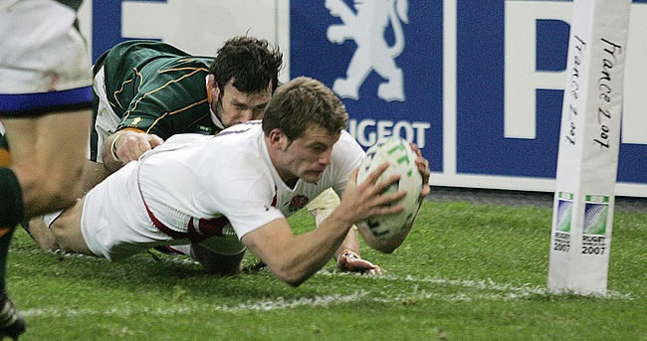
Principle 3: Differential Advantage
www.wessexlearning.com
Differential advantage is a net benefit or cluster of benefits, offered to a sizable group of customers, which they value and are willing to pay for, but cannot get, or believe they cannot get, elsewhere.

Slide 51
Principle 3: Differential Advantage
www.wessexlearning.com
Differential Advantage:
• Emphasizes competition: customer value is not enough.
• Some advantages are better than others.
• All differential advantages eventually erode – renewing differential advantage is crucial.
• The firm must be willing to cannibalize its differential advantage.
• A difference is not a differential advantage.

Slide 52
Four Marketing Principles
www.wessexlearning.com
Session Roadmap B
• Principle 1: Selectivity, Concentration
• Principle 2: Customer Value
• Principle 3: Differential Advantage
• Principle 4: Integration

Slide 53
Principle 4: Integration
www.wessexlearning.com
• The firm must carefully integrate all elements in design, execution of the market offer.
• Integration in two areas:
• At the firm – functional areas/business units
• At the customer – marketing mix
• Integration requires:
• Agreement on priorities: functions/management levels/business units
• Cooperative working relationships among those designing and implementing the market offer
• A shared value of serving customers – firm-wide external orientation

Slide 54
www.wessexlearning.com
Chapter 1
Introduction to
Managing Marketing

