Slide 1

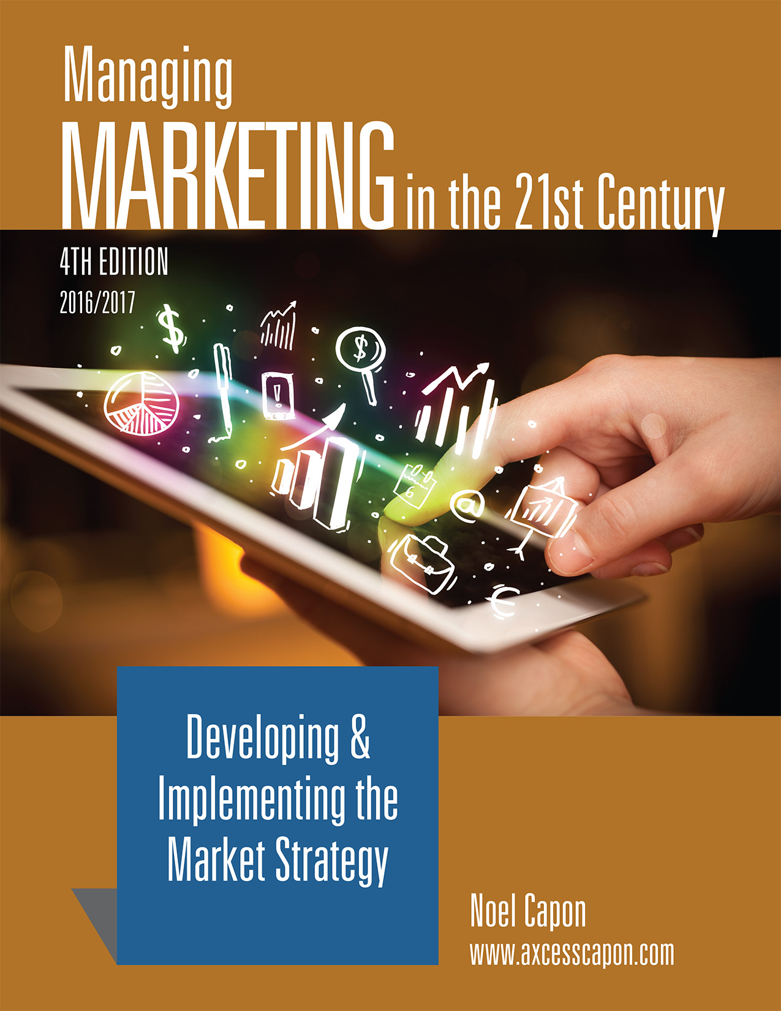



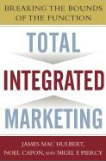
www.wessexlearning.com
Managing Markets Strategically
Professor Noel Capon
R.C. Kopf Professor of International Marketing
Columbia Business School
New York, NY

Slide 2
Managing Markets Strategically
www.wessexlearning.com
Section 1: Marketing and the Firm
Section 2: Fundamental Insights for Strategic Marketing
Section 3: Strategic Marketing
Section 4: Implementing the Market Strategy
Part A: Providing Customer Value
Chapter 12: Managing the Product Line
Chapter 13: Managing Services, Customer Service
Chapter 14: Developing New Products

Slide 3
www.wessexlearning.com
Chapter 13
Developing New Products

Slide 4
The Fundamental Business Model
www.wessexlearning.com
Shareholder Value
Organizational Survival, Growth
Current, Potential Profits
Competitors
Attract, Retain, Grow Customers
Competitors
Customer Value
Company

Slide 5
Six Marketing Imperatives
www.wessexlearning.com
• Imperative 1: Determine, recommend which markets to address
• Imperative 2: Identify, target market segments
• Imperative 3: Set strategic direction, positioning
• Imperative 4: Design the market offer
• Imperative 5: Secure support from other functions
• Imperative 6: Monitor, control execution/performance

Slide 6
Chapter Roadmap
www.wessexlearning.com
Where and How Innovation Occurs | New Product Development | Idea Generation | Preliminary Screening
What Fosters Product Innovation |  | Number of Ideas Scope of Search New Idea Sources New Idea Processes
Concept Development | Business-Case Analysis | Development | Product Testing
 |  | Product Design Quality Function Deployment Co-Creation New-Product-Development Portfolio
Market-Factor Testing | Test Marketing | Commercialization | Product Adoption

Slide 7
Developing New Products
www.wessexlearning.com
Session Roadmap A
• Innovation
• New product development

Slide 8
Developing New Products
www.wessexlearning.com
Session Roadmap A
• Innovation
• New product development

Slide 9
Innovation
www.wessexlearning.com
Innovation’s Importance: Peter Drucker
“The purpose of a business is to create a customer … Business has only two functions – marketing and innovation. All the rest are costs.”
“Marketing alone does not make a business enterprise. The second function of a business, therefore, is innovation … [Innovation] is the task of endowing human and material resources with new and greater wealth producing capacity.”

Slide 10
Innovation
www.wessexlearning.com
Perspectives on Innovation
“The best opportunities are visible, but not seen.” — Peter Drucker
“Genius is one percent inspiration and 99 percent perspiration.”
— Thomas Edison
“Creativity is just connecting things. When you ask creative people how they did something, they feel a little guilty because they didn’t really do it, they just saw something. It seemed obvious to them after a while. That’s because they were able to connect experiences they’ve had and synthesize new things.” — Steve Jobs

Slide 11
Innovation
www.wessexlearning.com
Main Driving Factors
• Market selection
• Organization
• R&D

Slide 12
Innovation
www.wessexlearning.com
Innovation Types
• Sustaining innovations: improve established products along existing performance dimensions historically valued by major customers
• Disruptive innovations: bring new and very different value propositions

Slide 13
Developing New Products
www.wessexlearning.com
Session Roadmap A
• Innovation
• New product development

Slide 14
New Product Development
www.wessexlearning.com
Approaches
• Basic technology research
• Applied technology research
• Market-focused development
• Marketing tinkering
Key Issues
• Problem focus
• Market knowledge
• Firm competence
• Complementer products
• Effectiveness measures

Slide 15
Developing New Products
www.wessexlearning.com
Session Roadmap B
• Stage-gate process
• Product adoption

Slide 16
Stage-Gate Process
www.wessexlearning.com
• Key issues
• Idea generation
• Preliminary screening
• Concept development
• Business case analysis
• Development
• Product testing
• Market-factor testing
• Test marketing
• Commercialization

Slide 17
Key Issues
www.wessexlearning.com
• Error types
• Type I
• Type II
• Cost of failure
• Financial commitment
• Kill points

Slide 18
Key Issues
www.wessexlearning.com
Cost of Failure/Financial Commitment – Type I

Slide 19
Stage-Gate Process
www.wessexlearning.com
• Idea generation Kill Point
• Preliminary screening Kill Point
• Concept development Kill Point
• Business case analysis Kill Point
• Development Kill Point
• Product testing Kill Point
• Market-factor testing Kill Point
• Test marketing Kill Point
• Commercialization Kill Point

Slide 20
Idea Generation
www.wessexlearning.com
• Success rates
• Idea sources
• Approaches

Slide 21
Idea Generation
www.wessexlearning.com
Success Rates

Slide 22

Idea Generation
www.wessexlearning.com
Idea Sources
• Internal generation (R&D, suggestion schemes, etc.)
• Customers
• Competitors
• Independent inventors
• Regulations
• Serendipity
• Idea libraries

Slide 23
Idea Generation
www.wessexlearning.com
Independent Inventors
Velcro
Kitty Litter
Dental
implants
Zebco
Nike
PowerBar
Super Soaker
water gun
Apple
Nature Boy &
Girl Diapers
Gatorade
Google
Facebook

Slide 24

Idea Generation
www.wessexlearning.com
Approaches
• Structured thinking
• attribute listing
• morphological analysis
• Unstructured thinking
• brainstorming
• various other processes

Slide 25
Preliminary Screening
www.wessexlearning.com
Criteria
• Fits with the business unit strategy
• Complements existing products
• Seems to meet customer needs
• Uses firm core competencies
• Likely to meet or exceed growth targets
• Likely to meet or exceed profitability targets

Slide 26
Preliminary Screening
www.wessexlearning.com
Assessment
Consistent with environmental goals
Fit with business unit strategy
Likely to meet profitability targets
Complements existing products
Likely to meet revenue growth targets
Meets needs
of existing customers
Uses firm’s core competencies
Meets needs of potential customers

Slide 27
Concept Development
www.wessexlearning.com
• Detail deliverable customer benefits
• Show superiority over current and expected competition –
differential advantage
Note: beware concept creep in development

Slide 28
Business Case Analysis
www.wessexlearning.com
Items
• Purpose: To assess the financial viability of the entire project including the various risk factors.
• Requires: Forecasting revenues, costs, investments.
• Revenue forecasts are typically the most difficult yet the most critical.
Considerations
• Sales revenues
• Cost of goods sold (COGS)
• Investment costs
• Discounting

Slide 29

Development
www.wessexlearning.com
• Customer sensitive
• Quality function deployment (QFD)
• Customer co-creation
• Development approaches
• Continuous development
• Parallel development
• Successive development
• New product development portfolio

Slide 30
Development
www.wessexlearning.com
Quality Function Deployment (QFD)
• Maps customer needs into design, development, engineering, manufacturing, and service functions
• Helps identify spoken and unspoken needs
Customer needs → firm actions and designs

Slide 31
Development
www.wessexlearning.com
Portfolio Design Goals
• Maximize portfolio value
• Seek portfolio balance
• Ensure the portfolio is strategically aligned
• Select the right number of projects

Slide 32
Product Testing
www.wessexlearning.com
  • Alpha tests – in-company; test with employees
  • Beta tests – with customers for soon-to-be-introduced products

Slide 33
Market-Factor Testing
www.wessexlearning.com
Product Testing is Insufficient; the firm should test the entire market offer
Marketing Mix Elements
• Simulated environment
• Virtual testing

Slide 34
Test Marketing
www.wessexlearning.com
Tests designed to mimic actual market conditions by offering the product to a small but representative subset of the entire market, and measuring the results, typically against a control.

Slide 35
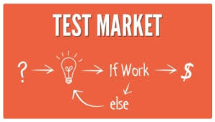
Test Marketing
www.wessexlearning.com
In Favor
• Fine-tunes launch
• Saves launch costs
• May yield unexpected insight
Against
• Alerts competitors
• Competitors take actions
• Draws excessive attention
• Costs money and time

Slide 36

Commercialization
www.wessexlearning.com
• Confirm segmentation and targeting
• Confirm market and market segment strategies
• Fine-tune and implement market offer
• Fine-tune and implement functional support

Slide 37
Stage-Gate Process
www.wessexlearning.com
• Idea generation Kill Point
• Preliminary screening Kill Point
• Concept development Kill Point
• Business case analysis Kill Point
• Development Kill Point
• Product testing Kill Point
• Market-factor testing Kill Point
• Test marketing Kill Point
• Commercialization Kill Point

Slide 38
Developing New Products
www.wessexlearning.com
Session Roadmap B
• Stage-gate process
• Product adoption

Slide 39
Product Adoption
www.wessexlearning.com
• Adopter groups
• Crossing the chasm
• ACCORD

Slide 40
Product Adoption
www.wessexlearning.com
A Useful Classification for New Product Adoption
Innovators | First to Adopt
Early Adopters | Visionaries
Early Majority | Motivated by current problems
Late Majority | Conservatives and skeptics
Laggards | The Traditionalists

Slide 41
Product Adoption
www.wessexlearning.com
Adopter Groups

Slide 42
Product Adoption
www.wessexlearning.com
Crossing the Chasm

Slide 43
Product Adoption
www.wessexlearning.com
Classroom Discussion
• What products can you identify that never “crossed the chasm”?
• What products took a long time to “cross the chasm”?

Slide 44
Product Adoption
www.wessexlearning.com
ACCORD – Factors Affecting Adoption Speed (direction of effect)
• Advantage (+)
• Compatibility (+)
• Complexity (–)
• Observability/Communicability (+)
• Risk (–)
• Divisibility/Reversibility (+)

Slide 45
Product Adoption
www.wessexlearning.com
ACCORD: Illustration – EZ Pass
• Advantage (+)
• Compatibility (+)
• Complexity (–)
• Observability/Communicability (+)
• Risk (–)
• Divisibility/Reversibility (+)

Slide 46
Developing New Products
www.wessexlearning.com
Session Roadmap B
• Stage-gate process
• Product adoption

Slide 47
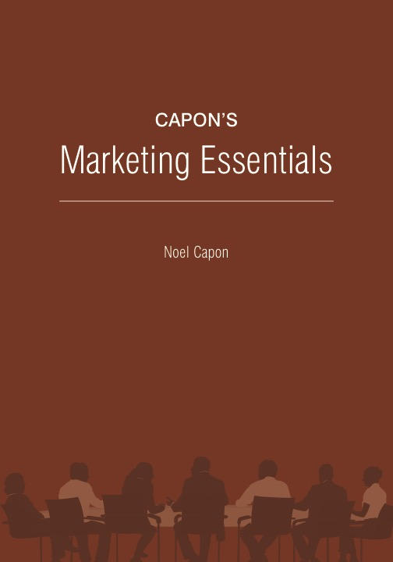
www.wessexlearning.com
Chapter 13
Developing New Products

