Slide 1

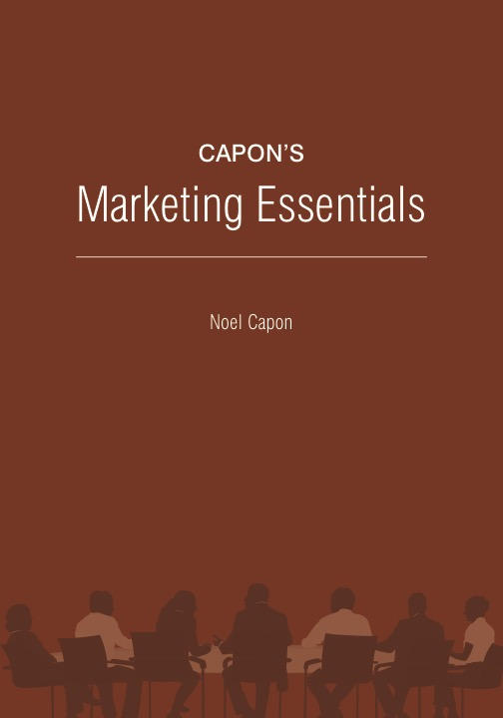
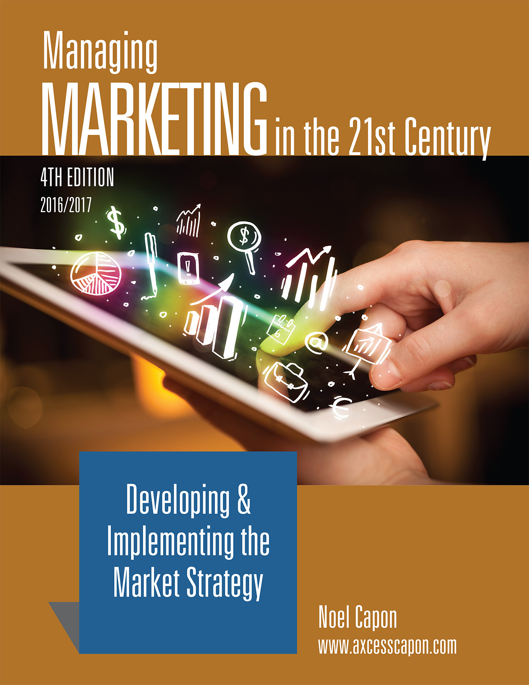


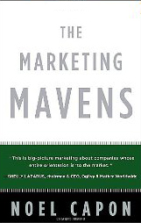
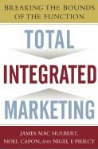
www.wessexlearning.com
Managing Markets Strategically
Professor Noel Capon
R.C. Kopf Professor of International Marketing
Columbia Business School
New York, NY

Slide 2
Managing Markets Strategically
www.wessexlearning.com
Section 1: Marketing and the Firm
Section 2: Fundamental Insights for Strategic Marketing
Section 3: Strategic Marketing
Section 4: Implementing the Market Strategy
Part C: Delivering Customer Value
Chapter 17: Distribution, Retailing, Wholesaling

Slide 3
www.wessexlearning.com
Chapter 17
Distribution, Retailing, Wholesaling

Slide 4
The Fundamental Business Model
www.wessexlearning.com
Shareholder Value
Organizational Survival, Growth
Current, Potential Profits
Competitors
Attract, Retain, Grow Customers
Competitors
Customer Value
Company

Slide 5
Six Marketing Imperatives
www.wessexlearning.com
• Imperative 1: Determine, recommend which markets to address
• Imperative 2: Identify, target market segments
• Imperative 3: Set strategic direction, positioning
• Imperative 4: Design the market offer
• Imperative 5: Secure support from other functions
• Imperative 6: Monitor, control execution/performance

Slide 6
Chapter Roadmap
www.wessexlearning.com
Distribution Systems and Their Evolution | Developing Distribution Strategy | Managing Distribution Channels
 | Distribution Functions Distribution Channels: Direct, Indirect Distribution Channel Breadth Criteria for Selecting, Evaluating Intermediaries Putting It All Together: The Distribution Strategy | Intermediary Compliance Power in Distribution Systems Conflict in Distribution Systems Planning for Power Changes The Partnership Model
Retailing | Wholesaling
Value Retailers Offer Alternative Retail Forms Retail Store Location Contemporary Retailing Trends Retail Profitability | Value to Suppliers Value to Retailers/End Users

Slide 7
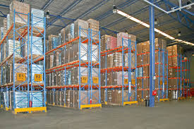

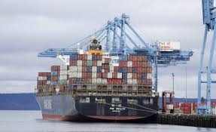
Distribution Entities
www.wessexlearning.com
• Agents, brokers, manufacturers’ representatives
• Banks and finance firms
• Distributors
• Wholesalers
• Warehouse operators
• Retailers
• Shipping lines
• Package delivery firms

Slide 8
Terminology in Distribution Systems
www.wessexlearning.com
Supplier Firm
Upstream
Distributor
Downstream
End-user customer

Slide 9


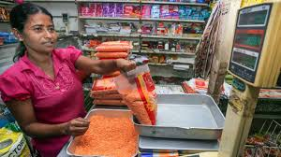
Distribution Strategy
www.wessexlearning.com
Firm Products Reach Consumers through Distribution
VS.

Slide 10
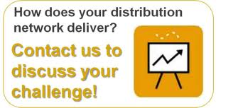
Distribution Systems
www.wessexlearning.com
Firm Products Reach Consumers through Distribution
• Distribution can be direct from supplier to customer
• Indirect distribution can be highly complex involving many intermediaries
• Supplier and distributor goals rarely overlap
• Distribution systems are full of conflict and power inequalities
• Distributors earn general reputation among suppliers and customers
• No distribution system lasts forever; new approaches change things

Slide 11
Distribution Systems & Evolution
www.wessexlearning.com
Distribution Systems and Their Evolution
Distribution systems are the network of channels that facilitate suppler goods and services reaching consumers/end users
Distribution channels and functions they perform are in constant flux
Changes in customer needs, competitor actions, and environmental forces exert pressure
Leading indicators of impending change include unhappy customers, poor logistics, and outdated system interfaces

Slide 12
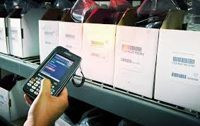
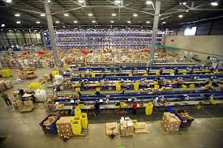
Distribution Systems & Evolution
www.wessexlearning.com
Distribution Systems and Their Evolution

Slide 13
Distribution Decisions
www.wessexlearning.com
Session Roadmap A
• Distribution strategy
• Managing distribution channels

Slide 14
Distribution Decisions
www.wessexlearning.com
Session Roadmap A
• Distribution strategy
• Managing distribution channels

Slide 15
Distribution Strategy
www.wessexlearning.com
• Distribution channel functions
• Distribution channels: direct or indirect
• Distribution channel breadth
• Criteria for selecting intermediaries
• Putting it all together

Slide 16
Distribution Strategy
www.wessexlearning.com
Distribution Channel Functions
Information sharing
Selling and promotion
Quality assurance
Inventory
Order collection
Marketing research
Physical movement
Physical-state changes
Assortment
Information
Distribution Functions
Physical Product
Bulk-breaking
Ownership
Service
Risk-shifting
Impartiality
Title transfer
Financing

Slide 17
Distribution Strategy
www.wessexlearning.com
Distribution Channels: Direct or Indirect

Slide 18
Distribution Strategy
www.wessexlearning.com
Distribution Channels: Direct or Indirect
• Factors favoring direct distribution
• Complex end-user customer purchasing decisions – multiple functions and high-level executives
• Custom-tailored products
• Delivery speed not critical
• Large quantity sales
• Small potential customer base
• Factors favoring indirect distribution

Slide 19
Distribution Strategy
www.wessexlearning.com
Distribution Channels: Direct or Indirect
• Factors favoring direct distribution
• Factors favoring indirect distribution
• Simple end-user customer purchasing decisions – low-level purchasing agents
• Stockable items, manufactured in large quantities, sold in small quantities
• Rapid delivery and service important
• Large potential customer base

Slide 20
Distribution Strategy
www.wessexlearning.com
Role of the Internet
• Consumer pick-up
• Direct delivery (digital products)
• Link with sales
• Package delivery
• Virtual displays

Slide 21

Class Discussion
www.wessexlearning.com
Which distribution entities do a good job of providing recorded music to consumers? Why did you select them? How has your selection changed over the past 10 years?

Slide 22
Distribution Strategy
www.wessexlearning.com
Distribution Channel Breadth
• Intensive
• Exclusive
• Exclusivity for supplier
• Showrooming

Slide 23
Distribution Strategy
www.wessexlearning.com
Criteria for Selecting, Evaluating Intermediaries
• Degree of market coverage
• Managerial competence
• Degree of aggressiveness, enthusiasm, taking initiative
• Appropriate size
• Credit and financial condition
• General reputation among suppliers and customers
• Selling capability – historical sales performance
• Forgo competitive products/welcome the supplier’s products

Slide 24
Distribution Strategy
www.wessexlearning.com
Putting It All Together

Slide 25
Distribution Decisions
www.wessexlearning.com
Session Roadmap A
• Distribution strategy
• Managing distribution channels

Slide 26
Managing Distribution Channels
www.wessexlearning.com
• Performance evaluation
• Intermediary compliance
• Power in distribution systems
• Conflict in distribution systems
• Planning for power changes
• The partnership model

Slide 27
Managing Distribution Channels
www.wessexlearning.com
Performance Evaluation
• Sales performance
• Selling capabilities
• Inventory maintenance
• Information provision

Slide 28
Managing Distribution Channels
www.wessexlearning.com
Intermediate Compliance: Problems with resellers
Do an inadequate job of solving consumer and end-user problems
Apply insufficient effort to consumers/end-user customers the supplier has targeted
Do not allow the firm to contact their sales forces
Require fixed payments to carry the supplier’s products
Get very close to end-user customers and will not provide the supplier with customer data
Do not use supplier promotional materials
Are overloaded with products from competing and non-competing suppliers
Are inadequately financed
Do not stress the supplier brand – in the extreme, push private-label or competitor brands
Do not pass on promotional programs and rebates to consumers and end users
Can’t or won’t meet supplier goals
Cherry-pick the supplier product line
Primarily sell on price, not on value
Makes ineffective use of supplier sales managers
Carry insufficient inventory

Slide 29
Managing Distribution Channels
www.wessexlearning.com
Power in Distribution Systems
Raw Material Providers
Manufacturers/ Brand Owners
Distributors/ Wholesalers
Retailers
Consumers/
End Users
Upstream
Downstream

Slide 30
Managing Distribution Channels
www.wessexlearning.com
Power in Distribution Systems: Conditions for Upstream Power
Demand greater than supply
Supplier poses credible threat of forward integration – to cut out distributors
Proprietary technology
Few substitute suppliers available
Few substitute products available
Supplier has extensive end-user contact
Supplier products important to distributor success
Supplier enjoys monopoly-like position
Individual distributors unimportant to supplier success
Distributor has high switching costs

Slide 31
Managing Distribution Channels
www.wessexlearning.com
Power in Distribution Systems: Conditions for Downstream Power
Supply greater than demand
Distributor poses credible threat of backward integration – to make supplier unnecessary
Products/services undifferentiated
Few substitute distributors available
Distributor has few switching costs
Supplier has little end-user data
Distributor enjoys monopsony-like position
Supplier products unimportant to distributor success
Distributor purchases are large percent of supplier output
Many firms can supply

Slide 32
Managing Distribution Channels
www.wessexlearning.com
Strategic Conflict in Distribution Systems
Manufacturer/
brand owner
Upstream
Distributor/
wholesaler
Downstream
Consumer/end user

Slide 33
Managing Distribution Channels
www.wessexlearning.com
Strategic Conflict in Distribution Systems: Initiated Upstream
• Supplier goes direct to end-user customers
• Supplier competes with distributor in a new market
• Supplier adds new distributors/distributor types

Slide 34
Managing Distribution Channels
www.wessexlearning.com
Strategic Conflict in Distribution Systems: Initiated Downstream
• End-users grow and desire direct-to-supplier relationships
• Distributors become large and change the power balance
• Distributors supply private-label products
• New buying influences enter the distribution channel

Slide 35
Planning for Power Changes
www.wessexlearning.com
Suppliers
• Become central to distributor success
• Broaden the scope of supplier options
• Improve bargaining power
• Raise distributor switching costs
Distributors
• Focus effort at end-user customers
• Focus effort at suppliers
• Broaden the scope of distributor options
• Improve bargaining power

Slide 36
The Partnership Model
www.wessexlearning.com
The Partnership Model
  Increasingly popular as an alternative to the power/strategic conflict approach
  Power/strategic conflict approach assumes a positive-sum game outcome
  Partnerships, channel members can establish joint strategic goals

Slide 37
Distribution Decisions
www.wessexlearning.com
Session Roadmap A
• Distribution strategy
• Managing distribution channel

Slide 38
Retailing and Wholesaling
www.wessexlearning.com
Session Roadmap B
• Value Retailers Offer
• Alternative Retail Forms
• Retail Store Location
• Contemporary Retailing Trends
• Retail Profitability
• Wholesaling

Slide 39
Retailing and Wholesaling
www.wessexlearning.com
Session Roadmap B
• Value Retailers Offer
• Alternative Retail Forms
• Retail Store Location
• Contemporary Retailing Trends
• Retail Profitability
• Wholesaling

Slide 40
Value Retailers Offer
www.wessexlearning.com
Value focused on delivery and service:
  Product assortment
    Broad versus narrow – many versus few product forms
    Deep versus shallow – many versus few product items per product form
  Customer experience
  Accessibility

Slide 41
Value Retailers Offer
www.wessexlearning.com

Slide 42
Value Retailers Offer
www.wessexlearning.com
Value focused on delivery and service:
  Product assortment
  Customer experience – many experience types; wide variation; physical versus virtual
  Accessibility
    Time convenience
    Place convenience

Slide 43
Retailing and Wholesaling
www.wessexlearning.com
Session Roadmap B
• Value Retailers Offer
• Alternative Retail Forms
• Retail Store Location
• Contemporary Retailing Trends
• Retail Profitability
• Wholesaling

Slide 44
Alternative Retail Forms
www.wessexlearning.com
Different Forms of Retailing
• Traveling retail stores
  ancient roots
  limited selection, but
  store visits consumer
Direct marketing
Internet retailing
Vending machines
Fixed location retail stores

Slide 45
Alternative Retail Forms
www.wessexlearning.com
Different Forms of Retailing
• Traveling retail stores
• Direct marketing – store visits customer, but
  Product examination limited or nonexistent – some retailers offer no-cost returns
  Time delay in receiving goods – competitive dimensions
  Alternative systems
  mass media – many mass communication forms
  direct mail – response rate low
  telemarketing/telesales – consumers may opt out
Internet retailing
Vending machines
Fixed location retail stores

Slide 46
Alternative Retail Forms
www.wessexlearning.com
Different Forms of Retailing
• Traveling retail stores
Direct marketing
Internet retailing – no special travel; home/office delivery
Vending machines
Fixed location retail stores

Slide 47
Alternative Retail Forms
www.wessexlearning.com
Internet retailing – no special travel; home/office delivery
  Assortments
    Very high – long-tail effect
  Product display
      Virtual – customer cannot touch and feel
      Easy to change
      Consumer search behavior very different from physical store
  Comparison shopping
      Search programs facilitated

Slide 48
Alternative Retail Forms
www.wessexlearning.com
Different Forms of Retailing
• Traveling retail stores
Direct marketing
Internet retailing
Vending machines – physical availability 24/7/265
Fixed location retail stores

Slide 49
Alternative Retail Forms
www.wessexlearning.com
Different Forms of Retailing
• Traveling retail stores
Direct marketing
Internet retailing
Vending machines
Fixed location retail stores

Slide 50
Alternative Retail Forms
www.wessexlearning.com
Variations among fixed location retail stores
  Physical product or services – purchase and receive right away
  Establishment size – varies widely
  Product/service evolution – retailers continually add/drop products
  Assortment – broad/narrow; wide/deep
  Product display – from expensive display to shipping cartons
  Service type and level – self service to extensive personal attention
  Ownership – from individuals to multinational corporations
  Number of stores – single/local store to many/multinational
  Connection between strategy and operations – tightly integrated to separated – franchising

Slide 51
Retailing and Wholesaling
www.wessexlearning.com
Session Roadmap B
• Value Retailers Offer
• Alternative Retail Forms
• Retail Store Location
• Contemporary Retailing Trends
• Retail Profitability
• Wholesaling

Slide 52
Retail Location
www.wessexlearning.com
Securing Traffic to Retail Stores
  Internet retailing – key challenge – increase website traffic
  Fixed location retail stores
    Location, location, location
    Main Options:
      Main street – concentration of complementary stores
      Outdoor malls – derivative of main street shopping; protection from traffic
      Indoor malls – provide managed environment; protection from traffic

Slide 53
Retailing and Wholesaling
www.wessexlearning.com
Session Roadmap B
• Value Retailers Offer
• Alternative Retail Forms
• Retail Store Location
• Contemporary Retailing Trends
• Retail Profitability
• Wholesaling

Slide 54
What factors are driving the growth of Internet shopping.
Do you see any limits to its growth? Will Internet shopping eventually put all other retail forms out of business? Why or why not?
Class Discussion
www.wessexlearning.com

Slide 55
Contemporary Retailing Trends
www.wessexlearning.com
Growth of Internet Shopping – many drivers
Tracking Shopping Behavior – explosion of data on consumer shopping patterns
Integrated Physical/Digital Operations
Globalization of Retailing – retailers going abroad with mixed results
Peer-To-Peer (P2P) Transactions – dramatic growth: Uber, Airbnb, and others – very high share valuations
Evolution in Purchasing, Payment Systems – credit/debit cards – Apple Pay and others

Slide 56
Retailing and Wholesaling
www.wessexlearning.com
Session Roadmap B
• Value Retailers Offer
• Alternative Retail Forms
• Retail Store Location
• Contemporary Retailing Trends
• Retail Profitability
• Wholesaling

Slide 57
Retail Profitability
www.wessexlearning.com
Margins
Setting Retail Price
Profitability

Slide 58
Margins
www.wessexlearning.com
Percent markup on cost = (20/80) x 100 = (1/4) x 100 = 25%
Percent retail margin = (20/100) x 100 = (1/5) x 100 = 20%

Slide 59
Margins
www.wessexlearning.com
Alternative Retail Metrics
Intermediate Measures | Output Measures
Number of shoppers | Sales per square foot
Length of visit | Sales per linear foot (supermarkets)
Average purchases per customer visit | Same-store sales growth
Number of customers per day | Sales per average inventory (inventory turns)

Slide 60
Retail Profitability
www.wessexlearning.com
Margins
Setting Retail Price
Profitability

Slide 61
Setting Retail Price
www.wessexlearning.com
Let:
C = Product Cost to the retailer ($)
P = Retail Selling Price ($)
M = Retail Margin, expressed as percent of Retail Selling Price (stated as a decimal)
Then:
P = C + (P x M)
P – (P x M) = C
P (1 – M) = C
P = C/(1 – M)
In the illustration:
C = $50; M = 40% or 0.4,
P = $50/(1 – 0.4) = $50/0.6 = $83.33

Slide 62
Retail Profitability
www.wessexlearning.com
Margins
Setting Retail Price
Profitability

Slide 63
Profitability
www.wessexlearning.com
Return on Investment (ROI) = Profit/Investment
ROI = profit/sales x sales/investment
ROI = profit margin x investment turnover

Slide 64
Retailing and Wholesaling
www.wessexlearning.com
Session Roadmap B
• Value Retailers Offer
• Alternative Retail Forms
• Retail Store Location
• Contemporary Retailing Trends
• Retail Profitability
• Wholesaling

Slide 65
Wholesaling
www.wessexlearning.com

Slide 66
Wholesaling
www.wessexlearning.com
Value to Suppliers
  Market access – wholesaler has ability to reach customers
  Information on customer requirements – marketing research function
Value to Retailers/End Users
  One-stop shopping – reduces number of connections; saves costs
  More effective procurement – cutting edge wholesales increasingly efficient
  Enhanced assortments – great options for retailers
  Consulting – provide services to retail customers

Slide 67
Retailing and Wholesaling
www.wessexlearning.com
Session Roadmap B
• Value Retailers Offer
• Alternative Retail Forms
• Retail Store Location
• Contemporary Retailing Trends
• Retail Profitability
• Wholesaling

Slide 68
Chapter 17
Distribution, Retailing, Wholesaling

