Slide 1

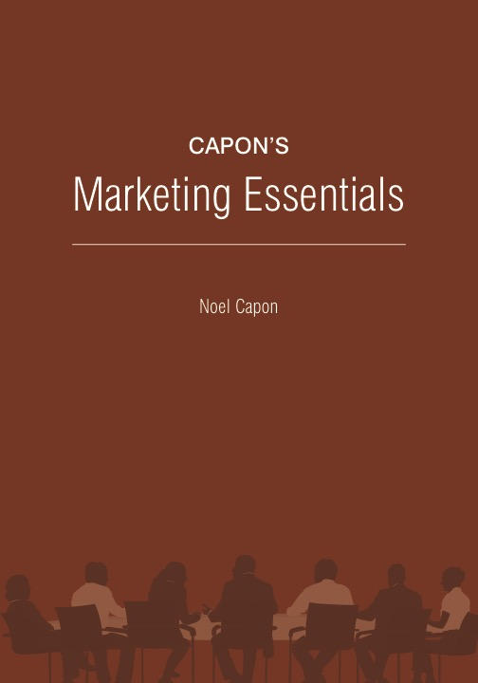
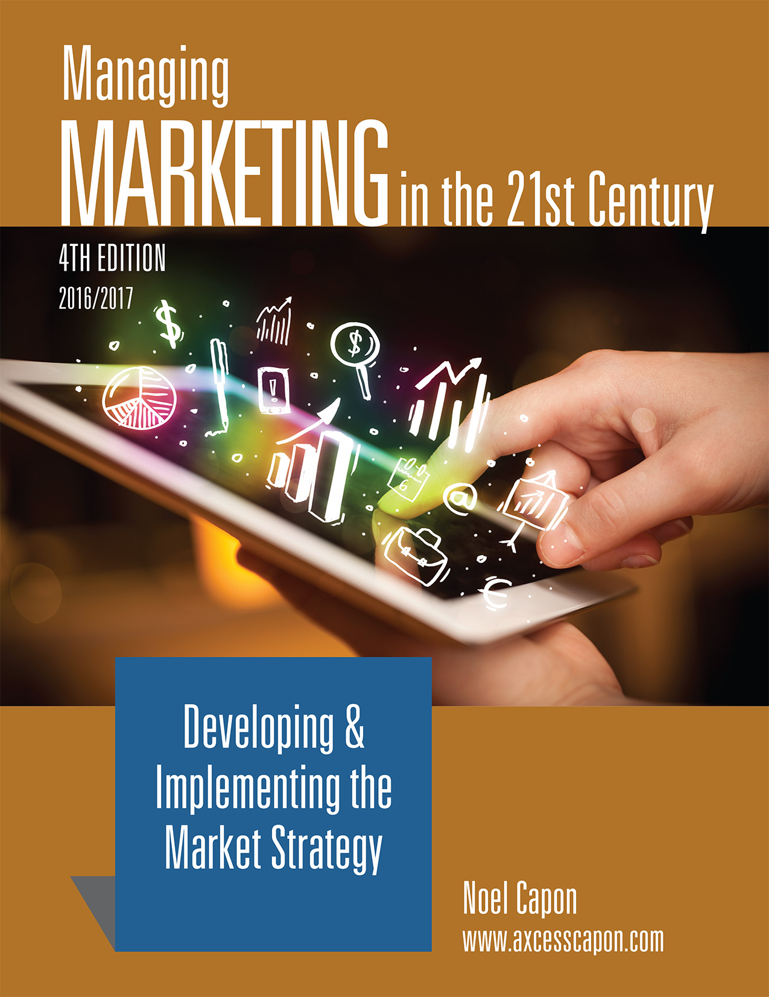



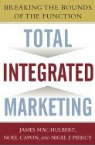
www.wessexlearning.com
Managing Markets Strategically
Professor Noel Capon
R.C. Kopf Professor of International Marketing
Columbia Business School
New York, NY

Slide 2
Managing Markets Strategically
www.wessexlearning.com
Section 1: Marketing and the Firm
Section 2: Fundamental Insights for Strategic Marketing
Section 3: Strategic Marketing
Section 4: Implementing the Market Strategy
Chapter 19: Ensuring the Firm Implements the
Market Offer as Planned
Chapter 20: Monitoring, Controlling Firm Performance, Functioning

Slide 3
www.wessexlearning.com
Chapter 23
Ensuring the Firm Implements the
Market Offer as Planned

Slide 4
The Fundamental Business Model
www.wessexlearning.com
Shareholder Value
Organizational Survival, Growth
Current, Potential Profits
Competitors
Attract, Retain, Grow Customers
Competitors
Customer Value
Company

Slide 5
Six Marketing Imperatives
www.wessexlearning.com
• Imperative 1: Determine, recommend which markets to address
• Imperative 2: Identify, target market segments
• Imperative 3: Set strategic direction, positioning
• Imperative 4: Design the market offer
• Imperative 5: Secure support from other functions
• Imperative 6: Monitor, control execution/performance

Slide 6
Chapter Roadmap
www.wessexlearning.com
Functional Excellence in Successful Externally Oriented Firms | Transforming to an External Orientation | Values, Vision, Mission, Strategy | Organizing the Firm’s Marketing Efforts
Customer Service Finance Human Resources Operations/Supply Chain Research, Development Sales Integrated Systems |  |  | Traditional Organizational Models Newer Nontraditional Organizational Models
Systems/Processes | Managing Human Resources | Sustaining an External Orientation
Hard Systems Soft Systems Optimizing Firm Systems/Processes

Slide 7
Ensuring the Firm Implements the Market Offer as Planned
www.wessexlearning.com
Session Roadmap A
• Functional excellence in externally oriented firms
• A framework for developing an external orientation
• Sustaining an external orientation

Slide 8
Ensuring the Firm Implements the Market Offer as Planned
www.wessexlearning.com
Session Roadmap A
• Functional excellence in externally oriented firms
• A framework for developing an external orientation
• Sustaining an external orientation

Slide 9
Functional Excellence in Externally Oriented Firms
www.wessexlearning.com
• Customer service – may deliver customer value and help secure differential advantage
• Finance – opportunities to craft favorable deals with customers
• Human resources – differential advantage from excellence in recruiting, selecting, and onboarding talent
• Operations and the supply chain – excellence provides basis for price flexibility; especially important in services where customers interface with firm operations
• Research & development – provide steady stream of new products
• Sales – salespeople continually interface with customers; maybe the key to firm success
• Integrated systems – ability to integrate efforts from many different functions can drive success

Slide 10
Ensuring the Firm Implements the Market Offer as Planned
www.wessexlearning.com
Session Roadmap A
• Functional excellence in externally oriented firms
• A framework for developing an external orientation
• Sustaining an external orientation

Slide 11
Transforming the Organization to Be More Externally Oriented
www.wessexlearning.com
Session Roadmap AA
• Values
• Vision, Mission
• Strategy
• Organizing the Firm’s Marketing Efforts
• Systems and Processes
• Managing Human Resources

Slide 12
A Framework for Developing an External Orientation
www.wessexlearning.com
Customers
(needs, wants, priorities)
Human Resource Management
(recruit & select, train & develop, work processes &
career paths, recognition & reward)
Systems and Processes
Values
Values
Organization Structure
(job design, reporting relationships)
Internal
Architecture
Strategy
External Focus
Vision, Mission

Slide 13


Values
www.wessexlearning.com
• Values are a common set of beliefs that guide the behavior of organizational members

Slide 14
Values
www.wessexlearning.com
• Definition: A common set of beliefs that guide the behavior of organizational members
• Hard values
• Soft values
• Culture
“Culture Eats Strategy for Breakfast.” Peter Drucker

Slide 15
Transforming the Organization to Be More Externally Oriented
www.wessexlearning.com
Session Roadmap AA
• Values
• Vision, Mission
• Strategy
• Organizing the Firm’s Marketing Efforts
• Systems and Processes
• Managing Human Resources

Slide 16
A Framework for Developing an External Orientation
www.wessexlearning.com
Customers
(needs, wants, priorities)
Human Resource Management
(recruit & select, train & develop, work processes &
career paths, recognition & reward)
Systems, Processes
Values
Values
Organization Structure
(job design, reporting relationships)
Internal
Architecture
Strategy
External Focus
Vision, Mission

Slide 17
Vision
www.wessexlearning.com
Definition
• A description of the ideal future state concerning a firm/business
Purpose
• Set broad direction and inspire
Illustrations
• Ford Motor Company – circa 1920s – “A car in every garage”
• Microsoft – 1980s/1990s – “A person computer on every desk”
• Microsoft – 2000s – “To enable people and businesses throughout the world to realize their full potential”

Slide 18
Mission
www.wessexlearning.com
Purpose
• Guides the firm’s search for market opportunities
• Codify where the firm does well, or aspires to do well

Slide 19
Mission
www.wessexlearning.com
Internal Resources
• Core ingredient or natural resource
We are a forest products company.
• Product or service
We are an automobile firm.
• Technology
We are an electronics firm.
External Focus
• Customer needs
We satisfy people’s transportation needs.
• Market or market segment
Our markets are families with young children.

Slide 20
Mission
www.wessexlearning.com
Mission: Illustration – Courtyard by Marriott (CM)
• To provide economy- and quality-minded frequent business travelers with a premier lodging facility, which is consistently perceived as clean, comfortable, well-maintained, and attractive, staffed by friendly, attentive, and efficient people.
• Combines product/service and market/market segment.

Slide 21

Mission: Class Discussion
www.wessexlearning.com
Classroom Discussion
• What do you think the mission statement should be for the following companies?.

Slide 22
Transforming the Organization to Be More Externally Oriented
www.wessexlearning.com
Session Roadmap AA
• Values
• Vision, Mission
• Strategy
• Organizing the Firm’s Marketing Efforts
• Systems and Processes
• Managing Human Resources

Slide 23
A Framework for Developing an External Orientation
www.wessexlearning.com
Customers
(needs, wants, priorities)
Human Resource Management
(recruit & select, train & develop, work processes &
career paths, recognition & reward)
Systems, Processes
Values
Values
Organization Structure
(job design, reporting relationships)
Internal
Architecture
Strategy
External Focus
Vision, Mission

Slide 24
Purpose of a Market Strategy
www.wessexlearning.com
Secure Differential Advantage
Guide Effective Allocation of Scarce Resources
Market Strategy
Provide Strategic Direction
Achieve Cross-Functional Integration

Slide 25
Transforming the Organization to Be More Externally Oriented
www.wessexlearning.com
Session Roadmap AA
• Values
• Vision, Mission
• Strategy
• Organizing the Firm’s Marketing Efforts
• Systems and Processes
• Managing Human Resources

Slide 26
A Framework for Developing an External Orientation
www.wessexlearning.com
Customers
(needs, wants, priorities)
Human Resource Management
(recruit & select, train & develop, work processes &
career paths, recognition & reward)
Systems, Processes
Values
Values
Organization Structure
(job design, reporting relationships)
Internal
Architecture
Strategy
External Focus
Vision, Mission

Slide 27
Organization Structure
www.wessexlearning.com
• Traditional approaches
• functional – focuses on separate activities
• product/brand management – manages products and brands separately
• market segment – manages individual market segments separately
• combined product/brand management and market segment – separate responsibilities for products/brands and market segments
• Newer approaches
• inclusion – puts many customer-oriented functions under marketing
• business process – organization built around processes
• customer management – organization focused on customer groups

Slide 28
Organization Structure
www.wessexlearning.com
Functional

Slide 29
Organization Structure
www.wessexlearning.com
Product/Brand Management

Slide 30
Organization Structure
www.wessexlearning.com
Market Segment

Slide 31
Organization Structure
www.wessexlearning.com
Combined Product/Market Segment

Slide 32
Organization Structure
www.wessexlearning.com
Inclusion

Slide 33
Organization Structure
www.wessexlearning.com
Business Process

Slide 34
Organization Structure
www.wessexlearning.com
Customer Management
Top
Management
B1
Top
Management
Advertising
B2
Marketing research
Brand Management System
B3
Manufacturing
R&D
B4
B1
B2
B3
B4
Customer Management System
Advertising
Marketing research
Manufacturing
R&D
Customer Portfolios
CP1
CP2
CP3
CP4

Slide 35
Transforming the Organization to Be More Externally Oriented
www.wessexlearning.com
Session Roadmap AA
• Values
• Vision, Mission
• Strategy
• Organizing the Firm’s Marketing Efforts
• Systems and Processes
• Managing Human Resources

Slide 36
A Framework for Developing an External Orientation
www.wessexlearning.com
Customers
(needs, wants, priorities)
Human Resource Management
(recruit & select, train & develop, work processes &
career paths, recognition & reward)
Systems, Processes
Values
Values
Organization Structure
(job design, reporting relationships)
Internal
Architecture
Strategy
External Focus
Vision, Mission

Slide 37
Systems and Processes
www.wessexlearning.com
• Hard systems – improve operational efficiency
• purchasing and billing
• customer relationship management
• customer involvement
• Soft systems – improve collaboration and cross-functional relationships
• securing insight
• market planning
• monitor, control
• Improving systems – improve organizational functioning
• best practice transfer
• benchmarking
• reengineering

Slide 38
Systems and Processes
www.wessexlearning.com
Reengineering: Illustration – IBM Credit
Customer
Sales
Representative
Administrator
Logger
Pricer
Credit Specialist
Business Practices

Slide 39
Systems and Processes
www.wessexlearning.com
Reengineering: Illustration – IBM Credit
Customer
Sales
Representative
Administrator
Logger
Control Desk
Pricer
Credit Specialist
Business Practices

Slide 40
Systems and Processes
www.wessexlearning.com
Reengineering: Illustration – IBM Credit
Customer
Sales
Representative
Deal Structurer

Slide 41
Transforming the Organization to Be More Externally Oriented
www.wessexlearning.com
Session Roadmap AA
• Values
• Vision, Mission
• Strategy
• Organizing the Firm’s Marketing Efforts
• Systems and Processes
• Managing Human Resources

Slide 42
A Framework for Developing an External Orientation
www.wessexlearning.com
Customers
(needs, wants, priorities)
Human Resource Management
(recruit & select, train & develop, work processes &
career paths, recognition & reward)
Systems, Processes
Values
Values
Organization Structure
(job design, reporting relationships)
Internal
Architecture
Strategy
External Focus
Vision, Mission

Slide 43


Human Resource Management
www.wessexlearning.com
Marketing executives
• Recruiting, selecting
• Training and development
• Measuring, rewarding
• Recognizing
• Work processes and career paths

Slide 44
A Framework for Developing an External Orientation
www.wessexlearning.com
Customers
(needs, wants, priorities)
Human Resource Management
(recruit & select, train & develop, work processes &
career paths, recognition & reward)
Systems, Processes
Values
Values
Organization Structure
(job design, reporting relationships)
Internal
Architecture
Strategy
External Focus
Vision, Mission

Slide 45
Ensuring the Firm Implements the Market Offer as Planned
www.wessexlearning.com
Session Roadmap
• Functional excellence in externally oriented firms
• A framework for developing an external orientation
• Sustaining an external orientation

Slide 46
Sustaining an External Orientation
www.wessexlearning.com
• Accounting systems – produce data to support an external orientation
• Bureaucracy – remove barriers to agility
• Centralization versus decentralization – decide how the firm should address various activities
• Excessive focus on organizational efficiency – can inhibit innovation
• Functional divisions – may create silos and silo-thinking
• Misaligned incentives – may create internal roadblocks
• Functional view of marketing – marketing is everybody’s business
• Internal politics – the enemy of customer centricity
• Inward-oriented marketing departments – protect turf; reject new ideas
• Social fabric of institutions – customers are less important than colleagues

Slide 47
Ensuring the Firm Implements the Market Offer as Planned
www.wessexlearning.com
Session Roadmap
• Functional excellence in externally oriented firms
• A framework for developing an external orientation
• Sustaining an external orientation

Slide 48
www.wessexlearning.com
Chapter 19
Ensuring the Firm Implements the Market Offer as Planned

