Slide 1

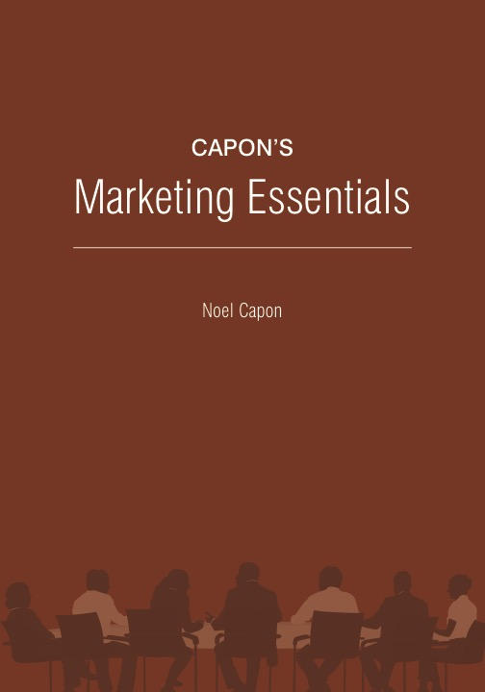
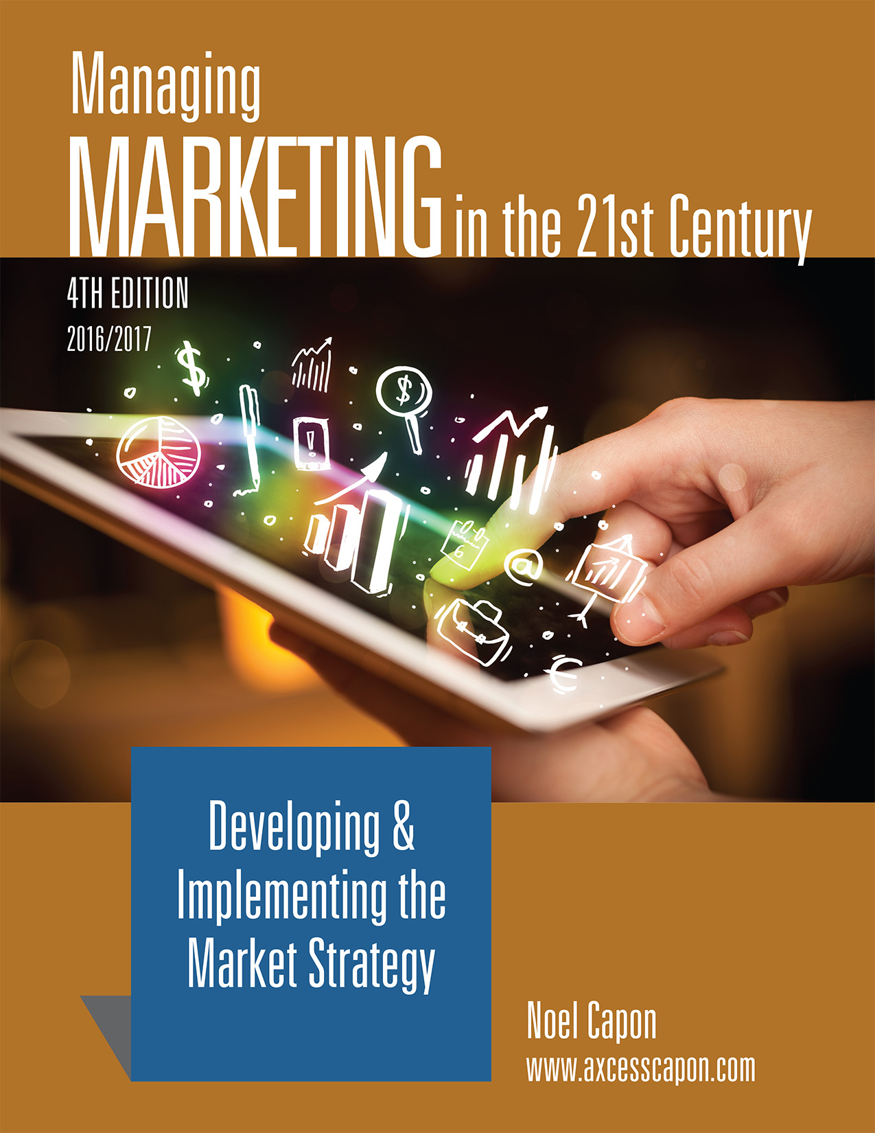



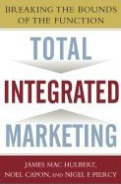
www.wessexlearning.com
Managing Markets Strategically
Professor Noel Capon
R.C. Kopf Professor of International Marketing
Columbia Business School
New York, NY

Slide 2
Managing Markets Strategically
www.wessexlearning.com
Section 1: Marketing and the Firm
Chapter 1: Introduction to Managing Marketing
Chapter 2: The Value of Customers
Section 2: Fundamental Insights for Strategic Marketing
Transition to Strategic Marketing
Section 3: Strategic Marketing
Section 4: Implementing the Market Strategy

Slide 3
Chapter 2
The Value of Customers

Slide 4
Chapter Roadmap
www.wessexlearning.com
Why Customers Are So Important for the Firm
CLV | Increasing CLV | Acquiring New Customers | Options for Addressing Customers | Being Selective About Customers
Calculating CLV | Increase the Profit Margin the Firm Earns from Customers Increase Customer Retention Rate – Reduce Customer Defection Rate Profit Margins and Customer Retention |  | Current Customers Potential Customers | Customer Profitability Customer Suitability
How to Bind Customers Closer to the Firm
Customer Relationship Management | Customer Loyalty Programs
Developing a CRM System Assessing the Value of Customers and Designing Firm Actions | Value of Rewards Programs: Customers Value of the Rewards Program: The Firm

Slide 5
The Fundamental Business Model
www.wessexlearning.com
Shareholder Value
Organizational Survival, Growth
Current, Potential Profits
Competitors
Attract, Retain, Grow Customers
Competitors
Customer Value
Company

Slide 6
The Value of Customers
www.wessexlearning.com
• Customers are the firm’s core assets
When the firm creates value for customers, and retains them…
Customers create value for the firm
• Customers are the critical source of cash inflows
They buy more products & services
So long as the firms continues to deliver customer value
• Globalization is driving increased emphasis on creating shareholder value
The firm must determine how to use CLV to enhance shareholder value

Slide 7
Two Faces of Value
www.wessexlearning.com
Products and services create customer value
Customer value attracts,
retains, and grows customers
By being attracted, grown, and retained, customers in turn create value for the firm and its shareholders

Slide 8
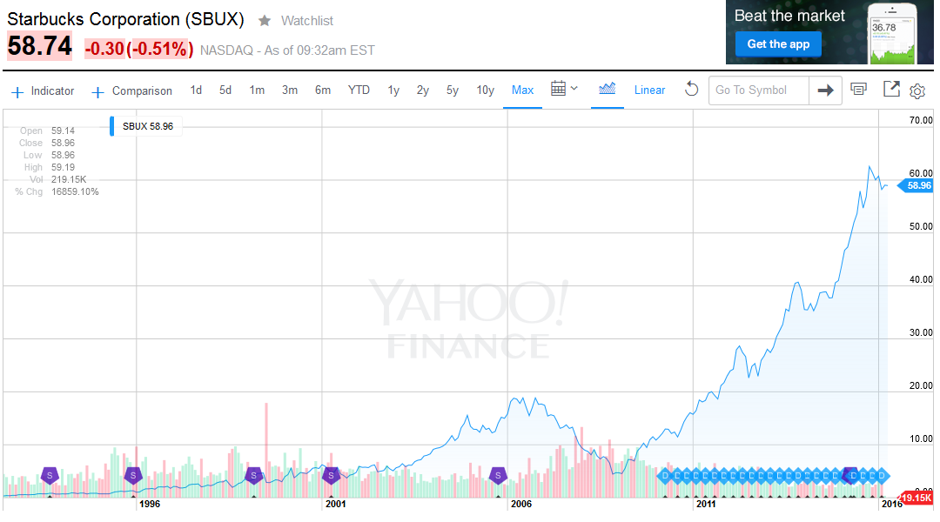
Starbucks Stock Price Performance
www.wessexlearning.com

Slide 9
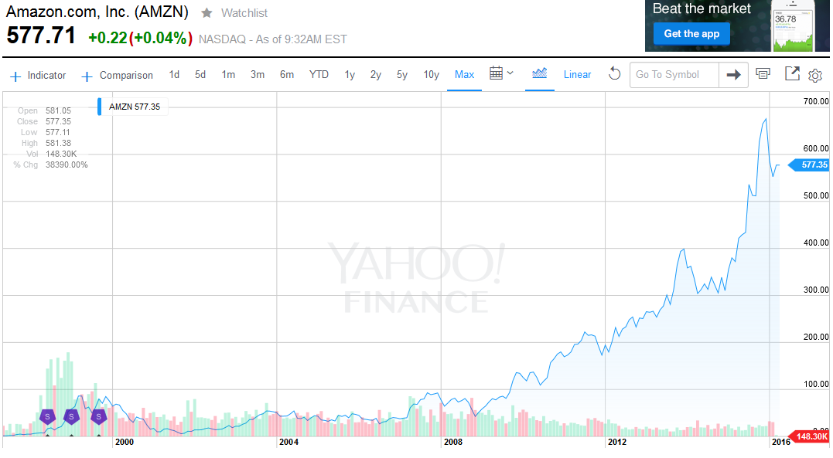
Amazon Stock Price Performance
www.wessexlearning.com

Slide 10

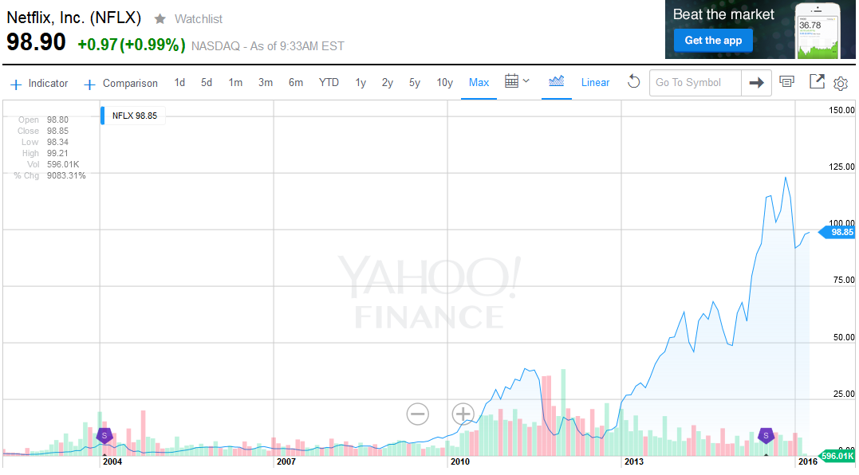
Netflix Stock Price Performance
www.wessexlearning.com

Slide 11
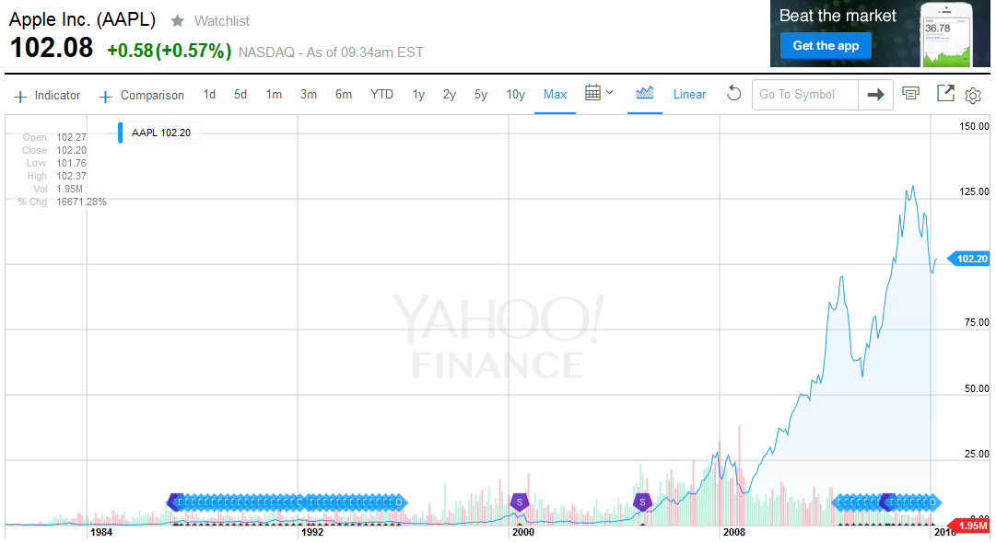
Apple Stock Price Performance
www.wessexlearning.com

Slide 12
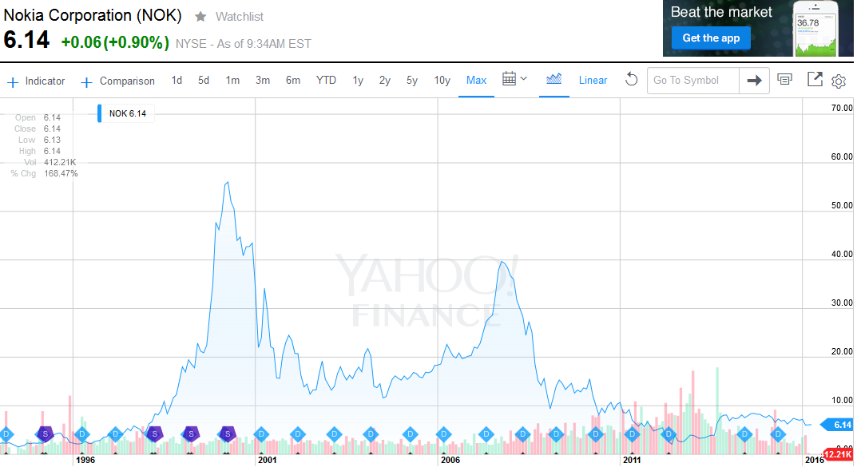
Nokia Stock Price Performance
www.wessexlearning.com

Slide 13

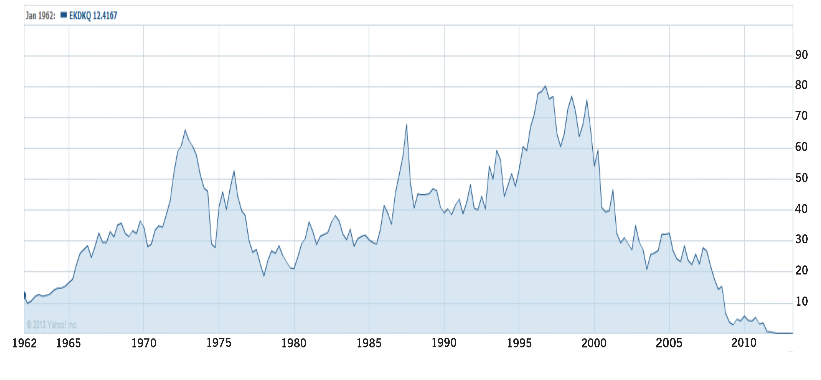
Kodak Stock Price Performance
www.wessexlearning.com
© Yahoo Inc.

Slide 14
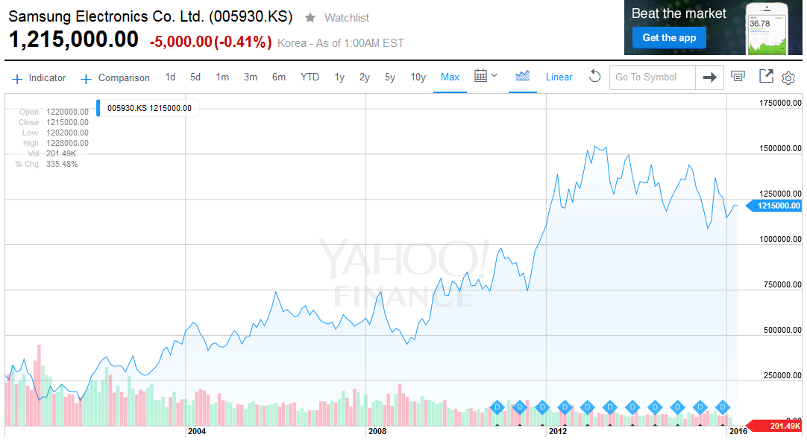
Samsung Stock Price Performance
www.wessexlearning.com

Slide 15
The Value of Customers
www.wessexlearning.com
Core Topics
• Why are customers so important for the firm?
Customer Lifetime Value (CLV)
• How can the firm bind customers closer?
Customer Relationship Management (CRM)

Slide 16
Why Are Customers So Important for the Firm?
www.wessexlearning.com
Session Roadmap A
• Customer lifetime value (CLV)
• Profit margin
• Customer retention
• Addressing current customers and potential customers
• Customer suitability

Slide 17
Why Are Customers So Important for the Firm?
www.wessexlearning.com
Session Roadmap A
• Customer lifetime value (CLV)
• Profit margin
• Customer retention
• Addressing current customers and potential customers
• Customer suitability

Slide 18
Customer Lifetime Value (CLV)
www.wessexlearning.com
 | Year 1 |  | Year 2 |  | Year 3
CLV = | m₁ x r₁ | + | m₂ x r₁ x r₂ | + | m₃ x r₁ x r₂ x r₃ | + | ………
 | (1 + d) |  | (1 + d)² |  | (1 + d)³
m = profit margin
r = customer retention rate
d = discount rate (cost of capital)
Definition: CLV = Discounted profit margin earned from the customer, factored by customer retention rate

Slide 19
Customer Lifetime Value (CLV)
www.wessexlearning.com
Customer Lifetime Value depends on three factors:
• Profit Margin
• Retention Rate
• Discount Rate
CLV = | r x m
 | (1 + d – r)
m₁ = m₂ = m₃ … = m
r₁ = r₂ = r₃ … = r

Slide 20
Customer Lifetime Value (CLV)
www.wessexlearning.com
Profit margin
CLV = | r x m
 | (1 + d – r)
Margin multiple = | r
 | (1 + d – r)
Increase profit margin, m
CLV = | m x r
 | (1 + d – r)
Increase customer retention rate, r
Reduce discount rate, d

Slide 21
Customer Retention
www.wessexlearning.com
Margin Multiple Values
 | Discount Rate (d)
Retention Rate (r) | 8% | 12% | 16% | 20%
60% | 1.25 | 1.15 | 1.07 | 1.00
70% | 1.84 | 1.67 | 1.52 | 1.40
80% | 2.86 | 2.50 | 2.22 | 2.99
90% | 5.00 | 4.09 | 3.46 | 3.00
95% | 7.31 | 5.59 | 4.52 | 3.80

Slide 22
Customer Lifetime Value
www.wessexlearning.com
Margin Multiple Values
 | Discount Rate (d)
Retention Rate (r) | 8% | 12% | 16% | 20%
60% | 1.25 | 1.15 | 1.07 | 1.00
70% | 1.84 | 1.67 | 1.52 | 1.40
80% | 2.86 | 2.50 | 2.22 | 2.99
90% | 5.00 | 4.09 | 3.46 | 3.00
95% | 7.31 | 5.59 | 4.52 | 3.80

Slide 23
Customer Lifetime Value (CLV)
www.wessexlearning.com
Review
• Customer lifetime value depends on just three factors
• profit margin
• customer retention rate
• discount rate
• Margin multiple definition — margin multiple = r / (1 + d – r)
• CLV simplification — CLV = m x r / (1 + d – r)
• Actions to increase CLV
• increase profit margin
• increase customer retention rate
• reduce discount rate

Slide 24
Why Are Customers So Important for the Firm?
www.wessexlearning.com
Session Roadmap A
• Customer lifetime value (CLV)
• Profit margin
• Customer retention
• Addressing current customers and potential customers
• Customer suitability

Slide 25
Profit Margin
www.wessexlearning.com
Increasing Profit Margin
• Customer selection
• Customer satisfaction
• Customization
• Raise prices
• Reduce operating costs
Aid to the Firm
• Learning
• Network externalities
• Positive word of mouth and referrals
• Referral programs
• Signals

Slide 26
Why Are Customers So Important for the Firm?
www.wessexlearning.com
Session Roadmap A
• Customer lifetime value (CLV)
• Profit margin
• Customer retention
• Addressing current customers and potential customers
• Customer suitability

Slide 27
Customer Retention
www.wessexlearning.com
Customer Retention/Defection Patterns
 | 90% retention | 80% retention
Year Start | 1,000 customers | 1,000 customer
Year 1 | 900 remain; 100 customers lost | 800 remain; 200 customers lost
Year 2 | 810 remain; 90 customers lost | 640 remain; 160 customers lost
Year 3 | 729 remain; 81 customers lost | 512 remain; 128 customers lost

Slide 28
Why Are Customers So Important for the Firm?
www.wessexlearning.com
Session Roadmap A
• Customer lifetime value (CLV)
• Profit margin
• Customer retention
• Addressing current customers and potential customers
• Customer suitability

Slide 29
Addressing Current Customers and Potential Customers
www.wessexlearning.com
Current Customers | CLV = | m x r
 |  | (1 + d – r )
Potential Customers | CLV = | m x r | – AC
 |  | (1 + d – r )
Decision Rule: Acquire potential customers when expected CLV is greater than the acquisition cost.

Slide 30
Addressing Current Customers and Potential Customers
www.wessexlearning.com
Some customers bring value to the firm; some do not
Measuring customer profitability is critical
A critical firm challenge is to identify the right customers
Options

Slide 31
Addressing Current Customers and Potential Customers
www.wessexlearning.com
How to Acquire Customers
• Independent marketing activities
• Affiliations
• Channel strategies
• Firm and business-unit acquisitions

Slide 32
Why Are Customers So Important for the Firm?
www.wessexlearning.com
Session Roadmap A
• Customer lifetime value (CLV)
• Profit margin
• Customer retention
• Addressing current customers and potential customers
• Customer suitability

Slide 33
Customer Suitability
www.wessexlearning.com
Issues
• Capacity constraints Insufficient ability to serve all customers
• Competition Customers may be potential competitors
• Evolving strategy Customer may not be a target with the new strategy
• Foreclosing options Potential customer will refuse to do business
• Impact on the firm’s reputation “Is there a Gucci in Kohl’s?”
• Impact on the offer Rule breakers create a bad image
• Instability May lead to a difficult relationship
• Non-payer High collection costs; write off receivables
• Potential costs High service or customization costs

Slide 34
Why Are Customers So Important for the Firm?
www.wessexlearning.com
Session Roadmap A
• Customer lifetime value (CLV)
• Profit margin
• Customer retention
• Addressing current customers and potential customers
• Customer suitability

Slide 35
How Can the Firm Bind Customers Closer?
www.wessexlearning.com
Session Roadmap B
• Customer relationship management (CRM)
• Customer loyalty

Slide 36
How Can the Firm Bind Customers Closer?
www.wessexlearning.com
Session Roadmap B
• Customer relationship management (CRM)
• Customer loyalty

Slide 37
Customer Relationship Management
www.wessexlearning.com
• Definitions and features
• The customer database
• Customer value and customer loyalty

Slide 38
Customer Relationship Management
www.wessexlearning.com
Definition
Customer relationship management is the ongoing process of identifying and creating new value with individual customers and sharing these benefits over a lifetime of association with them.
Features

Slide 39
Customer Relationship Management
www.wessexlearning.com
Definition
Features
• Synthesis of marketing, customer service, and quality management
• Goal is to form mutually beneficial relationships between the firm and its customers
• Technology plays an important role in CRM, but CRM is not about technology
• CRM techniques can be applied to other firm stakeholders – suppliers, shareholders, and current and potential employees

Slide 40
Customer Relationship Management
www.wessexlearning.com
• Definitions and features
• The customer database
• Customer value and customer loyalty

Slide 41
Customer Relationship Management
www.wessexlearning.com
The Customer Database
Customer Identifier | Customer Characteristics | Customer Contact History | Customer Purchase History | Customer Reponses to Firm Decisions | Customer Value Received | Customer Value to the Firm
Jane Doe
John Smith
XYZ Inc.
XYZ influencers and decision makers

Slide 42
Customer Relationship Management
www.wessexlearning.com
• Definitions and features
• The customer database
• Customer value and customer loyalty

Slide 43
Customer Relationship Management
www.wessexlearning.com
Customer Value and Customer Loyalty

Slide 44
How Can the Firm Bind Customers Closer?
www.wessexlearning.com
Session Roadmap B
• Customer relationship management (CRM)
• Customer loyalty

Slide 45
Customer Loyalty Programs
www.wessexlearning.com
Value for Customers — Design Factors
• Rate of earning
• Aspirational value of the reward
• Cash value of the reward
• Deterministic or probabilistic rewards
• Ease of collecting the reward
• Length of time to earn the reward
• Rewards based on the firm’s products or services, or a broad variety
• Soft and hard rewards
• Type of reward
Value for the Firm

Slide 46
Customer Loyalty Programs
www.wessexlearning.com
Value for Customers — Design Factors
Value for the Firm
• Creates competitor barriers
• Gains insight into customer behavior
• Lowers cost to serve loyal customers
• Makes loyal customers less price sensitive
• Encourages loyal customers to spend more
• Stimulates positive word of mouth from loyal customers
• Increases sales by purchase acceleration closer to the goal

Slide 47
How Can the Firm Bind Customers Closer?
www.wessexlearning.com
Session Roadmap B
• Customer relationship management (CRM)
• Customer loyalty

Slide 48
The Value of Customers
www.wessexlearning.com
Core Topics
• Why are customers so important for the firm?
• How can the firm bind customers closer?

Slide 49
www.wessexlearning.com
Chapter 2
The Value of Customers

