Slide 1

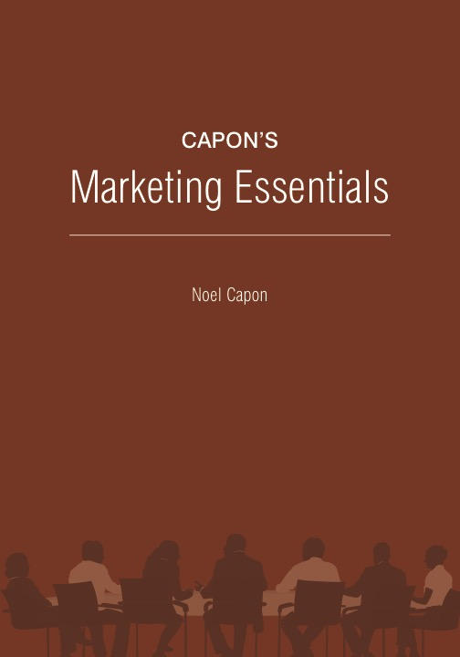
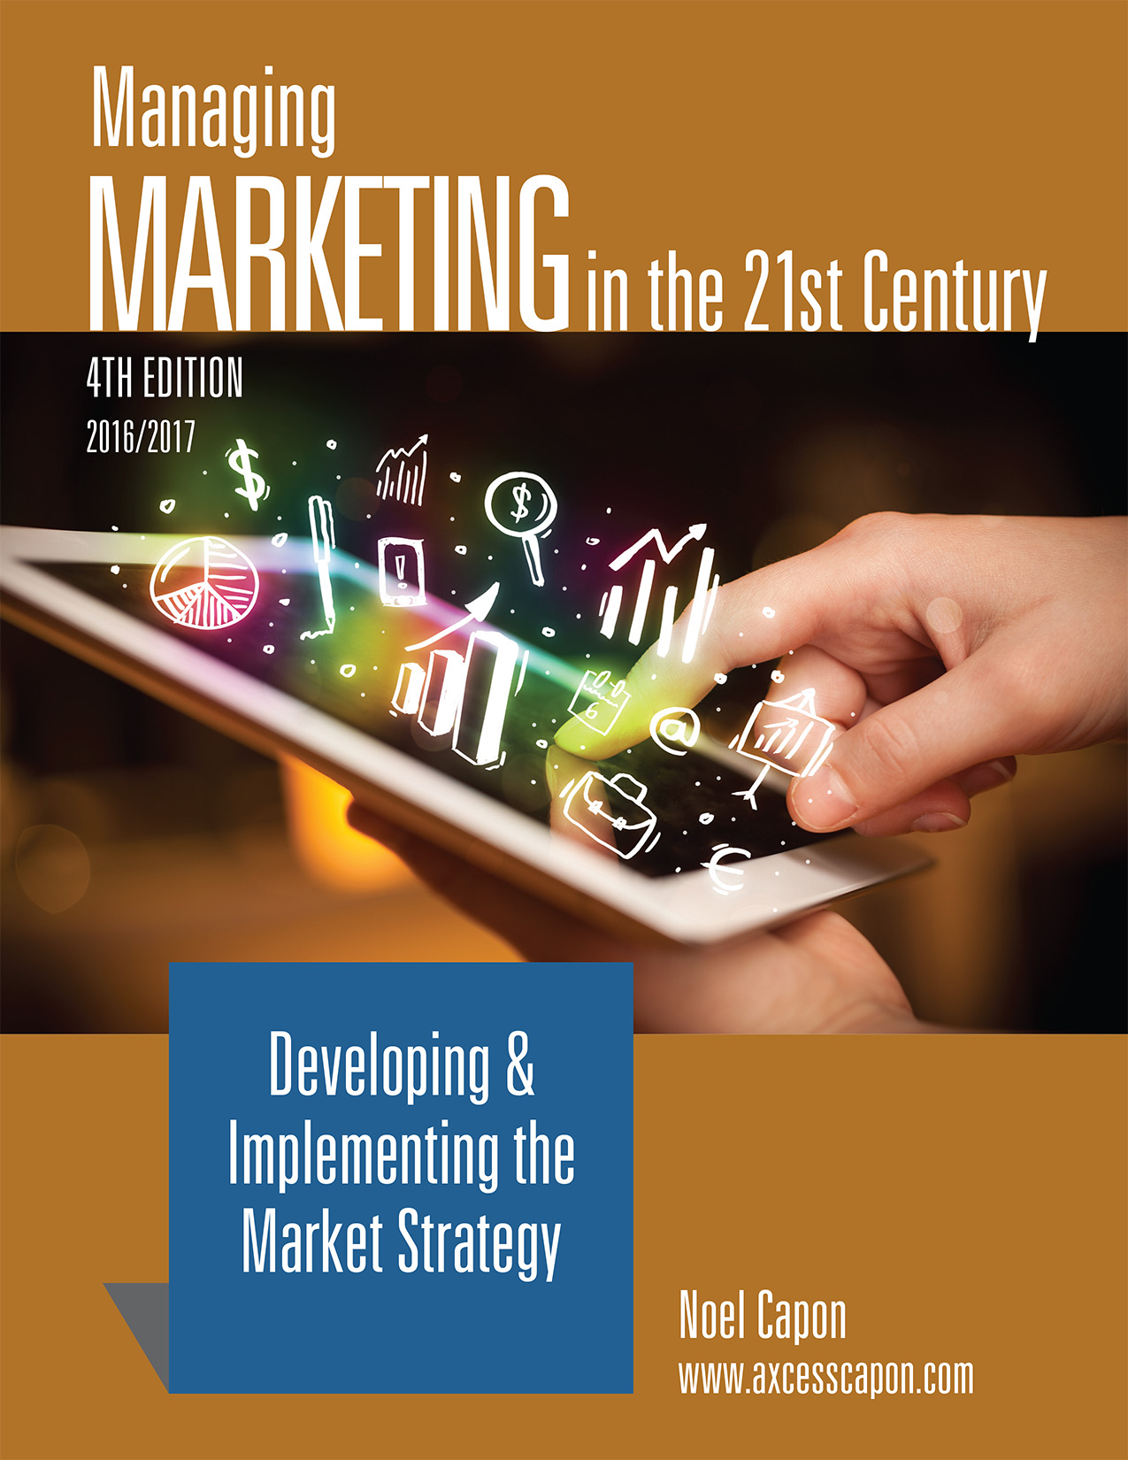



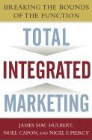
www.wessexlearning.com
Managing Markets Strategically
Professor Noel Capon
R.C. Kopf Professor of International Marketing
Columbia Business School
New York, NY

Slide 2
Managing Markets Strategically
www.wessexlearning.com
Section 1: Marketing and the Firm
Section 2: Fundamental Insights for Strategic Marketing
Chapter 3: Market Insight
Chapter 4: Customer Insight
Chapter 5: Insight about Competitors, Company, and Complementers
Transition to Strategic Marketing
Section 3: Strategic Marketing
Section 4: Implementing the Market Strategy

Slide 3
www.wessexlearning.com
Chapter 4
Customer Insight

Slide 4
Chapter Roadmap
www.wessexlearning.com
Who Are the Customers? | What Do Customers Need and Want? | How Do Customers Buy? | Influences on Consumer Purchase Decisions | Influences on Organizational Purchase Decisions
Macro-Level Customers, Micro-Level Customers Roles in the Purchase Decision Current Customers, Potential Customers Direct Customers, Indirect Customers | Customer Needs: Recognized versus Latent Attributes/Features versus Benefits/Values Hierarchies of Needs/ Features, Benefits/Values Functional, Psychological, and Economic Benefits and Values Characteristics of Benefits/Values Beyond Customer Benefits/Values — Customer Experiences | Purchase-Decision Stages | Environmental Individual | Changes in the Procurement Process Evolution in Buyer-Seller Relationships Increased Corporate Attention to Procurement Reduced Numbers of Suppliers

Slide 5
Customer Insight
www.wessexlearning.com
Session Roadmap
• Who are the customers?
• What do customers need and want?
• How do customers buy?
• Influences on customer purchase decisions

Slide 6
Customer Insight
www.wessexlearning.com
Session Roadmap
• Who are the customers?
• What do customers need and want?
• How do customers buy?
• Influences on customer purchase decisions

Slide 7
Who Are the Customers?
www.wessexlearning.com
A customer is any person or organization, in the channel of distribution or decision (excluding competitors), whose actions can affect the purchase of the firm’s products and services.

Slide 8
Who Are the Customers?
www.wessexlearning.com
• Macro versus micro
• Organizations are macro customers
• Individuals are micro customers
• Direct versus indirect
• Direct customers pay for the product
• Indirect customers play several different roles
• Roles in the purchase process: Multiple different roles
• Evolution: current versus future
• Current customers – revenues today
• Potential customers – revenues tomorrow

Slide 9
Who Are the Customers?
www.wessexlearning.com
Macro versus Micro
Organization
Macro level
Decision-making
unit (DMU)
Purchasing Committee
Individuals
Micro level

Slide 10

Who Are the Customers?
www.wessexlearning.com
Illustration: UPS
• Mailroom guy
• Shipping manager
• Customer service manager
• Logistics manager
• Chief financial officer
• Chief executive officer

Slide 11

Who Are the Customers?
www.wessexlearning.com
Direct versus Indirect
Complementary
Supplier
Supplier Firm
Direct Customer
Indirect Customer 1
Influencer/Advisor Organizations
Indirect Customer 2

Slide 12
Who Are the Customers?
www.wessexlearning.com
Direct versus Indirect
Complementary
Supplier
Supplier Firm
Direct Customer
Indirect Customer 1
Influencer/Advisor Organizations
Indirect Customer 2

Slide 13
Who Are the Customers?
www.wessexlearning.com
Direct versus Indirect
Complementary
Supplier
Supplier Firm
Direct Customer
Indirect Customer 1
Influencer/Advisor Organizations
Indirect Customer 2

Slide 14
Who Are the Customers?
www.wessexlearning.com
Direct versus Indirect
Complementary
Supplier
Supplier Firm
Direct Customer
(Interactions)
Indirect Customer 1
Influencer/Advisor Organizations
Indirect Customer 2

Slide 15
Who Are the Customers?
www.wessexlearning.com
Direct versus Indirect
Complementary
Supplier
Supplier Firm
Direct Customer
(Interactions)
Indirect Customer 1
Influencer/Advisor Organizations
Indirect Customer 2

Slide 16
Who Are the Customers?
www.wessexlearning.com
Roles in the Purchase Process
Initiator
Specifier
Coach
Major
Minor
Information Provider
Customer Roles
Influencer
Gatekeeper
Champion/
Sponsor
Spoiler
Decision-Maker
User
Buyer

Slide 17
Who Are the Customers?
www.wessexlearning.com
Purchase Decision Roles: Illustration – B2B
Roles | Purchase Decision: Multinational firm seeks supplier for marketing training programs
Initiator | Head of HR
Specifier | Junior HR personnel who develop the program
Influencer Champion/sponsor Spoiler | Senior line executives Senior executives committed to Columbia Business School Two senior line executives with MBAs from Harvard and Wharton
Decision-maker | CEO
Buyer | Purchasing officer
User | Middle managers
Gatekeeper | Senior HR personnel
Information provider | Bricker’s – good source on executive education
Coach | Consultant to firm; previously Columbia faculty member

Slide 18
Who Are the Customers?
www.wessexlearning.com
Purchase Decision Roles: Illustration – B2C
Roles | Purchase Decision: Family is deciding whether to take a cruise for the family vacation
Initiator | Family physician – advises family to take vacation for mother’s health
Specifier | Grandmother (has basic requirements that must be met)
Influencer Champion/sponsor Spoiler | Children Second cousin (works for cruise line) Daughter’s boyfriend – has summer job at a Caribbean resort
Decision-maker | Mother
Buyer | Father
User | Mother, father, children, grandparents
Gatekeeper | Live-in housekeeper
Information provider | Travel agent
Coach | Neighbor – takes three cruises annually

Slide 19
Customer Insight
www.wessexlearning.com
Session Roadmap
• Who are the customers?
• What do customers need and want?
• How do customers buy?
• Influences on customer purchase decisions

Slide 20
What Do Customers Need and Want?
www.wessexlearning.com
• Recognized versus latent
• Recognized — customers understanding their needs
• Latent — customers not aware of their needs
• Attributes and features, benefits, values ladder
• Attributes and features — include design element
• Benefits and values — what customers receive from features and attributes
• Hierarchy of needs — Maslow’s five major needs groups
• Types of value — Economic, Functional, Psychological
• Customer value issues
• Customer experiences — Experiences may be more important than benefits and values

Slide 21
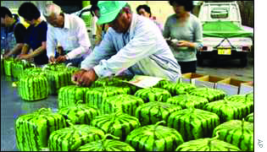
What Do Customers Need and Want?
www.wessexlearning.com
Recognized Need: Illustration – Cubic Watermelons

Slide 22
What Do Customers Need and Want?
www.wessexlearning.com
Latent Need: Illustration – Personal Watermelon

Slide 23
What Do Customers Need and Want?
www.wessexlearning.com
Maslow’s Hierarchy of Needs
Self-Actualization
Self-fulfillment
Ego
Prestige, Success, Self-Respect
Social
Love, Affection, Friendship, Belonging
Safety & Security
Protection, Order, Security
Physiological
Food, Drink, Air, Shelter, Sex

Slide 24
What Do Customers Need and Want?
www.wessexlearning.com
Attributes and Features, Benefits, Values Ladder
Influence Power
Increases!
Values
Why the customer
believes these benefits
are important
Benefits
What attributes
and features do
for the customer
Attributes and Features
Key product
characteristics

Slide 25
What Do Customers Need and Want?
www.wessexlearning.com
Laddering: Illustration – Electric Drill

Slide 26
What Do Customers Need and Want?
www.wessexlearning.com
Laddering: Illustration – Nivea Skin Cream

Slide 27
What Do Customers Need and Want?
www.wessexlearning.com
Laddering: Benefits
• Focuses attention on customer benefits and values
• Provides alternative communication options
• Broadens view of competition

Slide 28
Types of Value
www.wessexlearning.com

Slide 29
What Do Customers Need and Want?
www.wessexlearning.com
Economic Value (EVC): Illustration – Conveyor Belts
• Assumptions
• Conveyor belts can be made of cotton or polyester yarn
• Length of conveyor belt life is proportional to yarn strength
• Customer value is directly related to conveyor belt life
• Cotton-based conveyor belts
• Cotton strength = 2 grams per denier (g.p.d.)
• Cotton yarn price = 90¢ / lb.
• Polyester-based conveyor belts
• Polyester strength = 8 g.p.d.
• Extra processing cost for the customer from using polyester = 30¢ / lb.
Question: What is the EVC for polyester yarn?

Slide 30
What Do Customers Need and Want?
www.wessexlearning.com
Economic Value (EVC): Illustration – Conveyor Belts

Slide 31
What Do Customers Need and Want?
www.wessexlearning.com
Psychological Value
• Good feelings
• Status
• Reduces risk
• Confidence in job security

Slide 32
What Do Customers Need and Want?
www.wessexlearning.com
Customer Value Issues
• Actual value versus potential value
• Future value
• Presence value
• Scarcity value
• Value for whom
• When customers recognize value
• search benefits — value third party information
• use benefits — value after consumption
• credence benefits — value long after consumption

Slide 33
What Do Customers Need and Want?
www.wessexlearning.com
Customer Experiences
Type of Experience | Example
Real experience | Go to see a movie
Anticipatory experience | See an advertisement for the movie
Vicarious experience | Send a daughter to the movie

Slide 34
Customer Insight
www.wessexlearning.com
Session Roadmap
• Who are the customers?
• What do customers need and want?
• How do customers buy?
• Influences on customer purchase decisions

Slide 35
How Do Customers Buy?
www.wessexlearning.com
Purchase Decision Process
Recognize Problems
Acquire Information
Evaluate Alternatives
Make a
Choice
Purchase, Secure
Product
Postpurchase Processes

Slide 36
How Do Customers Buy?
www.wessexlearning.com
Acquire Information: Awareness Set Illustration – Soft Drink
Awareness Set
Mountain Dew Coke Pepsi Diet Pepsi Root Beer Ginger Ale Diet Ginger Al Hi-C Snapple Sprite | 7-Up Diet 7-Up Orange Slice Fanta Cherry Coke Cherry 7-Up Dr Pepper Diet Dr Pepper Mr. Pibb Caffeine-free Coke

Slide 37
How Do Customers Buy?
www.wessexlearning.com
Purchase Decision Process
Recognize Problems
Acquire Information
Evaluate Alternatives
Make a
Choice
Purchase, Secure
Product
Postpurchase Processes

Slide 38
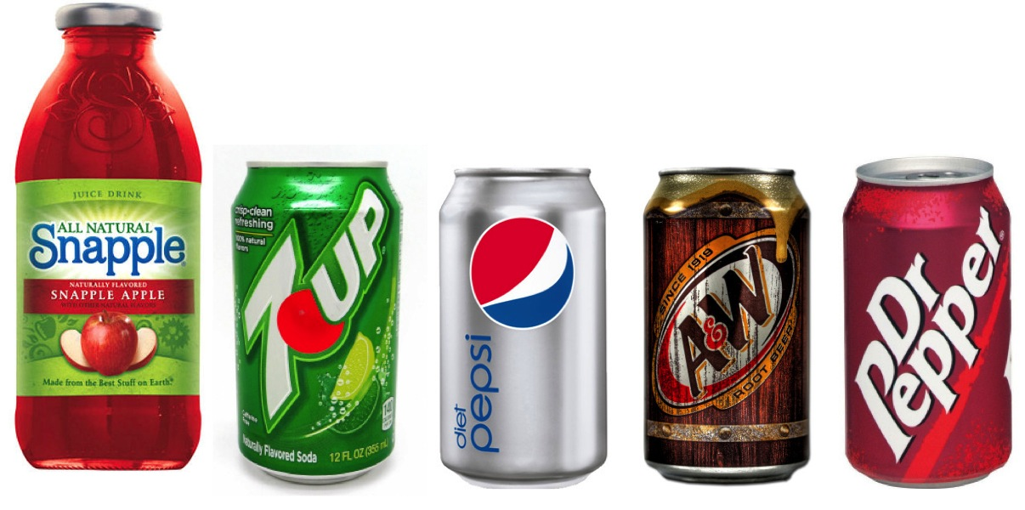
How Do Customers Buy?
www.wessexlearning.com
Evaluate Alternatives: Consideration Set Illustration – Soft Drink
Awareness Set |  | Consideration Set
Mountain Dew Coke Pepsi Diet Pepsi Root Beer Ginger Ale Diet Ginger Al Hi-C Snapple Sprite | 7-Up Diet 7-Up Orange Slice Fanta Cherry Coke Cherry 7-Up Dr Pepper Diet Dr Pepper Mr. Pibb Caffeine-free Coke | Snapple 7-Up Diet Pepsi Root Beer Dr Pepper

Slide 39
How Do Customers Buy?
www.wessexlearning.com
Purchase Decision Process
Recognize Problems
Acquire Information
Evaluate Alternatives
Make a
Choice
Purchase, Secure
Product
Postpurchase Processes

Slide 40
How Do Customers Buy?
www.wessexlearning.com
Make a Choice
• Rational approaches – order choice components by importance
• Less than fully rational approaches

Slide 41
How Do Customers Buy?
www.wessexlearning.com
Make a Choice: Illustration of Less Than Fully Rational Behavior
You are in a store about to buy a $25 book. Your friend walks by and says you can buy the same book two blocks away for $10.
Question: Would you walk two blocks to save $15?
You are in a store about to buy a home-entertainment system for $765. Your friend walks by and says you can buy the same system two blocks away for $750.
Question: Would you walk two blocks to save $15?

Slide 42
How Do Customers Buy?
www.wessexlearning.com
Make a Choice
You are about to buy a soft drink. You have 2 choices.
small – $1.00
large – $1.49
Which will you choose?
You are about to buy a soft drink. You have 3 choices.
small – $1.00
large – $1.49
very large – $1.89
Which will you choose?

Slide 43
How Do Customers Buy?
www.wessexlearning.com
Class Discussion
• Do you always act rationally in your purchase decisions?
• Can you identify a situation where you behaved less than rationally?

Slide 44
How Do Customers Buy?
www.wessexlearning.com
Purchase Decision Process
Recognize Problems
Acquire Information
Evaluate Alternatives
Make a
Choice
Purchase, Secure Product
Postpurchase Processes

Slide 45
How Do Customers Buy?
www.wessexlearning.com
Postpurchase Processes
Use
Use experience
Dissonance reduction
Communications with customers/potential customers
Comparison with others
Product and packaging disposal
Repurchase
Important Postpurchase Issues

Slide 46
How Do Customers Buy?
www.wessexlearning.com
Purchase Decision Process
Recognize Problems
Acquire Information
Evaluate Alternatives
Make a
Choice
Purchase, Secure Product
Postpurchase Processes

Slide 47
How Do Customers Buy?
www.wessexlearning.com
Purchase Decision Process
Recognize Problems
Acquire Information
Evaluate Alternatives
Make a
Choice
Purchase, Secure
Product
Postpurchase Processes

Slide 48
How Do Customers Buy?
www.wessexlearning.com
Purchase Decision Process: Illustration – DVD Player
Decision Process Stage | Customer Action and Cognitions
Recognizing problems | Sees advertisement: “That looks cool and I don’t have one.”
Acquiring information | Demonstration in store: “What is this thing?” “What does it do?” “What is the price?” “Where can I get one?”
Evaluating alternatives | Examine various options: “Is Sony better than Toshiba and Phillips?”
Making a choice | “I am going to buy Sony.”
Purchasing and securing the product | “Here’s my credit card.”
Post-purchase processes | “How do I hook this up?” “Where do I get service?”

Slide 49
Customer Insight
www.wessexlearning.com
Session Roadmap
• Who are the customers?
• What do customers need and want?
• How do customers buy?
• Influences on customer purchase decisions

Slide 50
Influences on Customer Purchase Decisions
www.wessexlearning.com
Consumer Decisions – B2C
• Environmental
• Individual
Organizational Decisions – B2B

Slide 51
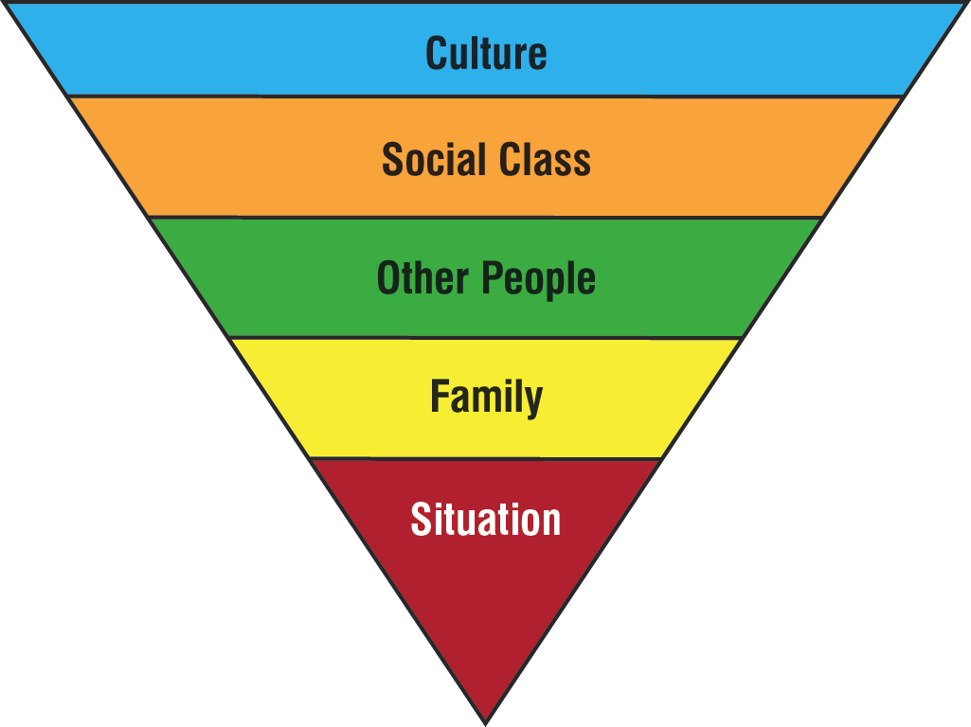
Influences on Consumer Purchase Decisions
www.wessexlearning.com
Environmental – Culture

Slide 52
Influences on Consumer Purchase Decisions
www.wessexlearning.com
Social Classes in America
Broad Category | Fine-grained Category | Description
Upper | Upper-upper (0.3%) | Inherited wealth, aristocratic names
 | Lower-upper (1.2%) | Newer social elite, corporate leadership
 | Upper-middle (12.5%) | Managers and professionals
Middle | Middle class (32%) | Average pay white-collar workers
 | Working class (38%) | Average pay blue-collar workers
Lower | Lower (9%) | Working, living standards just above poverty
 | Real lower-lower (7%) | On public assistance, poverty-stricken, often without work

Slide 53


Influences on Consumer Purchase Decisions
www.wessexlearning.com
Other People
• Primary reference group
• Secondary reference groups
• Aspirational groups

Slide 54
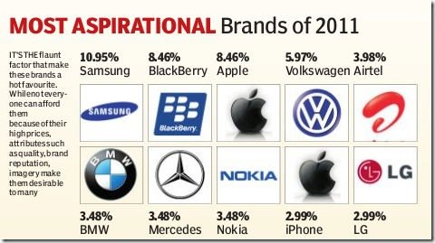
Aspirational Groups
www.wessexlearning.com
Aspirational Influences
Which brands in this portfolio, are still aspirational to you and which are not? Why not?

Slide 55
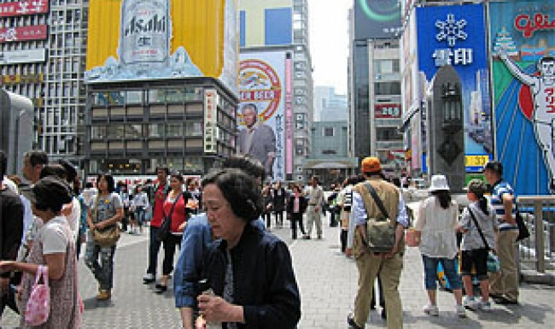
Influences on Consumer Purchase Decisions
www.wessexlearning.com
Individual
• Economic resources
• Technological competence
• Time
• Physical and mental health
• Should/want conflicts
• Lifestyle
• Life-cycle stage

Slide 56

Influences on Consumer Purchase Decisions
www.wessexlearning.com
Life-Cycle Stages
Infant and pre-school — parents make all purchase decisions
School-age — may influence parents making purchase decisions
Teenager, living at home, purchases from allowance, gifts, part-time jobs
Young, single, head of household, no children
Married, no children
Married, young children
Married, teenage children
Married, second family, young children
Married, no children, empty-nesters
Single, widow/widower

Slide 57
Influences on Customer Purchase Decisions
www.wessexlearning.com
Consumer Decisions – B2C
Organizational Decisions – B2B

Slide 58
Influences on Organizational Purchase Decisions
www.wessexlearning.com
• Changes in the procurement process
• broader scope of procurement responsibilities
• centralization
• globalization
• Internet
• procurement expertise
• Evolution in buyer-seller relationships
• Increased corporate attention to procurement
• Reducing the number of suppliers

Slide 59
Influences on Organizational Purchase Decisions
www.wessexlearning.com
• Changes in the procurement process
• Evolution in buyer-seller relationships
• Increased corporate attention to procurement
• Reducing the number of suppliers

Slide 60
Influences on Organizational Purchase Decisions
www.wessexlearning.com
Evolution in Buyer-Seller Relationships
Vendor
Quality Supplier
Partner
Add Organizational Value
Commodity Relationship
Increased Competitive Pressure
Deep Supplier/Global Account Relationship

Slide 61
Influences on Organizational Purchase Decisions
www.wessexlearning.com
• Changes in the procurement process
• Evolution in buyer-seller relationships
• Increased corporate attention to procurement
• organizational downsizing
• branding
• outsourcing
• Reducing the number of suppliers
• increased purchase complexity
• improved product quality
• greater procurement effectiveness
• reduced input costs
• better service

Slide 62
Influences on Organizational Purchase Decisions
www.wessexlearning.com
Reducing the number of suppliers
Company | Previous number of suppliers | New number of suppliers | Reduction (%) in number of suppliers
Airbus | 3,000 | 500 | 83%
BAA Airports | 11,500 | 3,000 | 74%
Barclay’s Bank | 2,000 | 180 | 90%
Boeing | 30,000 | 10,000 | 67%
Motorola | 10,000 | 3,000 | 70%
Texas Instruments | 22,000 | 14,000 | 36%
Volkswagen | 2,000 | 200 | 90%
Xerox | 5,000 | 500 | 90%

Slide 63
Influences on Organizational Purchase Decisions
www.wessexlearning.com
Influences
• Changes in the procurement process
• Evolution in buyer-seller relationships
• Increased corporate attention to procurement
• Reducing the number of suppliers

Slide 64
Customer Insight
www.wessexlearning.com
Session Roadmap
• Who are the customers?
• What do customers need and want?
• How do customers buy?
• Influences on customer purchase decisions

Slide 65
www.wessexlearning.com
Chapter 4
Customer Insight

