Slide 1

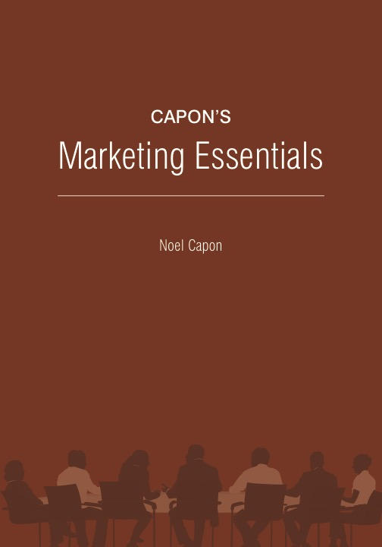
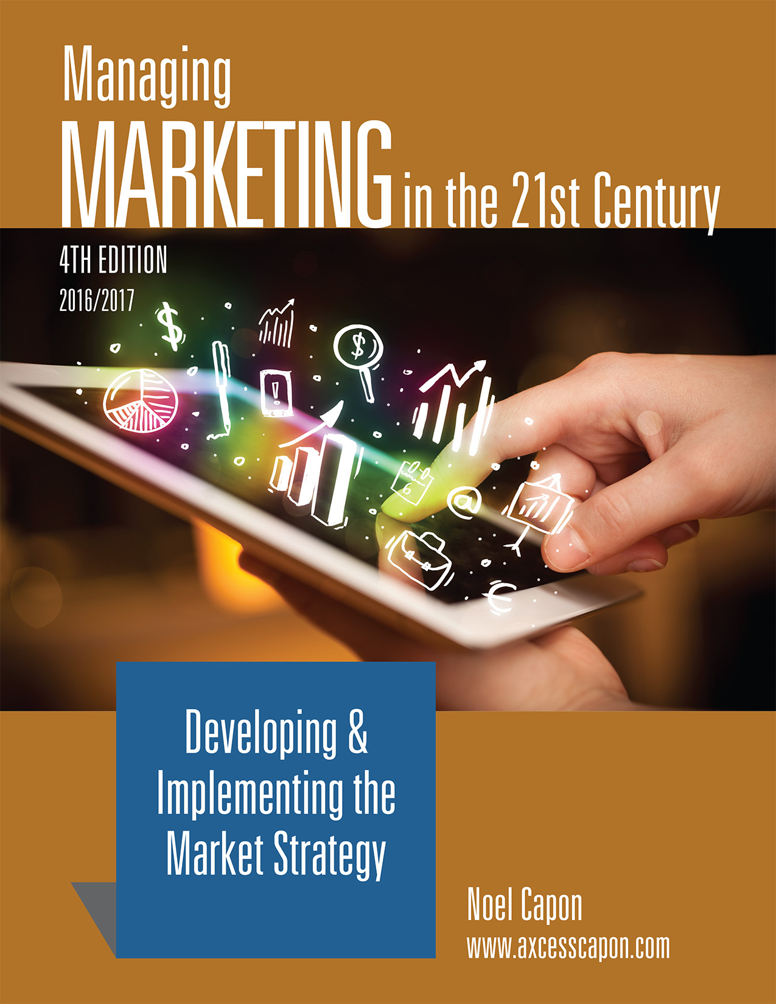



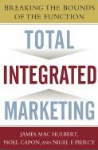
www.wessexlearning.com
Managing Markets Strategically
Professor Noel Capon
R.C. Kopf Professor of International Marketing
Columbia Business School
New York, NY

Slide 2
Managing Markets Strategically
www.wessexlearning.com
Section 1: Marketing and the Firm
Section 2: Fundamental Insights for Strategic Marketing
Section 3: Strategic Marketing
Chapter 6: Identifying, Choosing Opportunities
Chapter 7: Market Segmentation, Targeting
Chapter 8: Market Strategy – Integrating Firm Efforts for Marketing Success
Chapter 9: Managing through the Life Cycle
Chapter 10: Managing Brands
Section 4: Implementing the Market Strategy

Slide 3
www.wessexlearning.com
Chapter 6
Identifying,
Choosing Opportunities

Slide 4
Chapter Roadmap
www.wessexlearning.com
Strategy for Growth | Screening Criteria: Evaluating Opportunities | Implementing Growth Strategies
Vision – Firms ideal future state Mission – Aspirational view of overall firm direction Growth Path – Focused method to identify opportunities Timing of Entry – When to seize the opportunity | Objectives – Balance firm growth with risk, timing stability Compatibility (Fit) – Examine 3 core compatibility criteria Core Competence – Matching an opportunity with the firm’s knowledge, skills, and other resources Synergy – 2 + 2 = 5 Contribution to the Venture Portfolio | Internal Development Insourcing Outsourcing Acquisition Strategic Alliance Licensing and Technology Purchase/Sale Equity Investment Implementing Growth Strategies in the Modern Corporation

Slide 5
The Fundamental Business Model
www.wessexlearning.com
Shareholder Value
Organizational Survival, Growth
Current, Potential Profits
Competitors
Attract, Retain, Grow Customers
Competitors
Customer Value
Company

Slide 6
Six Marketing Imperatives
www.wessexlearning.com
• Imperative 1: Determine, recommend which markets to address
• Imperative 2: Identify, target market segments
• Imperative 3: Set strategic direction, positioning
• Imperative 4: Design the market offer
• Imperative 5: Secure support from other functions
• Imperative 6: Monitor, control execution/performance

Slide 7
Imperative 1: Determine, Recommend Which Markets to Address
www.wessexlearning.com
Session Roadmap
• Performance gaps
  Objective versus momentum
• Strategy for growth
  Which business to be in; which businesses not to be in
• Screening criteria
  Objectives, compatibility, competence, synergy, contribution to venture portfolio
• Implementation
  Various options

Slide 8
Imperative 1: Determine, Recommend Which Markets to Address
www.wessexlearning.com
Session Roadmap
• Performance gaps
• Strategy for growth
• Screening criteria
• Implementation

Slide 9
Performance Gaps
www.wessexlearning.com

Slide 10
Performance Gaps
www.wessexlearning.com
Closing Performance Gaps
• Key question
• which opportunities shall we target?
• Key options
• market penetration
• new markets and segments
• new products
• new businesses
• Key challenge
• identify and array opportunities so we may choose

Slide 11
Imperative 1: Determine, Recommend Which Markets to Address
www.wessexlearning.com
Session Roadmap
• Performance gaps
• Strategy for growth
• Screening criteria
• Implementation

Slide 12
Develop and Implement Growth Strategies
www.wessexlearning.com
Strategy for Growth
Screening Criteria
Implementation
Vision
Mission
Growth path
Timing of entry

Slide 13
Strategy for Growth
www.wessexlearning.com
• Vision
• Mission
• Growth path
• Timing of entry

Slide 14
Strategy for Growth: Vision
www.wessexlearning.com
Definition
• A description of the ideal future state concerning a firm/business
Purpose
• Set broad direction and inspire
Definition
• Ford Motor Company – circa 1920s – “A car in every garage”
• Microsoft – 1980s/1990s – “A personal computer on every desk”
• Microsoft – 2000s – “To enable people and businesses throughout the world to realize their full potential”

Slide 15
Strategy for Growth
www.wessexlearning.com
• Vision
• Mission
• Growth path
• Timing of entry

Slide 16
Strategy for Growth: Mission
www.wessexlearning.com
Purpose
• Guides the firm’s search for market opportunities
• Codify where the firm does well, or aspires to do well

Slide 17
Strategy for Growth: Mission
www.wessexlearning.com
Alternative Bases — Internal Resources
• Core ingredient or natural resource
We are a forest products company.
• Product or service
We are an automobile firm.
• Technology
We are an electronics firm.
Alternative Bases — External Focus
• Customer needs
We satisfy people’s transportation needs.
• Market or market segment
Our markets are families with young children.

Slide 18
Strategy for Growth: Mission
www.wessexlearning.com
• Core ingredient or natural resource (IR) — forest products company
• Product or service (IR) — cars, bicycles, jet aircraft
• Technology (IR) — electronics, glass
• Customer needs (EF) — transportation, entertainment
• Market or market segment (EF) — families with young children
Mission directs search for market opportunities

Slide 19
Strategy for Growth: Mission
www.wessexlearning.com
Mission: Illustration – Courtyard by Marriott (CM)
• To provide economy- and quality-minded frequent business travelers with a premier lodging facility, which is consistently perceived as clean, comfortable, well-maintained, and attractive, staffed by friendly, attentive, and efficient people.
• Combines product/service (IR) and market/market segment (EF).

Slide 20

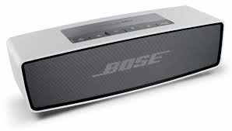

Strategy for Growth: Mission
www.wessexlearning.com
Mission Directs Search for Market Opportunities
Best Looking Hybrid Car
Best Sound System
Specialize in Personal Care Products

Slide 21
Strategy for Growth: Mission
www.wessexlearning.com
Modifying the Mission: Illustration
• Expanding
• Amazon
• Apple
• Google
• ServiceMaster
• Narrowing
• DuPont
• Corning
• Changing
• American Can
• Westinghouse
• Starburst
• Tyco
• McGraw Hill

Slide 22
Strategy for Growth
www.wessexlearning.com
• Vision
• Mission
• Growth path
• Timing of entry

Slide 23
Strategy for Growth: Growth Path Matrix
www.wessexlearning.com
Risk
Market Growth 2: Market Expansion (G) | Business Expansion: Concentric Products (H) | Conglomeration (I)
Market Growth 1: Market Extension (D) | Business Extension (E) | Business Expansion: Concentric Markets (F)
Market Penetration (A) | Product Growth 1: Product Extension (B) | Product Growth 2: Product Expansion (C)
New
Related
Market
Existing
Existing
Related
New (to firm)
Product/Technology

Slide 24
Strategy for Growth: Growth Path Matrix
www.wessexlearning.com
Alternative Paths
Risk
Market Growth 2: Market Expansion (G) | Business Expansion: Concentric Products (H) | Conglomeration (I)
Market Growth 1: Market Extension (D) | Business Extension (E) | Business Expansion: Concentric Markets (F)
Market Penetration (A) | Product Growth 1: Product Extension (B) | Product Growth 2: Product Expansion (C)
New
Related
Market
Existing
Existing
Related
New (to firm)
Product/Technology

Slide 25
Strategy for Growth
www.wessexlearning.com
• Vision
• Mission
• Growth path
• Timing of entry

Slide 26
Strategy for Growth: Timing of Entry
www.wessexlearning.com

Slide 27
Strategy for Growth: Timing of Entry
www.wessexlearning.com
Success Requirements – Pioneers – open up new markets
• Consistent R&D investment
• Willingness to take risks
• Excess people and capacity
• Understand market development dynamics
• Good lawyers (protect intellectual capital)
• Pioneering skills

Slide 28
Strategy for Growth: Timing of Entry
www.wessexlearning.com

Slide 29
Strategy for Growth: Timing of Entry
www.wessexlearning.com
Success Requirements – Follow-the-Leader – Enter as soon as possible after the leader
• Strong development R&D
• Speed of action
• Creative competitive intelligence
• Good lawyers (identify weak spots in patents)
• Financial strength to play catch-up

Slide 30
Strategy for Growth: Timing of Entry
www.wessexlearning.com
Success Requirements – Follow-the-Leader – FedEx, Gillette, Google entered as follow-the-leader firms
• Strong development R&D
• Speed of action
• Creative competitive intelligence
• Good lawyers (identify weak spots in patents)
• Financial strength to play catch-up

Slide 31
Strategy for Growth: Timing of Entry
www.wessexlearning.com

Slide 32
Strategy for Growth: Timing of Entry
www.wessexlearning.com
Success Requirements – Segmenters – focus on marketing research skills to target narrow segments
• Strong marketing research
• Good customer insight
• Ability to target narrow market segments
• Modular design philosophy
• Flexible operations systems

Slide 33
Strategy for Growth: Timing of Entry
www.wessexlearning.com

Slide 34


Strategy for Growth: Timing of Entry
www.wessexlearning.com
Success Requirements – Me-Too – low cost, low price
• Value Engineering
• Efficient, high-volume production
• Low overhead
• Aggressive purchasing

Slide 35
Strategy for Growth: Timing of Entry
www.wessexlearning.com

Slide 36
Develop, Implement Growth Strategies
www.wessexlearning.com
Strategy for Growth
Screening Criteria
Implementation
Vision
Mission
Growth path
Timing of entry

Slide 37
Imperative 1: Determine, Recommend Which Markets to Address
www.wessexlearning.com
Session Roadmap
• Performance gaps
• Strategy for growth
• Screening criteria
• Implementation

Slide 38
Growth Strategies: Screening Criteria
www.wessexlearning.com
Strategy for Growth
Screening Criteria
Implementation
Vision
Objectives
Mission
Compatibility (fit)
Growth path
Competence
Timing of entry
Synergy
Contribution to the
Venture portfolio

Slide 39
Screening Criteria
www.wessexlearning.com
Objectives
• Revenue and profit growth
• Risk
• Timing
• Stability
• Flexibility
Compatibility (fit)
Core competence
Synergy: 2 + 2 = 5
Contribution to the venture portfolio

Slide 40
Screening Criteria
www.wessexlearning.com
Objectives: Risks
• Demand risk
• Product/technology risk and market risk
• Competitor risk
• Financial risk
• Firm risk
• Physical environment risk
• Political risk

Slide 41
Screening Criteria
www.wessexlearning.com
Objectives
• Revenue/profit growth
• Risk
• Timing
• Stability
• Flexibility
Compatibility (fit)
Core competence
Synergy: 2 + 2 = 5
Contribution to the venture portfolio

Slide 42
Screening Criteria
www.wessexlearning.com
Objectives: Flexibility
• Acquisition
• Joint technology agreements
• Partial ownership
• R&D
• Venture capital

Slide 43
Screening Criteria
www.wessexlearning.com
Objectives
Compatibility (fit)
• product-market
• product-company
• company-market
Core competence
Synergy: 2 + 2 = 5
Contribution to the venture portfolio

Slide 44
Growth Strategies: Screening Criteria
www.wessexlearning.com
Strategy for Growth
Screening Criteria
Implementation
Vision
Objectives
Mission
Compatibility (fit)
Growth path
Competence
Timing of entry
Synergy
Contribution to the
Venture portfolio

Slide 45
Imperative 1: Determine, Recommend Which Markets to Address
www.wessexlearning.com
Session Roadmap
• Performance gaps
• Strategy for growth
• Screening criteria
• Implementation

Slide 46
Growth Strategies: Implementation
www.wessexlearning.com
Strategy for Growth
Screening Criteria
Implementation
Vision
Objectives
Internal development
Mission
Compatibility (fit)
Insourcing
Growth path
Competence
Outsourcing
Timing of entry
Synergy
Acquisition
Contribution to the
Venture portfolio
Strategic alliance
Licensing, technology purchase/sale
Equity investment

Slide 47
Growth Strategies: Implementation
www.wessexlearning.com
• Internal development
• Insourcing
• Outsourcing
• Acquisition
• Strategic alliance
• Licensing, technology purchase/sale
• Equity investment

Slide 48
Growth Strategies: Implementation
www.wessexlearning.com
Internal Development
• Advantages
• control
• cost
• Disadvantages
• expertise
• resources
• time

Slide 49
Growth Strategies: Implementation
www.wessexlearning.com
• Internal development
• Insourcing
• Outsourcing
• Acquisition
• Strategic alliance
• Licensing, technology purchase/sale
• Equity investment

Slide 50
Growth Strategies: Implementation
www.wessexlearning.com
• Internal development
• Insourcing
• Outsourcing
• Acquisition
• Strategic alliance
• Licensing, technology purchase/sale
• Equity investment

Slide 51
Growth Strategies: Implementation
www.wessexlearning.com
Outsourcing
• Rationale – better focus resources
• Areas for outsourcing (make or buy)
• service functions
• business processes
• production
• customer service
• advertising
• selling

Slide 52
Growth Strategies: Implementation
www.wessexlearning.com
• Internal development
• Insourcing
• Outsourcing
• Acquisition
• major
• small fill-in
• Strategic alliance
• Licensing, technology purchase/sale
• Equity investment

Slide 53
Growth Strategies: Implementation
www.wessexlearning.com
Strategy for Growth
Screening Criteria
Implementation
Vision
Objectives
Internal development
Mission
Compatibility (fit)
Insourcing
Growth path
Competence
Outsourcing
Timing of entry
Synergy
Acquisition
Contribution to the
Venture portfolio
Strategic alliance
Licensing, technology purchase/sale
Equity investment

Slide 54
Imperative 1: Determine, Recommend Which Markets to Address
www.wessexlearning.com
Class Discussion
• How do you assess Uber’s entry into the taxi market?
• How do you assess Airbnb’s market entry?
• Compare and contrast Uber and Airbnb.

Slide 55
Imperative 1: Determine, Recommend Which Markets to Address
www.wessexlearning.com
Session Roadmap
• Performance gaps
• Strategy for growth
• Screening criteria
• Implementation

Slide 56
www.wessexlearning.com
Chapter 6
Identifying,
Choosing Opportunities

