Slide 1

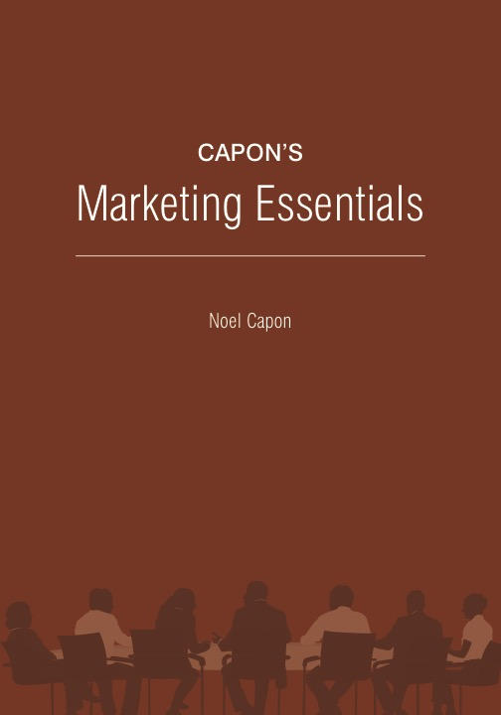
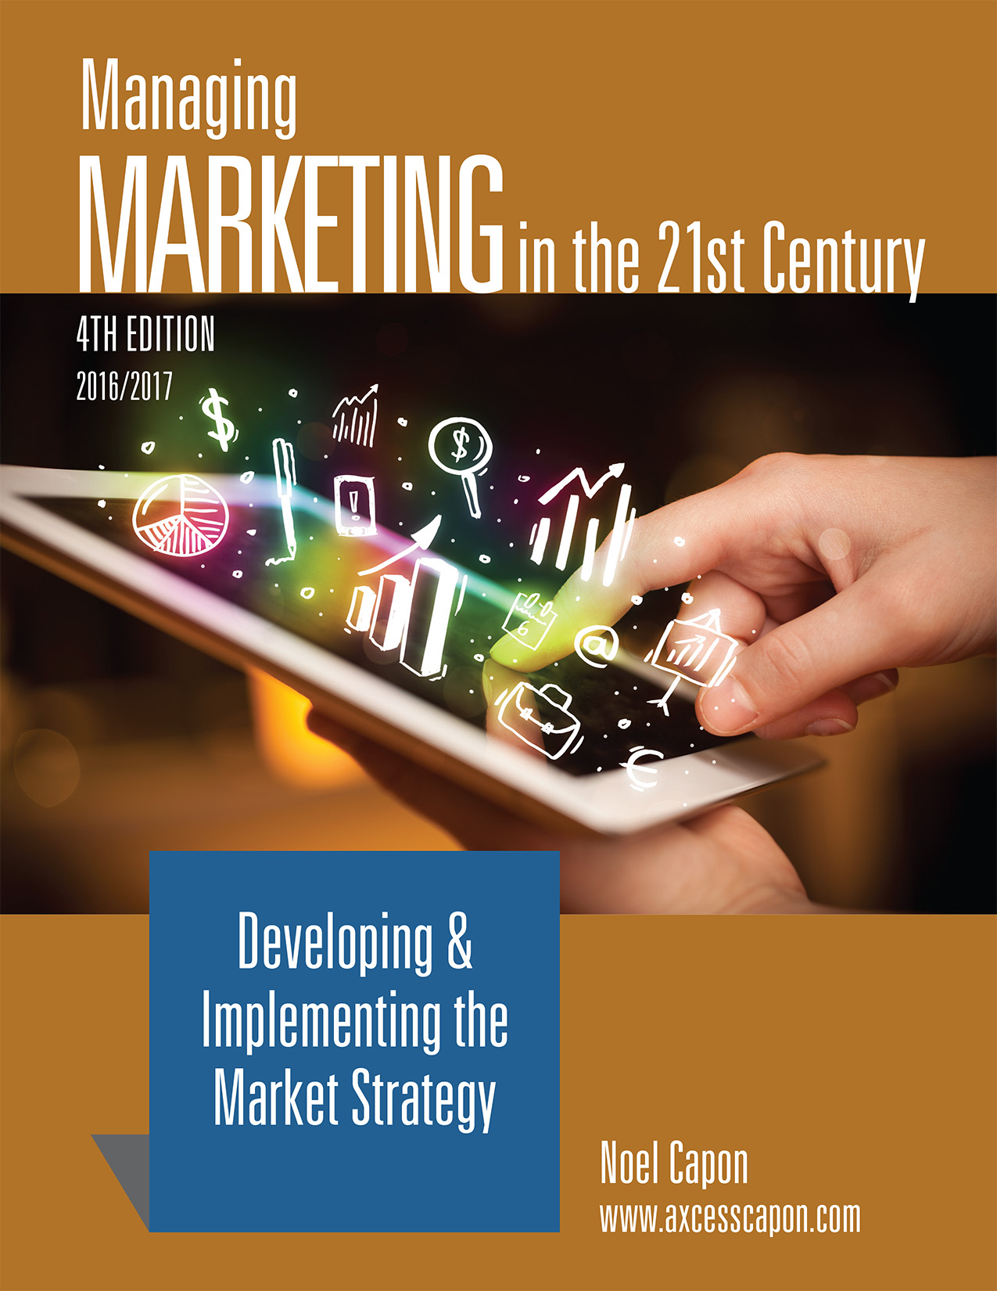



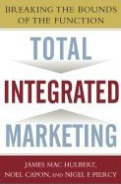
www.wessexlearning.com
Managing Markets Strategically
Professor Noel Capon
R.C. Kopf Professor of International Marketing
Columbia Business School
New York, NY

Slide 2
Managing Markets Strategically
www.wessexlearning.com
Section 1: Marketing and the Firm
Section 2: Fundamental Insights for Strategic Marketing
Section 3: Strategic Marketing
Chapter 6: Identifying, Choosing Opportunities
Chapter 7: Market Segmentation, Targeting
Chapter 8: Market Strategy – Integrating Firm Efforts
for Marketing Success
Chapter 9: Managing through the Life Cycle
Chapter 10: Managing Brands
Section 4: Implementing the Market Strategy

Slide 3
www.wessexlearning.com
Chapter 8
Market Strategy –
Integrating Firm Efforts
for Marketing Success

Slide 4
The Fundamental Business Model
www.wessexlearning.com
Shareholder Value
Organizational Survival, Growth
Current, Potential Profits
Competitors
Attract, Retain, Grow Customers
Competitors
Customer Value
Company

Slide 5
Six Marketing Imperatives
www.wessexlearning.com
• Imperative 1: Determine, recommend which markets to address
• Imperative 2: Identify, target market segments
• Imperative 3: Set strategic direction, positioning
• Imperative 4: Design the market offer
• Imperative 5: Secure support from other functions
• Imperative 6: Monitor, control execution/performance

Slide 6
Chapter Roadmap
www.wessexlearning.com
1. The Purpose of Market and Market-Segment Strategies | 2. Elements of the Market-Segment Strategy | 3. Performance Objectives
Provide strategic direction in the market Secure differential advantage Guide effective allocation of scarce resources Achieve cross-functional integration |  | Strategic objectives Operational objectives Setting performance objectives
4. Strategic Focus | 5. Positioning | 6. Implementation Programs
Increase unit sales – Branch A Improve margins and investment returns – Branch B Choosing a strategic focus: Increase unit sales? Improve margins and investment returns? | Select customer targets Frame competitor targets Design the value proposition Articulate reasons to believe Developing positioning statements | Implementing the marketing mix Aligning cross-functional support
7. Managing Multisegment Strategies

Slide 7
Market Strategy
www.wessexlearning.com
Session Roadmap
• Purpose of a market strategy
• Market strategy: market segment strategies
• Performance objectives
• Core strategy
• Implementation programs
• Market strategy: multisegment strategies

Slide 8
Market Strategy
www.wessexlearning.com
Session Roadmap
• Purpose of a market strategy
• Market strategy: market segment strategies
• Performance objectives
• Core strategy
• Implementation programs
• Market strategy: multisegment strategies

Slide 9
Purpose of a Market Strategy
www.wessexlearning.com
Secure Differential Advantage
Guide Effective Allocation of Scare Resources
Market
Strategy
Provide Strategic Direction
Achieve Cross-Functional Integration

Slide 10
Purpose of a Market Strategy
www.wessexlearning.com
Securing Differential Advantage
• What competitors cannot do.
• What competitors will not do.
• What competitors will be at a disadvantage if they do.
• Both the firm and competitors will benefit.

Slide 11
Purpose of a Market Strategy
www.wessexlearning.com
Secure Differential Advantage
Guide Effective Allocation of Scare Resources
Market
Strategy
Provide Strategic Direction
Achieve Cross-Functional Integration

Slide 12
Purpose of a Market Strategy
www.wessexlearning.com
Secure Differential Advantage
Guide Effective Allocation of Scare Resources
Market
Strategy
Provide Strategic Direction
Achieve Cross-Functional Integration

Slide 13
Purpose of a Market Strategy
www.wessexlearning.com
Achieve Cross-Functional Integration
R&D
Sales
Operations
Market
Strategy
Legal
Human
Resources
Finance

Slide 14
Purpose of a Market Strategy
www.wessexlearning.com
Class Discussion
What are the critical elements in Uber’s market strategy?

Slide 15
Market Strategy
www.wessexlearning.com
Session Roadmap
• Purpose of a market strategy
• Market strategy: market segment strategies
• Performance objectives
• Core strategy
• Implementation programs
• Market strategy: multisegment strategies

Slide 16
Market Strategy: Market Segment Strategies
www.wessexlearning.com
Marketing Imperative 2
Identify Market Segments
Target Market Segments
selected for effort
Market segment strategy – fundamental market strategy unit

Slide 17
Market Segment Strategy: Central Concepts
www.wessexlearning.com
Identify Market Segments
Desired Results
Core Strategy
Resource Allocation: Broad guidelines
Implementation Programs
Specific Required Actions: external, internal

Slide 18
Market Strategy
www.wessexlearning.com
Session Roadmap
• Purpose of a market strategy
• Market strategy: market segment strategies
• Performance objectives
• Core strategy
• Implementation programs
• Market strategy: multisegment strategies

Slide 19
Market Segment Strategy: Central Concepts
www.wessexlearning.com
Performance Objectives
• Strategic
• Operational
Core Strategy
Resource Allocation: Broad guidelines
Implementation Programs
Specific Required Actions: external, internal

Slide 20
Performance Objectives: Strategic Objectives
www.wessexlearning.com
Management must specify the trade-offs:
Growth, Market Share
Profits
Cash Flow

Slide 21
Performance Objectives: Strategic Objectives
www.wessexlearning.com
Evolution – Strategic objectives evolve over time

Slide 22
Performance Objectives: Set Performance Objectives
www.wessexlearning.com
When evaluating performance objectives, management must specify the trade-offs between three objective types:
Growth and Market Share
Profits
Cash Flow

Slide 23
Performance Objectives: Strategic Objectives
www.wessexlearning.com
• Provide numbers to support strategic objectives
• Specify, quantitatively, how much and by when
Strategic
Operational
Increase market share
…from 18% to 21%
by end 20XY
Primary
While holding
margins on sales
…at the current 20%
level
Secondary

Slide 24
Market Strategy
www.wessexlearning.com
Session Roadmap
• Purpose of a market strategy
• Market strategy: market segment strategies
• Performance objectives
• Core strategy
• Implementation programs
• Market strategy: multisegment strategies

Slide 25
Market Segment Strategy: Central Concepts
www.wessexlearning.com
Performance Objectives
• Strategic
• Operational
Core Strategy
• Strategic focus
• Positioning
Implementation Programs
Specific Required Actions: external, internal

Slide 26
Core Strategy: Strategic Focus
www.wessexlearning.com
Improve Profits and ROI
Increase Unit Sales Volume
Improve Margins &
Investment Returns
Current Revenue Base
New Revenue
Threats
Increase
customer
retention
Attract customers from competitors
Opportunities
Increase
customer use
Secure new business
The firm must make choices among the various branches

Slide 27
Core Strategy: Strategic Focus
www.wessexlearning.com
Improve Profits and ROI
Increase Unit Sales Volume
Improve Margins &
Investment Returns
Current Revenue Base
New Revenue
Increase Revenues
Reduce Costs & Assets
Increase
customer
retention
Attract customers from competitors
Raise
prices
Reduce operating costs
Increase
customer use
Secure new business
Improve the sales mix
Improve asset utilization
Growth
Cash Flow

Slide 28
Core Strategy: Positioning
www.wessexlearning.com
Positioning comprises four key decisions:
Select customer targets
• Customers to target for effort
Frame competitor targets
• Reference for customer targets to assess our offer
Design the value proposition
• Benefits/values we emphasize in communications with customer targets
Articulate reasons to believe
• Why customer targets should believe we can deliver on the value proposition

Slide 29
Core Strategy: Positioning
www.wessexlearning.com
Customer Targets
• Relationship to firm
• direct customers
• indirect customers
• Customer level
• Customer evolution
• Considerations

Slide 30
Core Strategy: Positioning
www.wessexlearning.com
Customer Targets
Subcomponent Manufacturer
Subcomponent Manufacturer
Component Manufacturer
Component Manufacturer
Finished-Goods Manufacturer
Finished-Goods Manufacturer
Distributor
Distributor
Retailer
Retailer
Final Consumer
Final Consumer
Flow of Goods

Slide 31
Core Strategy: Positioning
www.wessexlearning.com
Customer Targets
Push
Pull
Subcomponent Manufacturer
Subcomponent Manufacturer
Component Manufacturer
Component Manufacturer
Finished-Goods Manufacturer
Finished-Goods Manufacturer
Distributor
Distributor
Retailer
Retailer
Final Consumer
Final Consumer
Flow of Goods

Slide 32
Core Strategy: Positioning
www.wessexlearning.com
Customer Targets
• Relationship to firm
• Customer level
• macro customers
• micro customers – function, position, role, individual
• Customer evolution
• current customers
• potential customers
• Considerations
• reachability
• obvious versus creative
• influentials
• personally benefits but does not pay
A customer is any person or organization, in the chain of distribution or decision, who can identify your offer by company or brand name

Slide 33
Core Strategy: Positioning
www.wessexlearning.com
Competitor Targets
Suppliers
Current Direct
Competitors
New Direct Entrants
Indirect Competitors
The Firm
Buyers

Slide 34
Core Strategy: Positioning
www.wessexlearning.com
Framing Competitor Targets: Illustrations
• “Pepsi Cola is better than Coca Cola”
• “Pepsi Cola is the best cola”
• “Pepsi Cola is the best soft drink”
• “If you’re thirsty, drink Pepsi Cola”

Slide 35
Core Strategy: Positioning
www.wessexlearning.com
Value Proposition
• The heart of positioning
• Defines how the firm secures customers and defeats competitors
Psychological
Functional
Economic

Slide 36
Core Strategy: Positioning
www.wessexlearning.com
Positioning elements are interrelated
Supply-Chain Competitors
Consumers/End Users
Intermediaries/
Original Equipment Manufacturers
Direct Competitors
Indirect Competitors
Select
Customer Targets
Frame Competitor Targets
Positioning
Design the
Value Proposition
Articulate Reasons to Believe
Functional Value
Psychological Value
Economic Value

Slide 37
Core Strategy: Positioning
www.wessexlearning.com
Reasons to believe:
• Supporting evidence
• Why customer targets should believe we can deliver on the value proposition
Select
Customer Targets
Frame Competitor Targets
Positioning
Design the
Value Proposition
Articulate Reasons to Believe

Slide 38
Core Strategy: Positioning
www.wessexlearning.com
Class Recap
Question Answer
Who to Convince? customer targets
In the context of other alternatives? competitor targets
They will receive those benefits/values? value proposition
Because we have these capabilities? reasons to believe

Slide 39
Core Strategy: Positioning
www.wessexlearning.com
Illustration: Cemex
Customer targets Site managers
Project investors
Competitor targets Traditional cement producers
Value proposition Site managers: consistent delivery within 30 minutes of CEMEX receiving an order (versus the 3-hour standard)
Project investors: project completed 3 months sooner: additional rental revenues earned = $20 million; profits = $5 million
Reason to believe A global positioning satellite system on each truck and computer software that combines truck positions with plant output and customer orders to calculate optimal destinations and make en route redirections

Slide 40
Market Strategy
www.wessexlearning.com
Session Roadmap
• Purpose of a market strategy
• Market strategy: market segment strategies
• Performance objectives
• Core strategy
• Implementation programs
• Market strategy: multisegment strategies

Slide 41
Market Segment Strategy: Central Concepts
www.wessexlearning.com
Performance Objectives
• Strategic
• Operational
Core Strategy
• Strategic focus
• Positioning
Implementation Programs
• Marketing mix
• Functional support

Slide 42
Implementation Programs: Marketing Mix
www.wessexlearning.com
Develop detailed implications for all marketing activities
Price
Advertising
Service
Sales
Distribution
Promotion
Value Proposition
Market Research
Product
Operations
Purchasing
R&D
Finance
Technical Services
Human Resources
Legal
Logistics

Slide 43



Implementation Programs: Marketing Mix
www.wessexlearning.com
Waterford Crystal

Slide 44

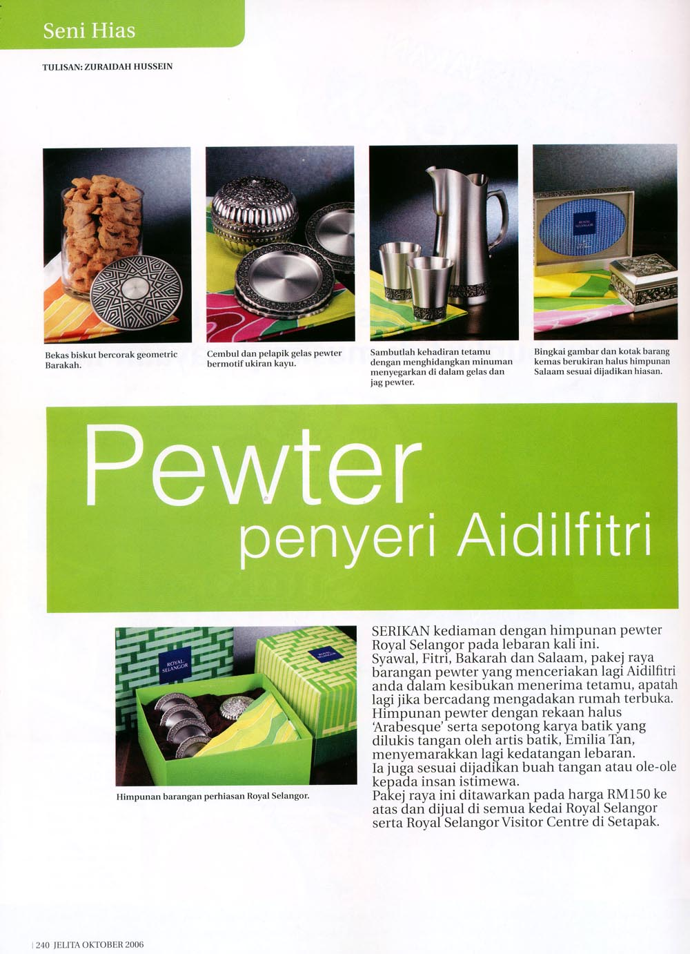


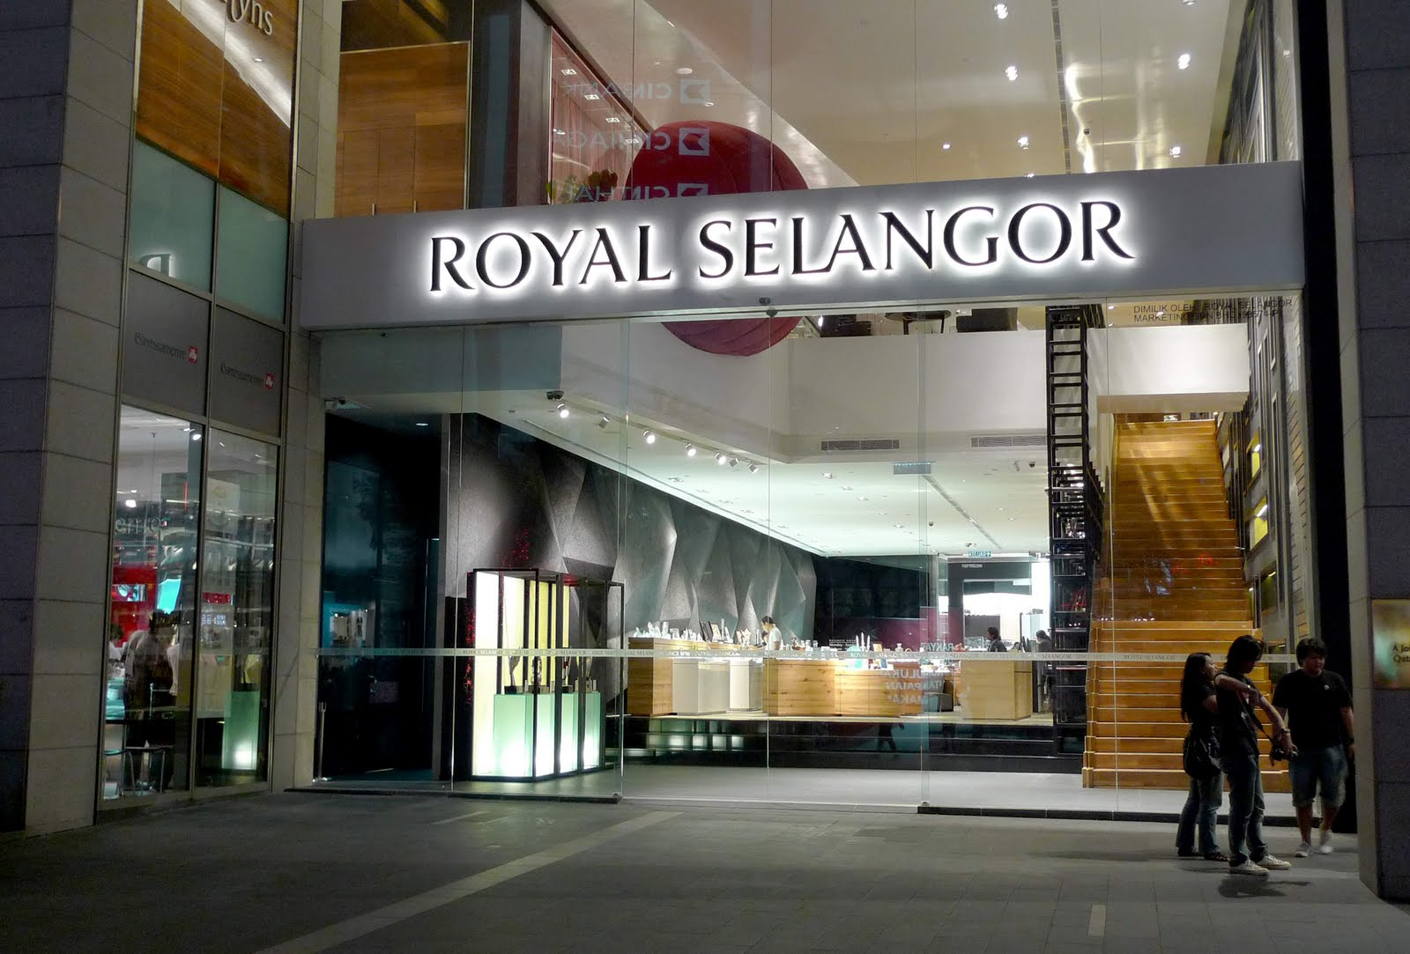
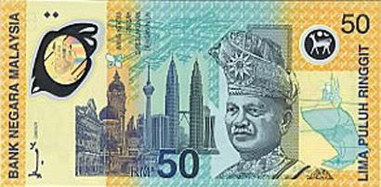

Implementation Programs: Marketing Mix
www.wessexlearning.com
Royal Selangor Pewter

Slide 45
Implementation Programs: Marketing Mix
www.wessexlearning.com
Develop detailed implications for all functional activities
Price
Advertising
Service
Sales
Distribution
Promotion
Value Proposition
Market Research
Product
Operations
Purchasing
R&D
Finance
Technical Services
Human Resources
Legal
Logistics

Slide 46
Market Segment Strategy: Central Concepts
www.wessexlearning.com
Performance Objectives
• Strategic
• Operational
Core Strategy
• Strategic focus
• Positioning
Implementation Programs
• Marketing mix
• Functional support

Slide 47
Market Strategy
www.wessexlearning.com
Session Roadmap
• Purpose of a market strategy
• Market strategy: market segment strategies
• Performance objectives
• Core strategy
• Implementation programs
• Market strategy: multisegment strategies

Slide 48
Market Strategy: Multisegment Strategies
www.wessexlearning.com
Firms often target multiple segments simultaneously
Relationship among market segment strategies
• Independence – approach each segment independently
• Positive synergies – firm effectiveness improves with additional segments
2 + 2 = 5
• Negative synergies – firm effectiveness reduced with additional segments
2 + 2 = 3

Slide 49
Market Strategy: Multisegment Strategies
www.wessexlearning.com
Marketing Mix Element | Potential Problem | Possible Solution
Product | Increased production costs, increased inventory costs, delivery delays | Modular design, just-in-time (JIT) assembly
Service | Alienate customers not receiving premium service package | Try to ensure perceived equity, and maintain physical separation where possible
Advertising | Exposure to different appeals | Ensure that appeals do not conflict and that messages across segments are consistent; use specialized media
Sales force | Salespeople ineffective with multiple products and/or in multiple segments | Extra training or develop specialized sales forces
Distribution | Alienate intermediaries | Secure financial-service package for selected intermediaries; consider different brands and packages
Pricing | Trains-shipment – diversion from one segment to another | Manage price differentials, differentiate elements like brand and package

Slide 50
Market Strategy
www.wessexlearning.com
Session Roadmap
• Purpose of a market strategy
• Market strategy: market segment strategies
• Performance objectives
• Core strategy
• Implementation programs
• Market strategy: multisegment strategies

Slide 51

Market Strategy
www.wessexlearning.com
Class Discussion
Local taxi services have suffered as Uber, Lyft, and other P2P services have expanded. What advice can you give local taxi companies after studying this chapter?

Slide 52
www.wessexlearning.com
Chapter 8
Market Strategy –
Integrating Firm Efforts
for Marketing Success

