Slide 2
Taxes, Borrowing, and the National Debt
In this world nothing can be said to be certain, except death and taxes.
— Benjamin Franklin (1706–1790), Complete Works, 1887–1888

Slide 3
Taxes, Borrowing, and the National Debt
One of the most obvious ways the government acquires revenue is through taxes
By taxing the public (individual income earners, property owners, businesses, consumers), the government acquires a large portion of the expenditure dollars it needs
Social and poverty programs, control over pollution and big business, assurance of equal opportunity, agricultural programs, crime control, efforts to increase aggregate demand and stabilize the economy
Recently increased military spending, large increases in spending in terms of stimulus money to expand our economy
Other means of government spending is by government borrowing – issues government securities (bonds and treasury bills)
Government security is really just an I.O.U. – a piece of paper saying it has borrowed money, promises to repay it (plus interest) at some future point
Government sells these pieces of papers to banks, corporations, foreigners, ordinary citizens

Slide 4
Government Taxes
Federal Taxes
The federal personal income tax
Payroll taxes
The corporate income tax
Miscellaneous taxes: excise and state taxes

Slide 5
Government Taxes

Slide 6
Government Taxes
Federal Taxes
The federal personal income tax
Roughly 47 percent of total federal income tax revenue
Placed on most forms of individual income
Taxable income called the tax base – the value of income, earnings, property, sales, other valued items to which a tax rate is applied (in the case of personal income tax, the tax base is incremental income)
Tax rate – the percentage of the tax base that is paid to the government as tax
Marginal tax rates – the percentage of incremental income falling within each of several tax brackets that is paid to the government as tax

Slide 7
Government Taxes
Federal Taxes
The federal personal income tax
Exemptions – amounts of money for each household member that can be deducted from household income before personal income tax rates are applied
Standard deduction – a fixed amount of money that taxpayers can deduct from their taxable income when calculating their personal income taxes, if other deductions not claimed
Tax credits – amounts of money by which income taxes payable to the government can be directly reduced – person or business must meet certain criteria to be eligible for a credit

Slide 8
Government Taxes
Federal Taxes
The federal personal income tax
Earned Income Tax Credit (EITC) – a federal tax credit for low-income working individuals and families – state governments may also utilize an EITC for their personal income taxes
Refundable – a refund is available even if an income earner does not pay taxes or pays only small amounts – as long as he or she files a tax form
Dividends – profits from the ownership of stock
Capital gains – the net income received when an asset is bought at a particular price and sold at a a higher price

Slide 9
Government Taxes
Federal Taxes
Payroll taxes
Taxes based on earnings from work and usually deducted directly from the paycheck
The second largest federal category of taxes for social insurance programs – Social Security and Medicare
The corporate income tax
Brings in about nine percent of total federal tax revenue – a net income tax because it taxes business income minus expenses (i.e. profits)

Slide 10
Government Taxes
Federal Taxes
Miscellaneous taxes: excise and estate taxes
Miscellaneous taxes category represents about nine percent of total federal tax revenue
Excise taxes – taxes applied to the purchase of specific goods or services
Estate taxes – taxes on highly valued estates as they are passed down as inheritances
Applies to assets such as homes, cash, stocks, etc.

Slide 11
Government Taxes
State and Local Taxes
Property tax – 31%
Sales tax – 23%
Income tax – 23%
Corporate tax – 4%
Other taxes – 19%

Slide 12
Government Taxes

Slide 13
Government Taxes
State and Local Taxes
Property tax primarily used by local governments – levied directly on owners of buildings and land, depend on property value
portion of property tax passed from owner to renter
Property taxes used to fund local public schools
Sales taxes levied on goods and services sold within the state, locality, or both – some states exempt certain items (medicine, food), others do not
Most states have a personal income tax – vary in significance by state (some with different tax brackets, others with one tax rate that applies to all – a flat-rate tax)
Other taxes include excise taxes, various fees and penalties

Slide 14
Government Taxes
Effects of Taxes on the Macroeconomy
Increased government spending
Increase in aggregate demand
Increase in taxes – less after-tax income to spend
Consumption spending goes down
Aggregate demand decreases
Combined effect
A small net increase in aggregate demand
Small expansion in the economy – appropriate if operating at a high level of capacity

Slide 15
Government Taxes

Slide 16
Government Taxes
The Effects of Taxes on Income Distribution
Progressive tax – takes a greater percentage of income from high-income people than from low-income people
Example: rate structure of the federal personal income tax
Proportional tax – takes the same percentage of income from people of all income levels
Example: flat rate personal income tax
Regressive tax – takes a greater percentage of income from low-income people than from high-income people
Sales taxes, most excise taxes, property taxes, Social Security tax

Slide 17
Government Taxes

Slide 18
Government Taxes

Slide 19
Government Taxes
Effects of Taxes on the Microeconomy of Individual Markets
Excise tax – new equilibrium (lower quantity, higher price)
Influences consumer behavior – encourages reduced consumption
Good source of government tax revenue
Burden of the tax – the impact of the excise tax that is felt by producers and consumers
Producers – lower profits
Consumers – higher prices paid for the product
Generally, consumers bear a large share of the burden of the gasoline excise tax

Slide 20
Government Taxes

Slide 21
Government Taxes
Effects of Taxes on the Microeconomy of Individual Markets
Property tax – new equilibrium (lower quantity, higher rent)
Burden of the tax – both
Portion of property taxes passed along to renters

Slide 22
Government Taxes

Slide 23
Government Taxes
The 2017 Tax Bill
Tax Cuts and Jobs Act (TCJA) passed by Congress in December 2017
Approved on an entirely partisan basis
Trump, 227 Republican members of the House of Representatives, 51 Republican members of the Senate
Opposed by 191 House Democrats, 48 Democratic Senators

Slide 24
Government Taxes
The 2017 Tax Bill
Features of the tax bill
Altered most of the marginal tax rates and tax brackets as of 2017. Other changes include
Elimination of personal exemptions
Roughly doubling of the standard deduction
Expansion of the child tax credit from $1,000 per child to $2,000
Limit on the total of deductions of state and local taxes to a maximum of $10,000
Limit on the deduction of interest on the first $750,000 of a new mortgage for a first or second home
Increase in the minimum value of estates subject to estate tax from $11.2 million to $22.4 million for married couples

Slide 25
Government Taxes
The 2017 Tax Bill
Features of the tax bill (continued)
Reduction in the maximum corporate tax rate from 35 percent to 21 percent
Elimination of the alternative minimum tax
Reduction in the individual income tax rates applied to pass-through businesses along with a 20 percent deduction on this income before the tax rates take effect
Reductions in the corporate tax rates intended to be permanent
Reductions in the personal income tax cuts are temporary

Slide 26
Government Taxes

Slide 27
Government Taxes
The 2017 Tax Bill
Controversy over the impact of the tax bill
Most controversy centered on the impact of the bill on income distribution and on the national debt
The largest absolute amounts of tax reductions are far higher for higher income people than lower income people
Distributional effect – benefits highly skewed towards the rich
Macroeconomic impact – GDP expected to increase by 0.8% in 2018, no further impact expected by 2025
The bill is expected to increase the national debt by $1.5 trillion (5.5% of GDP) over the next ten years

Slide 28
Government Taxes

Slide 29
Government Taxes
Global Comparisons in Taxes
Except for Canada, the United States has the lowest maximum tax rate among countries of the Western industrialized world – 37%
Most countries have maximum tax rates in the 40s to 50s
Highest marginal tax rates – Sweden (57%), Denmark (56%), Austria (55%)
These high tax rates enable widespread social programs

Slide 30
Government Taxes

Slide 31
Government Borrowing
The government issues securities
Anyone can purchase a government security
At some point in the future, the purchaser will receive the money back (plus interest)
Government spending financed by borrowing – expands the economy more than government spending financed through increased taxes

Slide 32
Government Borrowing
Effects of Government Borrowing on the Macroeconomy
Increased spending through borrowing – aggregate demand curve shifts forward
Increased spending through taxes – aggregate demand curve shifts backwards, very little expansion of the economy

Slide 33
Government Borrowing
Effects of Government Borrowing on Income Distribution
Bond owners – middle- or upper-income people
Repaid from additional borrowing, or taxes
If repaid from taxes – more income inequality
Low-income people bear a greater burden of tax payments
High-income people receive a greater benefit – interest income on bonds and other securities
Income distribution occurs from the poor to the rich – exacerbated by the 2017 tax bill

Slide 34
Government Borrowing
Effects of Government Borrowing on the Government Budget and the National Debt
Budget deficit – the difference between federal government spending and federal government tax revenue in any one year
Budget surplus – the difference between federal government tax revenue and federal government spending in any one year

Slide 35
The National Debt
The total amount of money owed by the federal government
Represents the accumulation of all funds borrowed by the federal government that have not yet been repaid
The government can continue to borrow indefinitely
With no limit on borrowing, the government can continually “roll over” its debt – can continue to borrow money to repay previously borrowed money

Slide 36
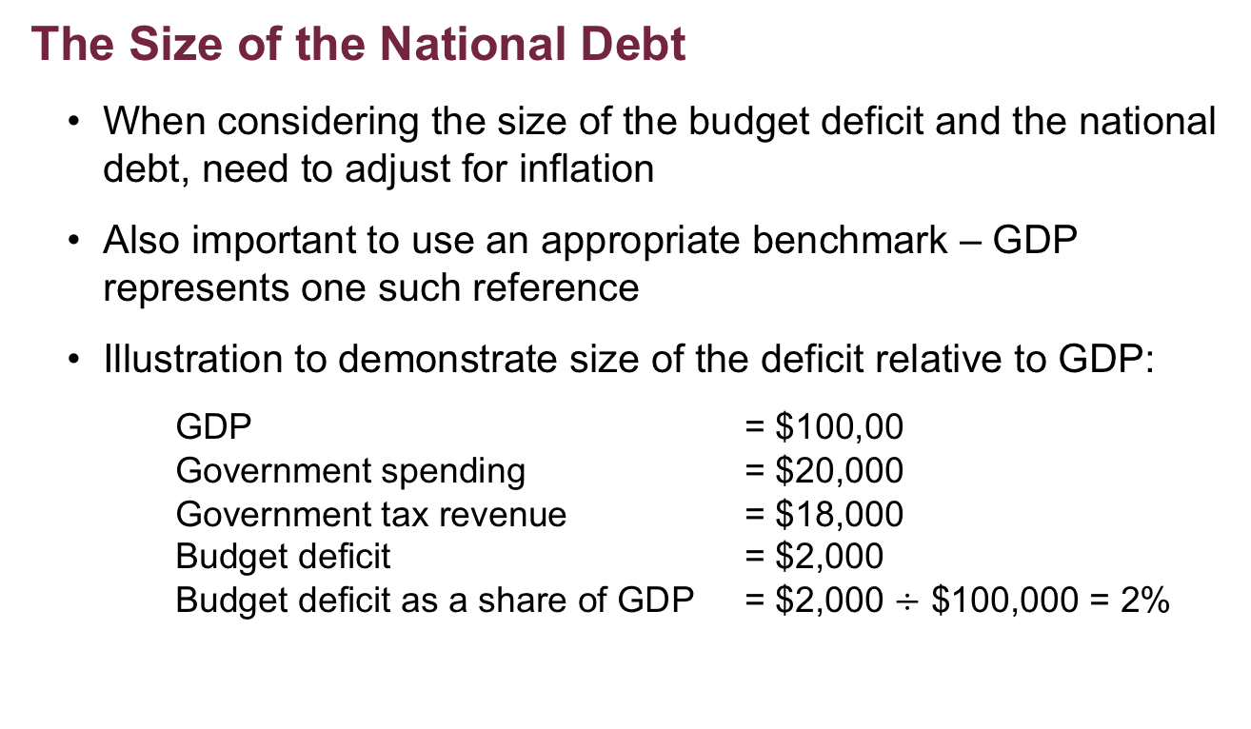
The National Debt
The Size of the National Debt
When considering the size of the budget deficit and the national debt, need to adjust for inflation
Also important to use an appropriate benchmark – GDP represents one such reference
Illustration to demonstrate size of the deficit relative to GDP:
GDP = $100,00
Government spending = $20,000
Government tax revenue = $18,000
Budget deficit = $2,000
Budget deficit as a share of GDP = $2,000 $÷$ $100,000 = 2%

Slide 37
The National Debt

Slide 38
The National Debt
The Size of the National Debt
Size of the national debt relative to GDP (the data):
1940: 53 percent
1946: 122 percent – huge government spending during WWII
1980 – quite low
Has increased steadily up to the present – due to cuts in taxes and increased spending on military and homeland defense, Social Security

Slide 39
The National Debt
Who Owns the National Debt
Buyers of government securities
Just over 26 percent owed to different levels and agencies of government
An additional 26 percent owed to businesses, financial institutions, U.S. persons
Much of this owed to Social Security trust funds and private pensions
Foreigners represent just over 46 percent of the national debt

Slide 40
The National Debt

Slide 41
The National Debt
Who Owns the National Debt
The impact of the national debt
Negative effects
Unequal income distribution, rising interest rates
Interest payments made to foreign people of concern – represent a real transfer of interest out of the U.S.
Potential burden passed on to our children – taxes on future generations to make interest payments to current owners of government securities
Especially onerous as deficits reach high levels

Slide 42
The National Debt
Who Owns the National Debt
The impact of the national debt
Positive consequences
Enables the government to expand the economy as needed
To make expenditures that can specifically benefit our society
Whether these benefits in the present (Social Security, poverty reduction) or in the future (health and education), the benefits accrue to our nation

Slide 43
Proposals to Require a Balanced Budget
Disallow any government borrowing – no addition to the national debt
All government expenditures must be financed by tax revenue
Government spending increase must be matched by an increase in tax revenue
Problems – too many variables unknown
National emergency – flooding, hurricane destruction
War – military spending
Recession – requires lower taxes and/or increased spending
Recession – loss of jobs, loss of income (less taxes paid), increase government spending (unemployment benefits)

Slide 44
Conservative versus Liberal
Conservatives
Favor reductions in government taxes – prefer to see income remain in the hands of the private economy
Worry about the effect of various taxes on incentives
Support excise taxes – if they encourage conservation
High levels of government spending financed by borrowing – increases in interest rates will crowd out private spending
Favor balanced budget
Tax cuts – force cuts in government entitlements
Liberals
Comfortable with government taxes and spending as long as the taxes do not heavily burden the poor and the middle class
Like to use tax credits to support worthwhile activity – spending on higher education, care of the elderly
Support excise taxes – if they encourage conservation, concerned about regressive taxes
Less concerned about budget deficits

Slide 45
Appendix 16–1: The Impact of Excise Taxes with Perfectly Inelastic Demand and Supply
Perfectly inelastic demand – demand in which buyers are completely unresponsive to changes in price
Excise tax
Decrease in supply
Higher price
No change in quantity
Consumers – larger tax burden

Slide 46
Appendix 16–1: The Impact of Excise Taxes with Perfectly Inelastic Demand and Supply

Slide 47
Appendix 16–1: The Impact of Excise Taxes with Perfectly Inelastic Demand and Supply
Perfectly inelastic supply – supply in which producers are completely unresponsive to changes in price
Excise tax
Cannot change the supply
No change in price
No change in quantity
Producers – entire tax burden

Slide 48
Appendix 16–1: The Impact of Excise Taxes with Perfectly Inelastic Demand and Supply

Slide 49
Appendix 16–1: The Impact of Excise Taxes with Perfectly Inelastic Demand and Supply
Greater tax burden
The group that is more unresponsive (inelastic) to price changes
Increase in production costs
Because of excise taxes, government regulations for safety or pollution standards, increased energy prices, etc.
Decrease in supply
The more inelastic the demand, the more the increased cost will be passed on to consumers (higher prices)
The more inelastic the supply, the more the cost will be borne by producers (lower profits)

Slide 50
Appendix 16–2: The Effect of Government Borrowing on Interest Rates
Interest rate – the percentage of borrowed funds that must be paid to the lender/investor for the privilege of using the funds
Loanable funds – money that is borrowed or lent
Demand curve for loanable funds – all who wish to borrow money
Businesses, individuals, government
Downward sloping – more willing and able to borrow money at low interest rates than at high interest rates
Supply curve for loanable funds – all who wish to lend money
Commercial banks, credit unions
Individuals with savings accounts (lending to banks), who purchase government securities (lending to the government)
Upward sloping – more willing to lend at higher interest rates

Slide 51
Appendix 16–2: The Effect of Government Borrowing on Interest Rates

Slide 52
Appendix 16–2: The Effect of Government Borrowing on Interest Rates
More borrowing – issuing government securities
Increased demand for loanable funds – higher quantity of funds borrowed and lent, higher interest rate
Crowding out – a situation in which increased government spending, financed by borrowing, causes interest rates to rise
Results in less spending by the economy
Never complete in the short run
Monetary policy can be used to control rising interest rates
In an overheated economy
A simultaneous expansionary fiscal policy (increase in government purchases) and expansionary monetary policy
Will probably cause an overexpansion of the economy and a threat of inflation

