Slide 1
Forecasting, the Why and the How
Chapter 1

Slide 2
Note to the Instructor
These slides aim to aid the instructor and are not intended to provide a complete presentation for all aspects of the book. However, we believe they do capture most of the important pedagogical questions that the instructor would aim to cover. If we have missed some aspects that need further explanation, or if you think that the format of any slide could be improved, please contact us with your suggestions or send us your improved versions of the content.
We look forward to receiving your views on how this material can be improved.
Keith Ord, Robert Fildes, & Nikos Kourentzes
August 2017

Slide 3
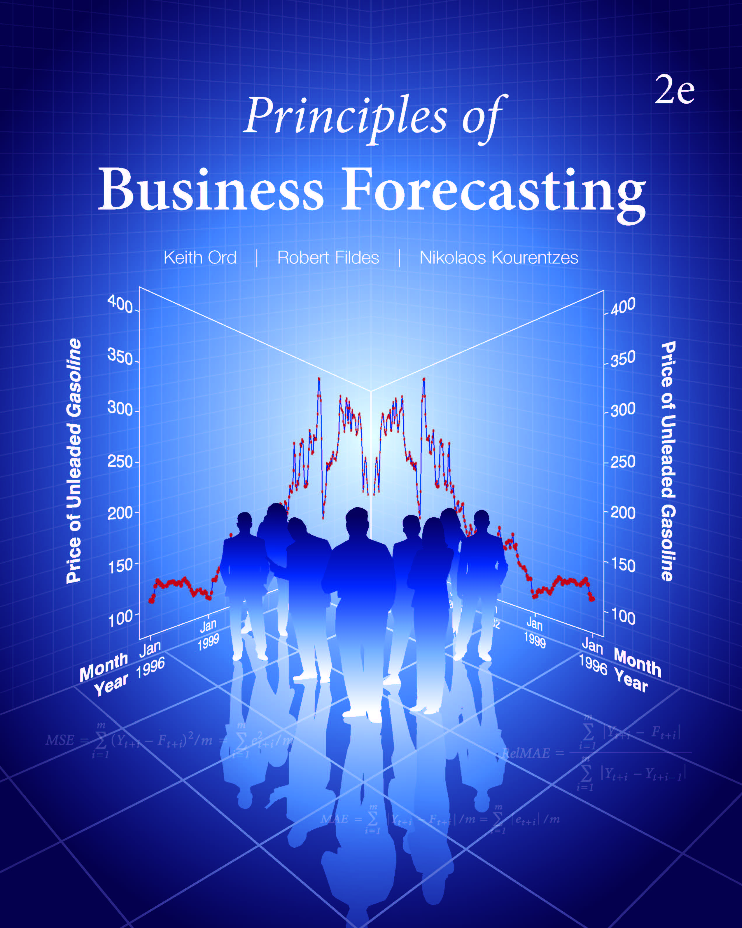
Chapter 1: Forecasting, the Why and the How
1.1 Why Forecast?
1.2 What and Why Do Organizations Forecast?
1.3 Examples of Forecasting Problems
1.4 How to Forecast
1.5 Forecasting Step by Step
1.6 Computer Packages for Forecasting
1.7 Data Sources
1.8 The Rest of the Book

Slide 4
Introduction
Forecast
Forecast is a prediction or estimate of an actual outcome expected in a future time period or for another situation.
The purpose of forecasting is to inform the process of planning.
The purpose of planning is to develop a course of action so that things don’t “just continue” based on a no-change forecast.

Slide 5
Discussion Question
Forecasts can be found everywhere!
What forecasts are regularly included in the daily newspapers, such as the Wall Street Journal, the New York Times, or the Times of London?

Slide 6
1.1 Why Forecast?
PIVASE
Purpose: What do we hope to achieve by generating the forecast? That is, what plans are dependent upon the results of the forecasting exercise? How far ahead do we wish to forecast? We refer to this period as the forecasting horizon.
Information: What do we know that may help us in forecasting. And when will we know it? Detailed data is only useful if it is available in timely fashion.
Value: How valuable is the forecast? What would you pay to have perfect knowledge of the future event?
Analysis: From analyzing the data can we develop a model that captures its characteristics? And how does it perform on new (hold-out sample) data?
System: What system of forecasts (models) and software is needed to meet the needs of the organization?
Evaluation: How do we know whether a particular forecasting exercise was effective and what the potential is for improvement?

Slide 7
1.1 Why Forecast?
Too few companies evaluate and monitor performance!
Table 1.1 Percentages of Respondents Who Regularly Monitor
Forecasting Performance

Slide 8
1.2 What and Why Do Organizations Forecast?
Brainstorm
What do organizations need to forecast?
What are the “tough?” problems?
Forecasts
Plans

Slide 9
1.2 What and Why Do Organizations Forecast?
Costs
raw materials
semi-finished goods
wage rates & overheads
interest rates
Sales/Activities
by industry
by region
by market/product (market share)
by product category, wholesaler, retailer
new product sales
competitive position —
e.g., prices, exchange rates
competitive behavior
customer service
prices
competitor activities
Technology
new products
new processes
diffusion rates
Social and Political Trends
demographics
wealth profile
welfare and health provisions
impact of technology
Projects
duration
costs
life cycle maintenance

Slide 10
1.2 What and Why Do Organizations Forecast?
Figure 1.1 An Organization’s Forecasting Needs

Slide 11
Discussion Questions
What might a nuclear electricity supplier or a water company need to forecast with regard to its key assets? Why?
A state or national government provides unemployment benefits for a period of six months following a layoff (or leaving school). It continues for a further six months if the applicant attends a job training program. What variables would the government need to forecast for its annual planning?

Slide 12
1.2 What and Why Do Organizations Forecast?
Forecasting Horizons
Short term
Usually a few days or weeks
Medium term
Usually a few months to 1 or 2 years
Long term
Usually more than 2 years
Depends on the Problem Area
Discussion Questions
What type of organizations have the shortest forecasting horizons?
Which have the longest?

Slide 13
1.2 What and Why Do Organizations Forecast?
Forecasting Problem Structure
Forecasting object
Level of aggravation
For a period, cumulative across periods, growth rate, event
Forecasting horizon
How far into the future?
Forecasting frequency
Yearly ➡ Monthly ➡ Weekly ➡ Daily ➡ Within Day…
Structure derived from decision making process
Forecasts required to support planning and decision making

Slide 14
1.2 What and Why Do Organizations Forecast?
Forecasting Problems
Product A
Product B
For a retailer, many thousand of products
Daily observations of sales
Often with zero sales, missing data

Slide 15
1.3 Examples of Forecasting Problems
Time Series
A time series is a set of observations ordered in time.
The values may refer to either a point in time (the current value of the Dow Jones Index is 22,000) or an aggregate over a period of time (total sales for the last month were 350 units).
Typically, we assume that the observations are equally spaced in time.
  How might we deal with irregular spacing such as stock markets closing at weekends or monthly sales?

Slide 16
1.3 Examples of Forecasting Problems
Figure 1.2 U.S. Monthly Retailers Sales

Slide 17
Time Series
A set of comparable observations ordered in time. The values may refer to either a point in time (“the current value of the Dow Jones Index is 17,000”) or an aggregate over a period of time (“total sales for the last month were 350 units”).
Trend: A time series contains a trend if it shows systematic movements (e.g., increase or decrease) over an extended period.
Seasonality: A time series has a season component if it displays a recurrent pattern with a fixed and known duration (e.g., months of the year, days of the week).
Cycle: A time series has a cyclical component if it displays somewhat regular fluctuations about the trend but those fluctuations have a periodicity of variable and unknown duration, usually longer than one year (e.g., a business cycle).

Slide 18
1.3 Examples of Forecasting Problems
Figure 1.3 Seasonally Adjusted Series for U.S. Monthly Retailers Sales

Slide 19
1.3 Examples of Forecasting Problems
Figure 1.4 Seasonal Factors for U.S. Monthly Retailers Sales

Slide 20
1.3 Examples of Forecasting Problems
Figures 1.5 & 1.6 Year-over-year Change and Percentage Changes in
U.S. Monthly Retail Sales

Slide 21
1.3 Examples of Forecasting Problems
Figure 1.7 Serious Injuries and Deaths on UK Roads,
January 1975–December 1984
Sudden shifts and changes in policy or circumstances
can change the basis for forecasting.

Slide 22
1.3 Examples of Forecasting Problems
Figure 1.8 Monthly U.S. Air Revenue Passenger Miles (billions),
January 2000–December 2015

Slide 23
Discussion Question
How would you estimate the effect of 9/11 (September 11, 2001) upon the airline industry with respect to losses in revenue passenger miles?

Slide 24
1.3 Examples of Forecasting Problems
Figure 1.9 The Record of English Soccer Club Manchester United
During the 2014–215 Premier League Season
[38 games plated, 19 home and 19 away]

Slide 25
Discussion Question
What conclusions can you draw from Figure 1.9 about the strength of the Manchester United team: Overall? Over time? Home and away?

Slide 26
1.3 Examples of Forecasting Problems
Figure 1.10 Scatterplot of Baseball Players’ Salaries Against the
Number of Years Played in the Major Leagues

Slide 27
1.4 How to Forecast
Figure 1.11 A Simplified Methodology Tree for Forecasting

Slide 28
1.5 Forecasting Step by Step
Define the forecasting and planning problem, the forecast horizon and decide the value of better forecasts.
Determine the resources to be devoted to providing the forecasts.
Collect relevant information, whether from a survey, from company records, or from information generated by other agencies (e.g., government).
Conduct an initial analysis of the data.
Select an appropriate forecasting method.
Generate forecasts.
Evaluate the forecasting exercise by checking forecasts against actual outcomes.

Slide 29
1.6 Computer Packages for Forecasting
Almost all statistical packages include routines for regression analysis.
Computer software for time series analysis is more variable.
The book uses a variety of software:
Excel (graphs and macros only)
General purpose statistical programs: Minitab, SAS, and SPSS.
Specialized forecasting software: Forecast Pro.
Specialized econometric software: Eviews and PcGive.
Open-source software: R
A brief summary of the capabilities of the major forecasting packages is provided in online Appendix B.

Slide 30
1.7 Data Sources
The Federal Reserve Bank of St. Louis maintains an extensive database of U.S. and international macroeconomic series. The website is known as FRED (https://research/stlouisfed.org/)
EconStats (http://www.econstats.com/index.htm) contains a large amount of economic and financial data on the United States and on several other countries, including the United Kingdom, China, and Japan.
Data.gov.uk (http://datagov.uk) offers easy-to-access government statistical series for the United Kingdom.
Econdata (http://econdata.net/) contains regional socioeconomic data for the United States.
The Forecasting Principles website (http://www.forecastingprinciples.com/) provides a variety of links to other sources and data sets.

Slide 31
1.8 The Rest of the Book
Chapter 2: An overview of the basic statistical tools used in forecasting
Chapters 3 and 4: Forecasting methods for trends and seasonal patterns in single series
Chapters 5 and 6: Underlying state-space and ARIMA models for single series methods
Chapters 7–9: Regression methods and related model-building approaches for forecasting
Chapter 10: Advanced methods for forecasting
Chapter 11: The use of judgment in creating and adapting forecasts
Chapters 12 and 13: Putting forecasting methods to work and making sure that forecasting is effective in practice

Slide 32
Minicase 1.1 Inventory Planning
The Nuts’n’Bolts hardware store stocks some high-value items and a large number of relatively low-value components. Inventory is reviewed weekly, and orders are placed with suppliers when inventory levels indicate that current levels are “too low.” Most suppliers deliver the low-value items within two weeks; some of the high-value items may take four weeks for delivery. How would you develop a forecasting system to predict the sales of such items at the individual SKU (Stock Keeping Unit) level? How would you use such forecasts to plan future purchases?
Use PIVASE to go through the necessary steps. For purposes of the discussion, assume that any historical data you might need can be made available.

Slide 33
Minicase 1.2 Long-Term Growth
You work for a consulting firm that is bidding on a contract to forecast the growth prospects of an electronics company over the next five years. The company has developed a specialized computer chip that is used in highly sensitive medical equipment and does not anticipate creating any new product lines, although periodic improvements to the chip are anticipated.
Write a short proposal describing how you would develop such forecasts, using PIVASE as a guide. For purposes of the assignment, assume that any historical data you might need can be made available, but describe carefully the nature of the data needed.

Slide 34
Minicase 1.3 Sales Forecasting
A company sells many hundreds of clothing products, historically through mail order and its own high street shops, but increasingly through the Internet. The firm also offers the customer four different purchase schemes, from pay on purchase through payment over different periods (of 6 and 12 months). The final plan allows a postponement of any payment for 12 months.
The firm has to ensure a supply of its advertised products to meet forecast demand. Adequate inventory has consequences for the distribution network. (the products need to be stocked and then shipped.) The retailer also has to decide which customers to target through mailings to stimulate further purchases.
What variables would the company need to forecast? What strategic financial decisions may need to be linked to the various customer purchase plans? Use the PIVASE framework to guide your thinking.

Slide 35
Minicase 1.4 Adjusting for Inflation
The data file for U.S. retail sales (US_retail_sales_2.xlsx) also contains monthly data for the U.S. Consumer Price Index (CPI) (US_CPI_2.xlsx).
Create a series called “real prices” by dividing sales by the CPI; then replicate Figures 1.2, 1.5, and 1.6 for this series.
Compare your results with the three figures provided in the text, commenting on major differences. (Use the same seasonal adjustment factors.)

Slide 36
Take-Aways
Make sure that the forecasting methods used will meet the underlying purpose of the forecasting exercise.
Ensure the method will provide forecasts sufficiently far ahead (the horizon).
Check that the required information will be available at the time the forecasts must be generated.
The resources devoted to the forecasting exercise should be consistent with the value the forecast will provide.
Validate the forecasts (evaluation).

