Slide 1
Advanced Methods of Forecasting
Chapter 10
No matter how advanced your camera you still need to be responsible for getting it to the right place at the right time and pointing it in the right direction to get the photo you want.
— Ken Rockwell, Your Camera Does Not Matter, 2005.

Slide 2
Chapter 10: Advanced Methods of Forecasting
10.1 Predictive Classification
10.2 Classification and Regression Trees
10.3 Logistic Regression
10.4 Neural Network Methods
10.5 Vector Autoregressive (VAR) Models
10.6 Principles: Predictive Classification, Neural Nets, and VAR Modeling
Appendices: Nonstationary Data

Slide 3
10.1 Predictive Classification
What is predictive classification?
Target variable: In predictive classification, the sample of observations (or cases) under analysis can be classified into two or more discrete categories based on the different possible outcomes of the target variable.
Target class: The particular category of interest in a predictive classification study, e.g., the “bads”: defaulters on a loan.
New observation
Class1 Class 2
?
Find examples of predictive classification and the corresponding targets.

Slide 4
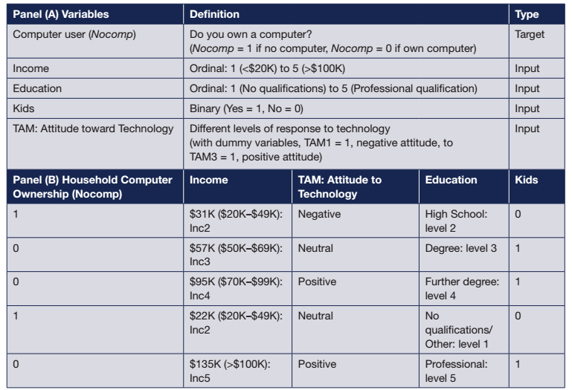
10.1 Predictive Classification
Cross-Sectional Survey Data
Ownership
Income
Education
Kids
etc.
An Example: Predicting Ownership of Computers

Slide 5
10.1 Predictive Classification
A simple predictive model:
Where Y_{t}=1 if the household owns a computer=0 otherwise,
Xs are various explanatory variables, e.g. income.
Split the sample into a training (estimation) sample of 80%; Test Sample – 20% remaining.
Define:
X₁=1 if the household income is level2
X₂=1 if the household income is level3, etc.
Question: There are 5 incoming categories. How many dummy variables do we need?

Slide 6
10.1 Predictive Classification
The results: A model for predicting household ownership of computers depending on income

Slide 7
10.1 Predictive Classification
Evaluating the Accuracy of the Predictions
The classification matrix
 |  | Predicted
 |  | Nontarget Event | Target Event (Nonowner)
Actual | Nontarget = 0 (Owner) | h₀₀ | h₀₁
 | Target = 1 (Nonowner) | h₁₀ | h₁₁
The total sample N = (h₀₀ + h₀₁ + h₁₀ + h₁₁),
A 50 percent threshold, or cutoff, gives
The overall proportion classified as correct is
(Instructor: Complete in class.)

Slide 8
10.1 Predictive Classification
Evaluating the Accuracy of the Predictions
The classification matrix
Target event – households not owning computers as shown:
sensitivity =
measures the proportion of target events that are correctly predicted (i.e., nonowners)
specificity =
measures the proportion of correctly predicted nontarget events

Slide 9
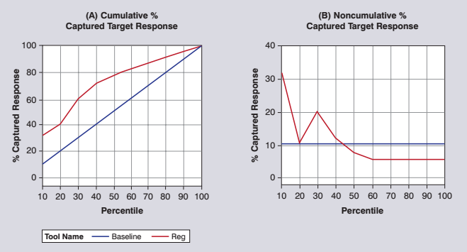
10.1 Predictive Classification
Evaluating the Accuracy of the Predictions
Graphs help interpret the classification accuracy

Slide 10
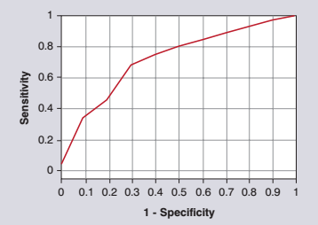
10.1 Predictive Classification
Evaluating the Accuracy of the Predictions
Receiver Operating Characteristic (ROC) Curve
Sensitivity
proportion of target events correctly predicted
Specificity
proportion of nontarget events falsely predicted
Graphs for helping interpret the classification accuracy.
Question: What do you observe?

Slide 11
10.1 Predictive Classification
Evaluating the Accuracy of the Predictions
Using Profit or Loss
P_{G} – profit (loss) from a correct classification of the target
P_{B} – profit (loss) from miss-classifying a non-target as a target
Expected Profit(Cutoff ) = P_{G}h₁₁ + h₀₁P_{B}
Question: For a web-based insurance provider, what costs and profits should be considered in deciding whether to offer a policy to a new customer?

Slide 12
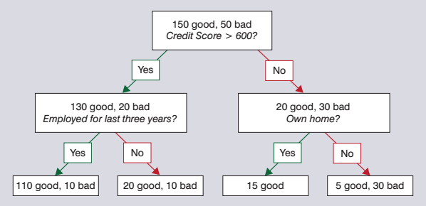
10.2 Classification and Regression Trees
Two leaves recommend granting the loan:
Credit score > 600 and employed
Credit score < 600 and owning home

Slide 13
10.2 Classification and Regression Trees
Performance Measure II
Suppose:
Granting a bad loan costs an average of $10K
Approving a good loan generates $2K
No loans: Total profit = 0
All loans approved: Total profit = ?
Question: Does our classification model help?
Note: different cut-offs or threshold values will give different classification matrices

Slide 14
10.2 Classification and Regression Trees
Performance Measure II
1st level:
Sensitivity = Specificity = Profit =
2nd level:
Sensitivity = Specificity = Profit =
(Instructor to complete)

Slide 15
10.2 Classification and Regression Trees
Algorithms I
CHAID (Chi-squared Automatic Interaction Detection)
At each step, CHAID chooses the independent (predictor) variable that has the strongest interaction [as measured by a chi-squared criterion] with the dependent variable.
Categories of each predictor are merged if they are not significantly different with respect to the dependent variable.
Different software packages have different approaches to operationalizing these steps.

Slide 16
10.2 Classification and Regression Trees
Algorithms II
If a split produces the same proportions of goods and bads it has zero value as a predictor.
No value in split ⇨ No association between predicted and actual.
Expected number of {Good/Good} cases =
Observed value = 110, a difference of 6

Slide 17
10.2 Classification and Regression Trees
Algorithms III
The chi-square statistic is:
If there was no value in the split, this statistic would be small.
A formal chi-squared test at a 1% significance level shows this to be significant (critical value with 1 df, 6.63)

Slide 18
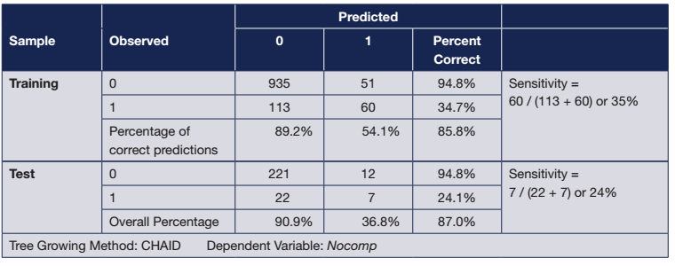
10.2 Classification and Regression Trees
Computer Ownership Revisited
Note: Always examine performance on the test data set
No deterioration here

Slide 19
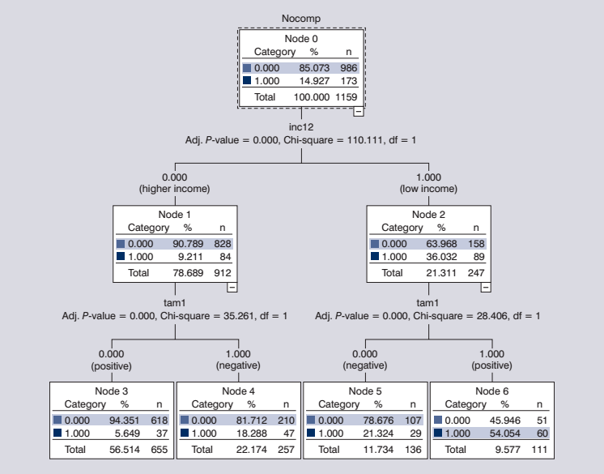
10.2 Classification and Regression Trees
Computer Ownership Revisited

Slide 20
10.3 Logistic Regression
Computer Ownership Example (continued I)
Let P_{i} = Probability that household does not own a computer
Model:
or
where
A linear function of explanatory variables of ownership
Note: Special programs including SPSS and SAS are needed to estimate this. Unlike regression, there is no simple equation for calculating the parameter estimates.

Slide 21
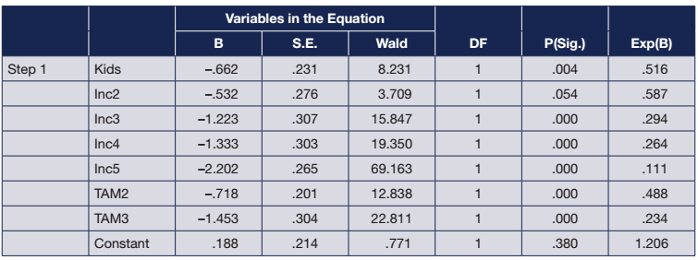
10.3 Logistic Regression
Computer Ownership Example (continued II)
Odds Ratio; last column – Exp(B) measures the proportional increase (decrease) in the odds against ownership, e.g. having kids increases the probability of ownership by 1/(0.516) or 94% relative to not having kids.
Question: Do the parameter estimates make sense?

Slide 22
10.3 Logistic Regression
Two ways of defining the cut-off (threshold) for classification I
The logistic model derives estimated probabilities of non-ownership for each individual in the training or test samples.
To decide whether to predict an individual as a non-owner (or owner) we must specify a cut-off.
Either choose a fixed proportion – say the 50% of sample with highest probability of being in the target (non-ownership) class.
Or
Classify any individual with a prediction higher than some chosen probability, say 0.9.
These give different classification matrices.

Slide 23
10.3 Logistic Regression
Two ways of defining the cut-off (threshold) for classification II
(A) 50% cutoff, with approximately the top 50% predicted to be nonowners
(B) Cutoff value of 0.5, classifying those cases with a predicted probability of nonownership of 0.5 or greater as nonowners
Question: What’s the difference between the two approaches here?

Slide 24
10.3 Logistic Regression
Evaluating a Logistic Regression Model
Examine the p-values of the model to simplify the model.
Don’t drop insignificant dummy variables that define a categorical variable, e.g. income.
Check residuals for outliers.
Focus on the standardized residuals
Consider different specifications comparing their overall fit
Does the model work well across all values of P_{i}?
Does the model add value on the hold-out sample?

Slide 25
10.3 Logistic Regression
Evaluating a Logistic Regression Model
Does the model add value on the hold-out sample?
Issues
Small number in target class
Dealing with more than two categories
Choosing between classification models

Slide 26
Take-Aways from Classification Methods
Consider a variety of different classification methods
Use a variety of error measures to evaluate the methods
In developing classification models, always retain a subset of the data with which to test the effectiveness of the proposed methods
Always compare the new method with a benchmark classification approach
(The Basic Principle of Forecasting)

Slide 27
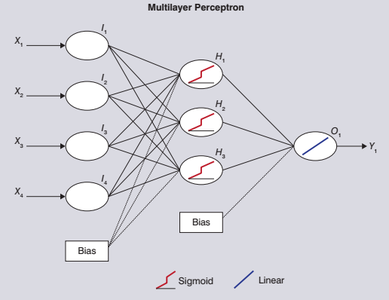
10.4 Neural Network Methods
Hidden layer
3 hidden nodes
Output
Inputs
Explanatory variables
Neural Network: A nonlinear mapping of inputs into output(s)

Slide 28
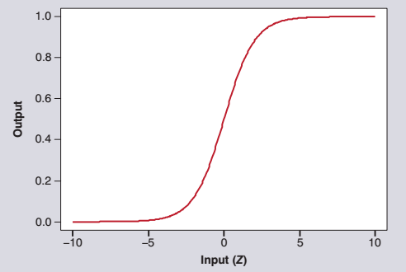
10.4 Neural Network Methods
Sigmoid Logistic Function Hidden Nodes
Saturation part
Nonlinear part
Linear part
Saturation part

Slide 29
10.4 Neural Network Methods
Sample Sets
Estimation set
Used to build a model and find the values of its parameters. Also known as fitting sample or training set.
Validation set
Used to select between different methods (e.g. neural network vs. exponential smoothing) and set hyperparameters (e.g. number of hidden nodes). Together with the estimation set, they constitute the in-sample data.
Hold-out-set
Used to evaluate the forecasts on unseen data. Also known as the test set.

Slide 30
10.4 Neural Network Methods
Modeling Issues
Which inputs to include?
How to setup the network architecture (number of hidden nodes, hidden layers, etc.)?
How to ensure that the network does not overfit?

Slide 31
10.4 Neural Network Methods
Modeling Steps I
Data pre-processing to ensure pre-processed inputs avoid saturation (between 0 & 1)
a and b are the new min and max values.
Divide sample into training and test sets (validation in optional)
Choice of input variables
It is a regression style problem and regression procedures are applicable. However, additional exploration and experimentation to identify nonlinear interactions is needed. Scatterplots are useful!

Slide 32
10.4 Neural Network Methods
Modeling Steps II
Network architecture
Typically a single hidden layer is adequate
Find the number of hidden nodes by experimentation (on the validation set) or combine using ensembles

Slide 33
10.4 Neural Network Methods
Modeling Steps III
Train the network
For forecasting problems we minimize the Sum of Squared Errors (SSE)
For classification problems we can alternatively minimize cross-entropy

Slide 34
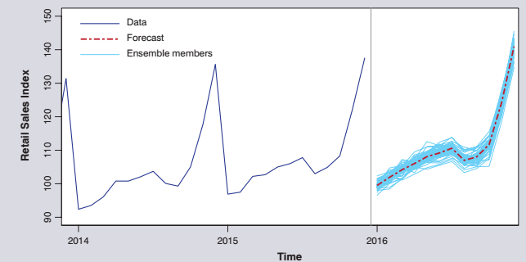
10.4 Neural Network Methods
Modeling Steps IV
Neural network ensembles
To counter overfitting we can combine networks across different training starts (different initial weights)
Or across different architectures and input selections
Use the mean or median prediction as the final forecast

Slide 35
10.4 Neural Network Methods
A cross-sectional NN analysis I
Find architecture
Area Under the Curve (AUC): a metric to summarize ROC

Slide 36
10.4 Neural Network Methods
A cross-sectional NN analysis II
Classification matrices for different cut-offs
Question: Why are the low cut-offs more relevant in this example?

Slide 37
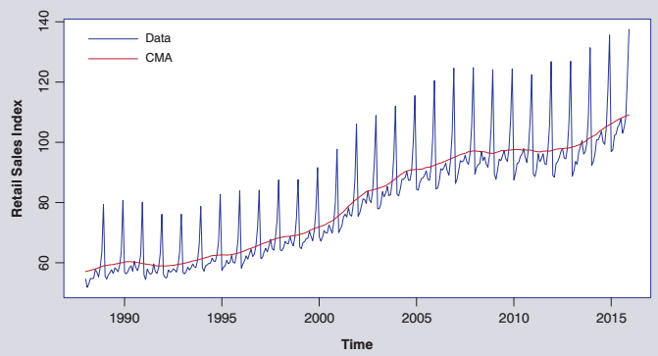
10.4 Neural Network Methods
A time series NN example I
What characteristics can you identify?
What would be good benchmarks?

Slide 38
10.4 Neural Network Methods
A time series NN example II
Data pre-processing. Transform the data.
Jan-88 to Dec-14 in-sample. Last year as test.
Last 20% of in-sample as validation to find hidden nodes.
Use seasonal binary dummies for seasonality.
Use ensemble of 20 nets.

Slide 39
10.4 Neural Network Methods
A time series NN example III
Extreme Learning Machines (ELM): Similar to NNs, but we do not fully train them. Only fit output weights with OLS → Computationally very efficient.
Question: How do you interpret these results?

Slide 40
Take-Aways for Neural Network Modeling
How to get the best out of NN
Scale the data before estimating the neural network model.
Use a variety of random starting values.
Combine them in an ensemble forecast (median is recommended) to avoid overfitting.
Use experimentation (validation or cross-validation) to set hyperparameters (e.g. number of hidden nodes).
And when do they work
Comparative performance with other standard methods
Works well for time series and classification problems.
Very useful when there are nonlinear interactions or for high frequency data.

Slide 41
10.5 Vector Autoregressive (VAR) Models
The simple autoregressive model:
The basic idea:
Vector Variables (Y_{t})=f(lagged variables Y_{t} )

Slide 42
10.5 Vector Autoregressive (VAR) Models
Price of Unleaded Gasoline (Jan 96 to Dec 15)
Question: What variables do you think influence unleaded pump prices?

Slide 43
10.5 Vector Autoregressive (VAR) Models
VAR of Unleaded, Crude, and CPI

Slide 44
10.5 Vector Autoregressive (VAR) Models
Various criteria available
AIC – Akaike’s Information Criterion
SC –Bayesian (Schwarz) Information Criterion (also known as BIC)
Note conflicting conclusions: SC usually points to simpler models, here with 3 lags.

Slide 45
10.5 Vector Autoregressive (VAR) Models
Other VAR modeling issues
Specifying the model: in levels, differences or…advanced alternatives available
Estimating the model
OLS
Producing the forecasts
With only lags they can be produced automatically (as with a simple AR model)
Exogenous variables may be added in
Avoids too many parameters
More intuitive models
But forecasting is conditional on the exogenous variables
Potential problem when data are nonstationary

Slide 46
10.5 Vector Autoregressive (VAR) Models: Example
Out-of-sample: 2014–2015
In-/Out-of-sample differences: effect of financial crisis!
Different metrics provide different answers

Slide 47
Take-Aways for VAR Modeling
Use a VAR model (based on lags), as opposed to single equations based upon concurrent values of the explanatory variables.
Reduce the lag length on each variable separately.
Model the data in levels, rather than differences, initially.
Examine all the model’s variables for potential nonstationarity.
Use theoretical analysis, graphs, autocorrelations, and such to decide whether the variables are nonstationary.
Beware: Relying on tests alone is dangerous because these tests have weak power.
For nonstationary data, develop a constrained model (e.g. an Error Correction Model (ECM) model) and compare it with an unrestricted model and a model in differences.
Instructors note: These points depend on what you’ve taught with regard to modeling nonstationary data.

Slide 48
10.6 Principles I
Classification Methods
Consider a variety of different classification methods.
Use a variety of error measures.
Always retain a test set to evaluate the effectiveness of the proposed methods.
Always compare a proposed new method with a benchmark!
Neural Networks
Scale data before estimating NNs
Train the network multiple times, using a variety of starting values
Use ensemble forecasting to avoid overfitting

Slide 49
10.6 Principles II
VAR Models
Use a VAR model (with lags) instead of a set of single equations.
Reduce the lag length of each variable separately.
Initially model the data in levels, then try differences.
Examine all model’s variables for potential nonstationarity.
For nonstationary data develop Error Correction Model and compare with unrestricted model and a model in differences.

Slide 50
Appendix 10B The Effects of Nonstationary Data
Differenced CPI
Definition: A time series is stationary if the mean, variance, and autocorrelation function are independent of time
If modelling non-stationary series, spurious relationships are too easily identified
Overcome the problem with differencing

Slide 51
Appendix 10B The Effects of Nonstationary Data
One response: model in differences
A model in levels has implications for a model in differences and vice versa.
But a non-stationary variable, unleaded prices cannot be modeled by a stationary variable (CPI) alone and vice versa. The residuals would be autocorrelated.

Slide 52
Appendix 10C Differencing and Unit Roots
We need to identify a nonstationary time series to protect ourselves from ‘spurious regression’
Deciding whether a time series is nonstationary
Look at it
Think about the variable
Test
Augmented Dickey-Fuller test: γ=1 for nonstationarity
Added constant:
Added constant and trend:

Slide 53
Appendix 10C Differencing and Unit Roots
Constant and trend, results from EViews
Rejects the null hypothesis of a unit root
Try the other versions of ADF: evidence of unit root!
Contradictory results: weak discriminatory power of the test.

Slide 54
Appendix 10C Differencing and Unit Roots
What to do?
Do not automatically model in first differences
If variables are stationary. model in levels
Include sufficient lags to remove autocorrelation
If some variables nonstationary, model those in differences – residual autocorrelation: include lags
Compare results of modelling in levels and differences
Which is better & interpretable?

Slide 55
Appendix 10D Introduction to Cointegration
Consider
If X is stationary, Y nonstationary, then ε cannot be!
Similarly, if Y is stationary and X is nonstationary ε cannot be.
Two nonstationary I(1) variables X and Y are said to be cointegrated if {Y-(α+βX)} is stationary.
N.B. An I(1) variable is stationary in its first difference.

Slide 56
Appendix 10D Introduction to Cointegration
An example of cointegrated series

Slide 57
Appendix 10D Introduction to Cointegration
Consider
Or in first differences
Just the first difference model with λ*=1 and
Engle and Granger (1987) showed that where there is a cointegrating relationship between Y and X
Error (or Equilibrium) Correction Model

Slide 58
Appendix 10D Introduction to Cointegration
Why does it matter?
Where a cointegrated relationship is established it is theoretically better to estimate equation 4.
Computer programs will establish whether the relationship(s) exist between the variables.
Programs such as EViews will also estimate the relationship.
But does estimating (4) produce better forecasts?
Question: What’s the difference between equations 2, 3, and 4?

Slide 59
Appendix 10E Modeling with Nonstationary Data
Model selection strategies for nonstationary variables

Slide 60
Appendix 10E Modeling with Nonstationary Data
Based on the empirical evidence,
First test, then deciding on stationarity.
Identify cointegrating restrictions.
Imposing appropriate restrictions should lead to better forecasts.
Compare the restricted model with unconstrained alternative (it’s easy).

Slide 61
Appendix 10E Modeling with Nonstationary Data
Unrestricted model is more accurate, but requires forecasts of CPI and Crude_price for multi-step forecasts!
Model selection matters!

Slide 62
Take-Aways on Modeling Nonstationary Data
Examine series for nonstationarity including testing.
Ensure the equations in levels and differences ‘balance’.
Consider imposing constraints, e.g. differences, error (equilibrium) correction.
Only impose constraints if they are compatible with the data.
Compare results from alternative specifications.

Slide 63
Minicase 10.1 KMI BioPharma, Inc.: Biocide
A new industrial product – how to market the product successfully
Market research data on customer responses
Does the market segment?
Data in Biocide.xlsx
Is a segmentation strategy likely to be successful
A logistic regression can predict potential purchasers
The brief:
To prepare a management report to justify any proposed segmentation strategy
To identify additional analyses that need to be carried out

