Slide 1
Judgment-Based Forecasting
Chapter 11
They couldn’t hit an elephant at this dist…
— Last words of General John B. Sedgwick at the Battle of Spotsylvania, 1864.

Slide 2
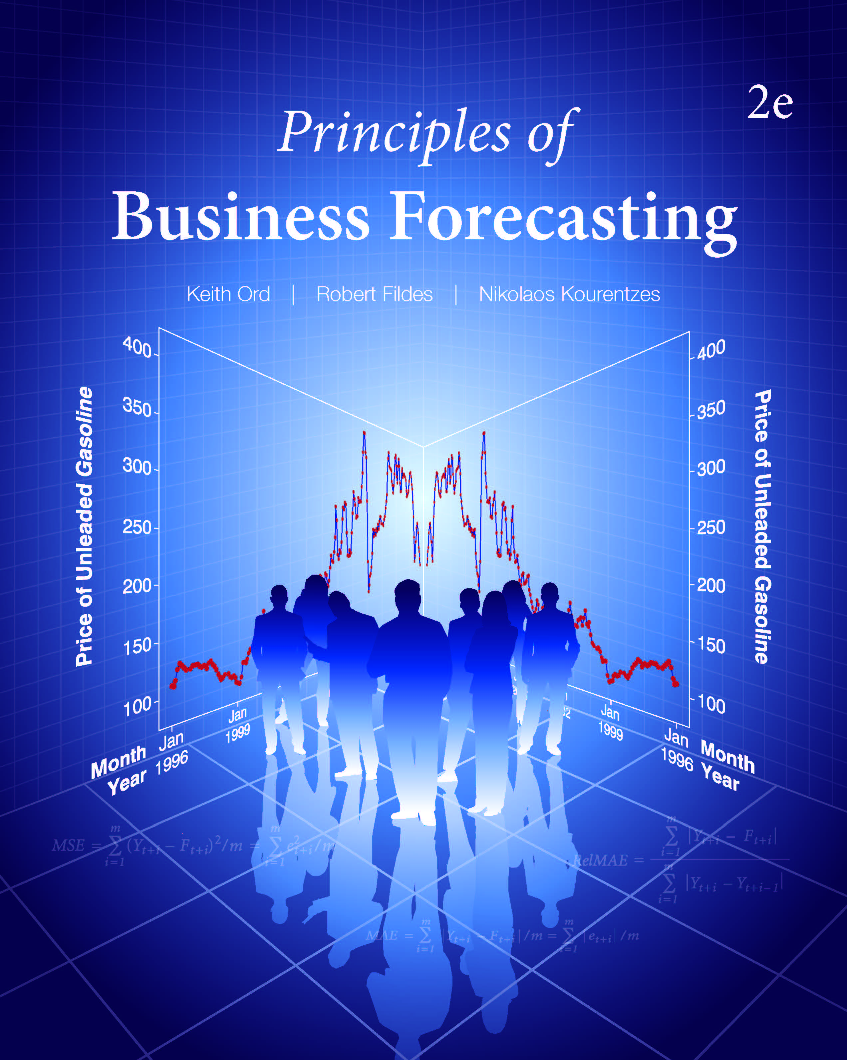
Chapter 11: Judgment-Based Forecasting
11.1 Judgmental or Quantitative Forecasting?
11.2 Judgmental Methods
11.3 The Delphi Method
11.4 Forecasting Using Prediction Markets
11.5 Assessing Uncertainty Judgmentally
11.6 The Use of Scenarios
11.7 Judgmental Forecasting Principles

Slide 3
Introduction
Judgmental forecasting: The process of producing forecasts based on integrating information based on subjective beliefs of individuals. The integration may be made informally or through a structured process. The forecast may also be obtained by aggregating the subjective forecasts of a number of individuals.
Quantitative forecasting: Forecasting based on the application of a prescribed explicit analysis of numerically coded data. This kind of forecasting may be causal, extrapolative, or a blend of both.

Slide 4
Introduction
Forecasts, Plans, and Targets
Forecasts should represent the most likely (typical or expected) value
Plans are a response by the organization to its forecasts in order to move towards its objectives
Targets represent estimates of what might be achieved in favorable circumstances when implementing a plan. A realistic target should therefore be based on the corresponding forecast

Slide 5
11.1 Judgmental or Quantitative Forecasting?
Data Requirements
Quantitative – assumes sufficient quantitative information is available
Extrapolative: need the past values of the series alone
Causal: need past values of both the dependent variable and the explanatory variables
Judgmental – little or no quantitative information may be available [or used] but subjective or qualitative data exist
Combined – Adjust a quantitative forecast by informed judgment

Slide 6
11.1 Judgmental or Quantitative Forecasting?
Heuristics and Biases in Judgmental Forecasting
(Kahneman and Tversky)
Forecasters may succumb to:
An availability bias, wherein the forecaster relies too heavily on easily available and memorable information.
The representativeness heuristic, in which the forecaster matches a situation to a similar earlier event without taking into account its frequency of occurrence.
The anchoring and adjustment heuristic, whereby the forecaster uses (anchors onto) an initial value such as the last observation and then adjusts the value to give a revised forecast.
Over-optimism or motivational bias where the forecaster is motivated to bias the forecast towards a preferred state.

Slide 7
11.1 Judgmental or Quantitative Forecasting?
These biases lead to invalid forecasts; they may lead to poor decision making, particularly when combined with overconfidence in their beliefs as to the accuracy of their forecasts.
Question: Identify examples of such biases in business decision making

Slide 8
11.1 Judgmental or Quantitative Forecasting?
Comparison of Judgmental and Quantitative Forecasting

Slide 9
11.1 Judgmental or Quantitative Forecasting?
What Kind of Forecast?
Are quantitative data available?
How valuable is the forecast?
How many items need to be forecast?
Would the numerical data be available in timely fashion?
Are there any data that cannot be incorporated into a quantitative forecast?

Slide 10
11.1 Judgmental or Quantitative Forecasting?
Date of Rate Change | Rate (%)
29-Jun-06 | 8.25
18-Sep-07 | 7.75
31-Oct-07 | 7.50
11-Dec-07 | 7.25
22-Jan-08 | 6.50
30-Jan-08 | 6.00
18-Mar-08 | 5.25
30-Apr-08 | 5.00
8-Oct-08 | 4.50
29-Oct-08 | 4.00
16-Dec-08 | 3.25

Slide 11
11.1 Judgmental or Quantitative Forecasting?
Plot of U.S. Prime Rate Changes
What do you expect of interest rates?
A naïve extrapolation ignoring changes in economic activity and confidence would be dangerous

Slide 12
Discussion Questions
When do you think the next change is the Prime Rate will occur?
What is your forecast for the magnitude of the change?
Can you suggest any quantitative methods that would work for this example?
A naïve extrapolation ignoring changes in economic activity and confidence would be dangerous

Slide 13
11.2 Judgmental Methods
Judgmental Forecasting Methods
Single Expert (Unaided Judgment)
Expert and Group Opinion
Sales Force Projections (or Sales Force Composite)
Customer Surveys
Use of Analogies
Delphi Method
Electronic Markets
What problems do you see in relying on:
an expert or a group of experts?
survey methods?
Can such difficulties be overcome? How?

Slide 14
Discussion Questions
Your role as the forecast manager of a company that manufactures and sells machine tools worldwide is to organize the company’s forecasting process of gathering the area and regional sales forecast to produce the company’s total sales by product.
What considerations should you bear in mind, what information would you collect, and what information would you share?
What role might quantitative methods have in this process?

Slide 15
11.2 Judgmental Methods
The Roles of Experts
Individual experts
Crowd of experts: betting markets
‘Jury’ of Experts
Focus groups
Combining Experts
Sales force projections
Difficulties:
Identifying expertise
Choosing the sample
Politics of groups
Are there ‘Superforecasters’ – especially talented experts?

Slide 16
11.2 Judgmental Methods
Customer Surveys
Discussion Question
During the next 12 months, what do you think the changes are that you buy a new car?
Certain, practically certain (99 in 100)
Almost sure (9 in 10)
Possible (5 in 10)
Unlikely (1 in 10)
Definitely will not (1 in 100)
Questions:
Is your response a true reflection of your purchasing intentions?
Are you a typical purchaser?

Slide 17
11.2 Judgmental Methods
Analogies
Forecasting by Analogy: Forecasts that are based upon comparisons with similar past events or past situations similar to that being forecast, e.g., often made for new products or in conflict/political situations
Define the attributes characterizing event
Score past and future events on attributes, e.g., present/absent
Forecast outcome of forthcoming event based on the most similar past event(s)

Slide 18
11.2 Judgmental Methods
The Next U.S. Presidential Election
Similarity Score = 1 (the average absolute difference in ratings)
Questions: The Principal factors in an election are listed in the first column.
Are any factors missing?
What do you conclude about the most recent election?

Slide 19
11.2 Judgmental Methods
Use of Analogies
Strength:
Provide forecasts when numerical data do not exist (e.g. new products, major project development)
Weakness:
Prone to bias and selective choice of similarity measures (e.g. underestimating the cost of hosting the Olympic Games in order to gain approval)
Evidence suggests identifying similar events difficult
Question: How would you characterize the similarities and differences between various retail promotions you have experienced?

Slide 20
11.2 Judgmental Methods
Advantages and Disadvantages of Judgmental Methods
Advantages of Expert Judgmental Methods
May be used in the absence of detailed quantitative data.
Management is more likely to buy into the forecasting process because more directly involved.
Forecasts can be more timely
The forecaster has control over the resulting forecast and is therefore committed to it.
Flexibility comes with some weaknesses:
Some opinion leaders may exert undue influence over others
Underlying assumptions may be left unstated.
Information may not be shared.
Targets and forecasts may become entwined.
Difficult to assess uncertainty.

Slide 21
11.3 The Delphi Method
Developed by military planners in 1950s
Aimed to overcome disadvantages
Purpose is to elicit views without concerns about personal interactions
Initially slow, but can now be done interactively
Delphi Decision Aid freeware available at: http://armstrong.wharton.upenn.edu/delphi2
Key Components
Anonymity
Controlled feedback
Repetition
Statistical summary
Consensual forecasts

Slide 22
11.3 The Delphi Method
Key Steps in the Delphi Method
Determine the question(s) and objectives
Choose a (diverse) panel of experts
Circulate an information pack of agreed trends, reports etc.
Request responses to a structured questionnaire by the end of round 1
Summarize the responses statistically, and summarize the rationale behind the responses
Update information and complete round 2 of the survey. Repeat if necessary

Slide 23
11.3 The Delphi Method
A Delphi Group Exercise
Identify a question of interest and carefully formulate the statement of the issue
Identify a group recorder [GR] for your group.
Write down your own estimate without consulting others, and submit your values to your GR along with any comments.
Follow the Delphi process for at least two rounds.
If there are multiple groups, a common question could be used and the results compared.

Slide 24
11.4 Forecasting Using Prediction Markets
The aim of prediction markets is to estimate the probability of an event, e.g., the collapse of the Euro as a currency or the election of a particular candidate
A prediction market mimics the structure of a stock market and thus requires:
A well-defined event of interest
A group of “traders” who will maintain an active market with respect to that event
A flow of new information that will encourage trading

Slide 25
11.4 Forecasting Using Prediction Markets
Prediction Markets: The Iowa Electronic Market
http://www.biz.uiowa.edu/iem
Operated by the Tippie College of Business at the University of Iowa since around 1988
Allows traders to:
place a bid (an order to buy)
place an ask (an order to sell)
withdraw an outstanding bid or ask
make a purchase at the current market price
execute a sale at the market price

Slide 26
11.4 Forecasting Using Prediction Markets
Prediction Markets: An Election Example
Market offers two options
Contract A delivers $1 if the Republicans win and $0 if the Democrats win;
Contract B delivers $1 if the Democrats win and $0 if the Republicans win.
For each $1 invested, trader receives one unit of each stock.
Trader may buy/sell each separately subject to having funds/stock available.
How much would you be willing to pay for a contract that delivers $1 if the Republicans win and $0 if the Democrats win?
If your price is higher than the prevailing market price you would buy such a contract; if it is below you would sell.
The currently traded price is then taken as the probability that the given candidate would win

Slide 27
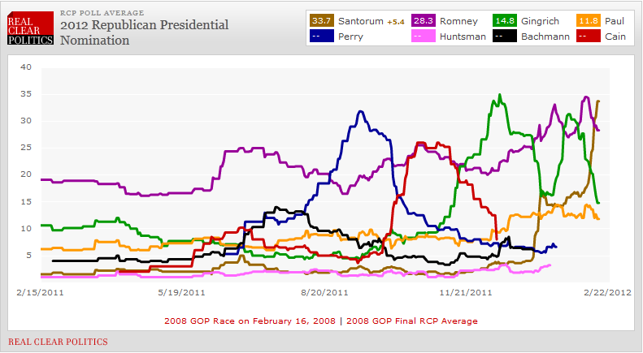
11.4 Forecasting Using Prediction Markets
The value of each share is taken as the estimate of the probability that candidate would win

Slide 28
11.4 Forecasting Using Prediction Markets
Prediction Markets
Incentives to be accurate
The elimination of bias
Elicits (latent) views that may not otherwise be heard
A reduction in the time spent in discussions
Dynamic updating of the prices and forecasts
But
Limited evidence of accuracy
Reflects a consensus of traders rather than ‘purchasers/voters’

Slide 29
Discussion Questions
Do we need a random sample of traders?
Will the sum of the contract prices drop below $1?
Will the sum of the contract prices stay above $1?
How would we extend to multiple options?
Are electronic markets useful in business?
Major issues only (set-up cost)
Issue must have sufficient new information to justify regular trading
Specific target (e.g. Federal Reserve Board meeting) useful as a focus
Easy to attract participants

Slide 30
11.5 Assessing Uncertainty Judgmentally
Assessing Uncertainty – Gas Prices
ISSUE: The price of a (U.S.) gallon of regular gasoline at your local gas station.
Consider two possible bets:
Activity A: Draw a ticket from the hat; you win if it is numbered 1 through 95 and you lose if it is 96 through 100.
Activity B: Set the upper price limit, say at $2.00 for next month; you win if the actual price is at or below that level and you lose if it is above.
Which bet do you prefer?
Prefer A: raise price in Activity B
Prefer B: lower price in Activity B
Continue until you find the price at which you are indifferent between the two bets. That price is your estimate of the 95th percentile.
Repeat for other lotteries, e.g., 90th percentile.

Slide 31
11.5 Assessing Uncertainty Judgmentally
Decomposition: Tornado Insurance
Insurance companies often offer protection against catastrophic risks for seemingly modest premiums. Is such insurance worthwhile? A tornado strike is one example of a catastrophic event over which we have no control and might consider purchasing insurance.
A decomposition of this event might involve the following steps:
How many tornados per year are sighted in my area (county, state?)
What proportion of these tornados touch down and cause damage?
Over what proportion of the total area is the damage severe?
What would the total (reimbursable) cost be to me of my business being wiped out?

Slide 32
11.5 Assessing Uncertainty Judgmentally
Probability of Damage
The probability of your business being severely damaged by a tornado in the course of a year can be estimated approximately by:
Number x Touchdown x Damage
where
Number – expected number of tornadoes in my area
Touchdown = proportion that touch down and cause damage
For commonly occurring events, more precise calculations are appropriate. For very rare events, the probability of two or more happening is exceedingly small, so it suffices to use {expected number x probability}

Slide 33
Discussion Questions
How would you decompose the possible effects of global warming (a predicted increase of 0.3 degrees Fahrenheit, or 0.2 degrees Celsius, per decade) on the eastern seaboard of the United States?
Do your answers change if the analysis relates to the Mediterranean? Or the North Sea?
Why or why not?

Slide 34
11.5 Assessing Uncertainty Judgmentally
Combining Forecasts
Given forecasts from different sources, possibly over different time frames and using different methodologies, how should we combine them?
What benefits might we expect from such an activity?

Slide 35
11.5 Assessing Uncertainty Judgmentally
Question: How would you combine these forecasts?

Slide 36
11.5 Assessing Uncertainty Judgmentally
Question: How would you try to forecast such series? Think of them as highly volatile “market shares.”

Slide 37
11.5 Assessing Uncertainty Judgmentally
Assessing the Accuracy of Qualitative Predictions
Yes – a correct prediction, no – incorrect
Assign 0 to an incorrect prediction, 1 if correct
$$B=\sum_{i=1}^{n}{(P_{i}−O_{i})^{2}/n}$$
Where P_{i} is the probability of event O_{i} occurring
B = 0.20 where 1 is the maximum achievable

Slide 38
11.6 The Use of Scenarios
A scenario is a consistent set of statements about possible future events and trends and their dependencies. A scenario traces the progression of the present to the future through a descriptive narrative.
Define the scope of the study
Identify the major stakeholders and actors.
Identify the basic trends
Identify key uncertainties
Construct initial scenario themes

Slide 39
11.6 The Use of Scenarios
Check for consistency and plausibility
Develop initial scenarios aimed at identifying key themes
Fill research gaps and model (or role-play) aspects of the sub-problems to check for consistency
Revise the initial scenarios to focus on key decisions being contemplated
A scenario is not a forecast; it is based on a set of forecasts (produced by a variety of methods). A set of scenarios aims to capture the key uncertainties in the problem.

Slide 40
11.6 The Use of Scenarios
Role-Playing
Used where there is a conflict between parties (e.g. war games)
Individuals (or groups) take on the different roles in the conflict
Play out a background scenario (e.g., climate change leading to increased famine in North Africa)
Identify different roles to be taken up.

Slide 41
11.7 Judgmental Forecasting Principles
Identify the decision to be made and the inputs required to make that decision.
Different individuals should perform the planning and forecasting tasks.
Develop clear wording for the questions, consider alternative versions, and always pretest.
Ask experts to justify their forecasts in writing.
Keep records of past forecasts and use them to provide feedback.
De-bias judgmental forecasts when there is a continuous record
Don’t use Focus groups for forecasting
Use them for defining the core elements of the forecasting task.

Slide 42
11.7 Judgmental Forecasting Principles
Use decomposition when uncertainty is high or when the task is complex; otherwise use global or holistic estimation.
When carrying out a Delphi study, use between 5 and 20 experts who possess domain knowledge yet have heterogeneous backgrounds.
Continue Delphi polling until the responses show stability; generally, three structured rounds are enough but hard to achieve.
In prediction markets, the predictions must be perceived to be important and involve the choice of specific actions
The number of participants in prediction markets need not be large, but the participants must be active.
In-company markets may benefit from their competitive aspect and from personal interaction among traders.
Real incentives must be provided.

Slide 43
11.7 Judgmental Forecasting Principles
When using analogous situations to produce a forecast, determine the attributes with respect to which the situations can be compared so that a more objective identification of relevant analogies can be made.
Decompose the forecasting task when uncertainty is high or the task is complex
Focus scenario construction on key strategic questions and uncertainties rather than on general questions that fail to delineate key uncertainties.
Use multiple scenarios to focus on uncertainties.
Develop scenarios that characterize “extreme” archetypes aimed at capturing possible diverse futures.
In constructing scenarios, follow judgmental forecasting principles to overcome the biases that occur when experts forecast.

Slide 44
Take-Aways
Use Judgmental methods to:
develop forecasts in the absence of numerical data
enhance quantitative forecasts when additional information is available
Judgmental forecasts are susceptible to bias and manipulation:
Improve communications and understanding between forecasters and policy makers by making assumptions explicit
Make the forecasting process transparent
The performance of judgmental forecasts should be monitored and feedback provided to the forecasters.

Slide 45
Minicase 11.1
Working as a group develop two scenarios, one optimistic as far as Mammoth, an oil exploration company is concerned and one pessimistic. The Mammoth Oil Company (MOC) is considering whether to set up an oil rig in a deep-water location in the Arctic. The rig is expected to operate with a 20-year life-span.
Several issues have already been resolved: The presence of a large oil field in the area has been established,
the depth of the water (and hence the approximate costs of the platform and pipelines) is known.
What additional information would be helpful in refining the scenarios to make them more plausible? Could role-playing prove useful in making the “stories” more convincing? Reflect with your group members on what have learnt in trying to develop these scenarios?

