Slide 1
Putting Forecasting Methods to Work
Chapter 12
Production is not the application of tools to materials, but logic to work.
— Peter F. Drucker

Slide 2
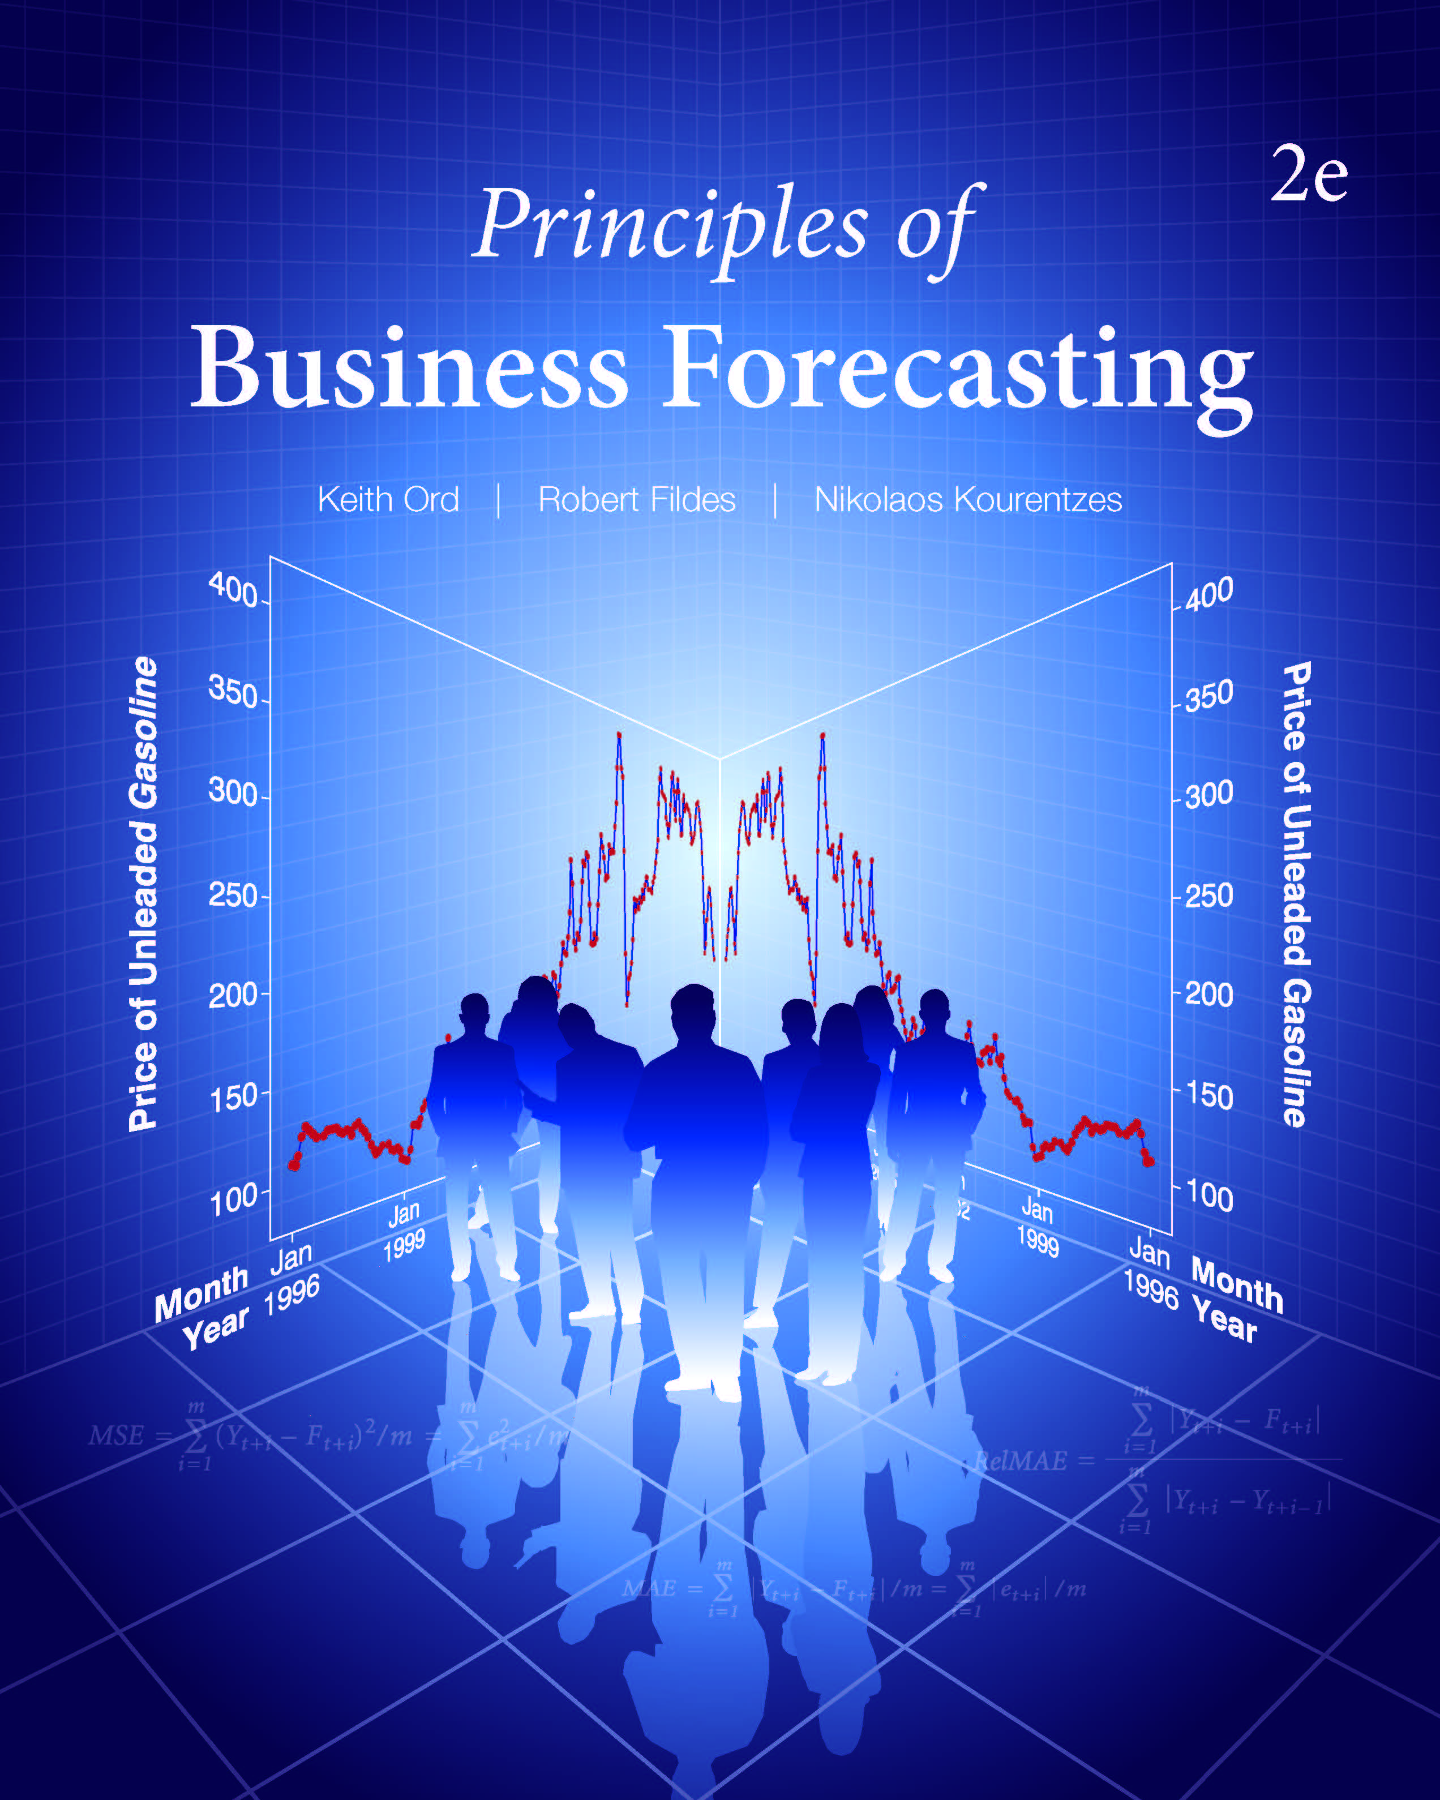
Chapter 12: Putting Forecasting Methods to Work
12.1 Evaluating a Forecasting Process
12.2 The Role of Forecasting Support Systems
12.3 Operations
12.4 Marketing
12.5 Forecasting Individual Behavior
12.6 Macroeconomic Forecasting
12.7 Other Applications
12.8 Forecasting Principles in Application

Slide 3
12.1 Evaluating a Forecasting Process
Organization specific
Accuracy;
Costs and resources needed;
The availability of the data;
Speed with which the forecasts are produced.
The impact on the bottom line, e.g. profit, service level.
Comprehensibility.
Captures key features of the activity system such as the effects of promotional activities and special events.
Motivational effects.
PIVASE!

Slide 4
12.1 Evaluating a Forecasting Process
Evaluating Forecasting Methods: Forecasting Competitions
Will benchmark studies help?
Carrying out your own benchmark study – the role of Forecasting Competitions.
Specify the population of relevant time series.
Define the forecasting task precisely.
Specify the forecasting methods to be considered
Include a standard benchmark
Include current practice.
Define the performance measures linked to value.
Specify the data to be used in training the methods.
Calculate error measures and choose best method.

Slide 5
12.1 Evaluating a Forecasting Process
Evaluating Forecasting Methods: Forecasting Competitions
The role of error measures in forecast comparisons
Two methods used to forecast electricity usage in two households
Conflicting overall results
Choice depends on error measure chosen
Explain how this applies to evaluating the forecasting accuracy of products in a grocery store.

Slide 6
12.1 Evaluating a Forecasting Process
Evaluating Forecasting Methods: Forecasting Competitions
Criteria for selecting error metrics
Sensitivity to outliers
RMSE is based on squared errors and therefore sensitive to outliers
Sensitivity to performance on individual series
MAE can be dominated by small errors when data values are large
MAPE can be affected by series with actuals close to zero
Effect of scale
MAPE and relative errors (RelMAE) are scale-independent
The measure’s interpretability
RMSE is not easily interpretable, MAPE is. RelMAE very useful for comparisons.

Slide 7
12.1 Evaluating a Forecasting Process
Evaluating Forecasting Methods: Forecasting Competitions
Conclusions from Forecasting Competitions (Fildes et al.,1998)
Statistically sophisticated or complex methods do not typically produce more accurate forecasts than simpler ones.
The rankings of the performance of the various methods vary with the error measures used.
The relative performance of the various methods depends upon the length of the forecasting horizon.
The characteristics of the data series are important factors in determining relative performance
develop methods to ‘fit’ the characteristics of your data series
Comparisons based on a single time series and a single forecast origin are unreliable; use
multiple time series and forecast origins are recommended.
Consider damped trend smoothing as a benchmark.

Slide 8
12.1 Evaluating a Forecasting Process
Combining Forecasting Methods
Suppose we have two separate forecasting methods, each delivering one-step-ahead forecasts of Y_{t}: F_{1t} and F_{2t}.
Instead of trying to decide which of the two methods is better,
produce a combined forecast for Y_{t} by averaging the two individual forecasts:
or more generally:
When more than two forecasts are available:
Questions:
What other methods can you think of for combining forecasts?
What are some advantages and disadvantages?

Slide 9
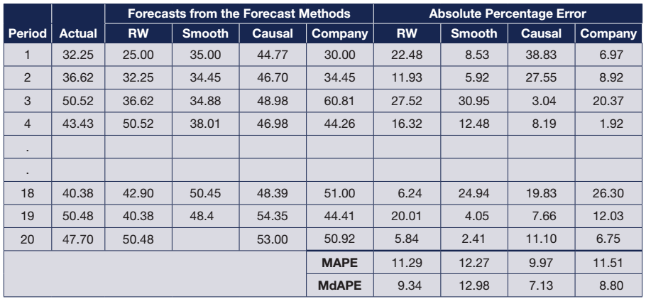
12.1 Evaluating a Forecasting Process
Combining Forecasting Methods
Example of forecast combination: individual forecasts

Slide 10
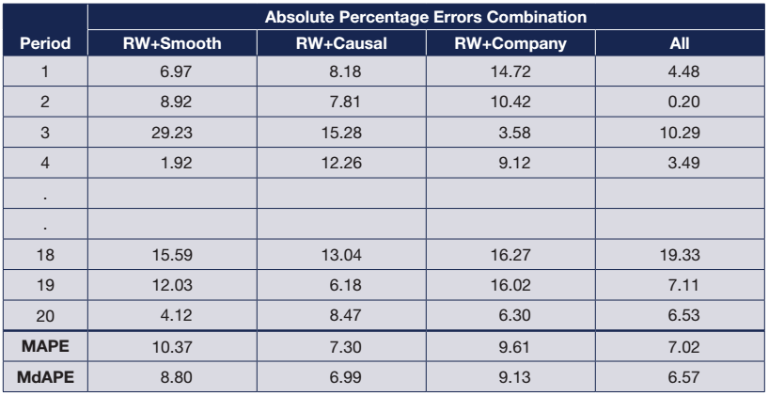
12.1 Evaluating a Forecasting Process
Combining Forecasting Methods
Example of forecast combination: combined forecasts
Best individual forecast MAPE: 9.97, MdAPE: 7.13

Slide 11
Discussion Question
How is the process of combining forecasts similar to portfolio diversification in finance?
Why might such procedures reduce the forecast error (or investment risk)?

Slide 12
Take-Aways for Evaluating Forecasting Methods
Specify the Forecasting Task precisely (PIVASE)
Always compare the current (or proposed) method against established benchmarks
Error measures must be chosen to ‘fit’ the problem
Base comparisons on a large sample of time series, forecast origins, and out-of-sample forecasts
Use formal procedures to combine forecasts
Equal weights are hard to beat, removing extremes
Combine models where there is substantial uncertainty

Slide 13
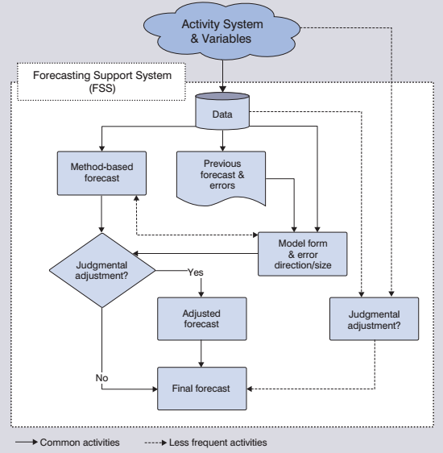
12.2 The Role of Forecasting Support Systems
The Forecasting System

Slide 14
12.2 The Role of Forecasting Support Systems
Forecasting Support Systems (FSS)
A set of (typically computer-based) procedures that facilitate interactive forecasting of key variables in a given organizational context.
An FSS enables users to combine relevant information, analytical models, and judgements, as well as visualization, to produce (or create) the forecasts and monitor their accuracy.

Slide 15
12.2 The Role of Forecasting Support Systems
Evaluating a system (e.g., for possible purchase)
Key dimensions of FSS
Data aspects
Categorization of data (e.g. new and established products)
Frequency of data and their match to the decision problem (e.g. weekly forecasts and decisions)
Ability to include a range of variables (hard and soft)
Links to other information systems (e.g. ERP inventory)
Common interface for input and output

Slide 16
12.2 The Role of Forecasting Support Systems
Key dimensions of FSS
Forecasting methods and their accuracy
Range of methods
Ability to include additional variables (e.g. weather)
Suitability of methods for organization’s data
Appropriate measures of accuracy of alternative methods compared with current performance
User-Computer interface
Ease of learning and ease of use
Report-writing capabilities
Support for judgemental adjustments to model-based forecasts

Slide 17
12.2 The Role of Forecasting Support Systems
Key dimensions of FSS
Supplier Company characteristics
Viability, history, list of clients
Project team
Specialist forecasting support
Cost
Purchase price
Maintenance
Consulting/training
Questions:
What are requirements?
What are desirables?

Slide 18
12.2 The Role of Forecasting Support Systems
Forecast Adjustment
The aim when adjusting a statistical forecast
To take into account complexity omitted from the statistical model
70%+ forecasts by manufacturers adjusted
Retailers stocking many thousands of SKUs adjust fewer
Key questions
When to adjust?
Size of adjustment?
Adjusted forecast
System forecast
Adjusted forecast
Actual demand
System forecast

Slide 19
12.2 The Role of Forecasting Support Systems
Forecast Adjustment
Adjusting a Statistical Forecast
Model-based forecasts should only be adjusted:
if the forecaster has substantial information about factors excluded from the statistical forecast.
Adjustments can be made more effective:
by developing a data base of their past effectiveness and the reasons the adjustments were made.
by developing statistical summaries of past adjustments to provide advice on the size of the adjustment.

Slide 20
12.2 The Role of Forecasting Support Systems
Forecast Adjustment

Slide 21
12.2 The Role of Forecasting Support Systems
Forecast Adjustment
Promotional Sales with a Baseline Forecast
Developing a Baseline Forecast
Use a simple exponential smoothing model updated on non-promoted periods
Develop a regression model
Question: In forecasting sales during promotions periods, what factors might limit the effectiveness of the two approaches we have described?

Slide 22
Take-Aways for Forecasting Support Systems
Structure judgmental adjustments
Compare the statistical system forecast with the adjusted final forecast
Collect a ‘rich’ data base on promotions and events
Base the system forecast on the regular periods
Not when promotions are run
Use promotional models if possible
Use well-tested software
Commercial software cannot be assumed to be valid
Benchmark results

Slide 23
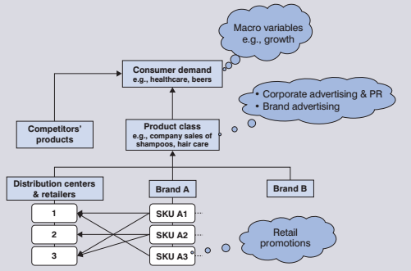
12.3 Operations
The Hierarchy of Market Drivers
Questions:
What forecasts are needed by a chain of supermarkets to support their operations?
By a criminal justice court?

Slide 24
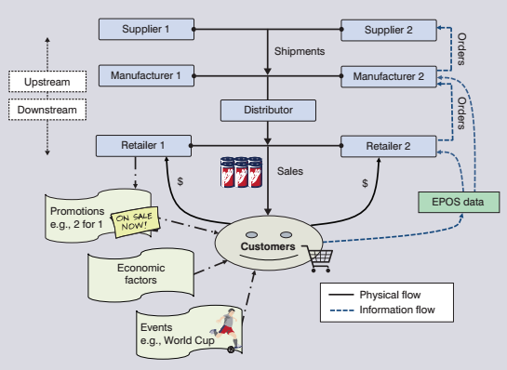
12.3 Operations
Data Issues in Supply Chain Forecasting
Forecasting across the Supply Chain

Slide 25
12.3 Operations
Data Issues in Supply Chain Forecasting
Demand Data in Operations
What is recorded?
Demand, sales, or shipments
Clean the data to account for lost sales.
But when an out-of-stock situation is observed,
Sales is observed.
Demand includes lost or backlogged sales.
Questions:
How might you estimate P(Demand?Stock)?
How do these issues affect call center forecasting of traffic?

Slide 26
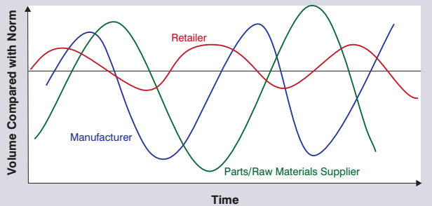
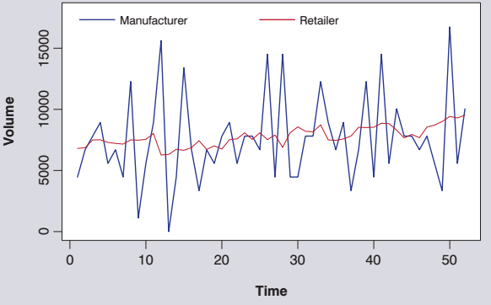
12.3 Operations
Supply Chain Forecasting and the Bullwhip Effect
An increase of the demand variability upstream in the supply chain
Causes:
Special events (e.g. promotions)
Ineffective flow of information across supply chain levels
Order batching
Distance of manufacturers/suppliers from end customer
Schematic
Real Data Example

Slide 27
12.3 Operations
Supply Chain Forecasting and the Bullwhip Effect
Dealing with the Bullwhip Effect
Share information
EPOS data from the retailer
Retailer forecasts
Inventory data
Benefits from collaborative information sharing
Gathering of forecasting expertise from diverse sources
Inventory Reductions
Improved Order Forecast Accuracy
Fewer Stock-outs & Increased Customer Service
More predictable order cycles – no Bullwhip
Collaborative Planning, Forecasting, and Replenishment – CPFR
Question: How could a manufacturer best use a retailer’s forecasts to improve the accuracy of its own forecasts?

Slide 28
12.3 Operations
Hierarchical Forecasting
Hierarchy of Demand Data by Product Grouping
Hierarchy of Demand Data by Geographical Grouping

Slide 29
12.3 Operations
Hierarchical Forecasting
Different parts of the organization require different levels of detail in order to support planning decision.
When the mapping from bottom level to top is unique we deal with a demand hierarchy.
When the mapping is non-unique we deal with grouped demand series.
Hierarchical forecasting enforces forecast consistency:
the sum of forecasts of lower levels adds-up to higher levels: not guaranteed when forecasting independently.

Slide 30
12.3 Operations
Hierarchical Forecasting
Top-Down and Bottom-Up Forecasts (hierarchical demand)
Question: What advantages and disadvantages do you see in adopting either a top-down approach or a bottom-up approach?

Slide 31
12.3 Operations
Hierarchical Forecasting
Choosing between approaches:
Compare results using a forecast competition.
What is the forecasting objective? Guide selection of evaluation metric and approaches considered.
What level in the hierarchy is most important for the organization’s decisions?
Combination approach
Attempts to overcome the limitations of both
Allows for grouped series.

Slide 32
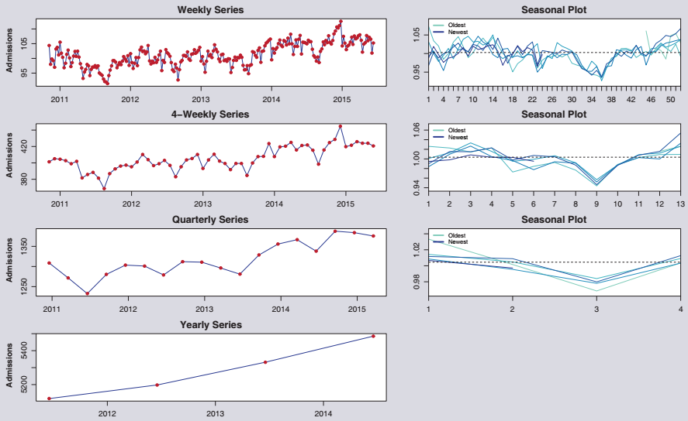
12.3 Operations
Forecasts and Time Aggregation
Different elements of the time series structure are dominant in different temporal aggregation levels

Slide 33
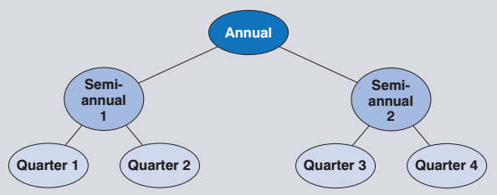
12.3 Operations
Forecasts and Time Aggregation
Which aggregation level to choose?
What is the forecast objective/forecast horizon?
At what level is it easier to forecast the time series? The appropriate forecast method may change.
Forecasting competition, but careful to compare results on a common aggregation level!
Alternatively, instead of choosing a level we can keep all with a Temporal Hierarchy.
As with hierarchical forecasting, model using combination approach for grouped series.

Slide 34
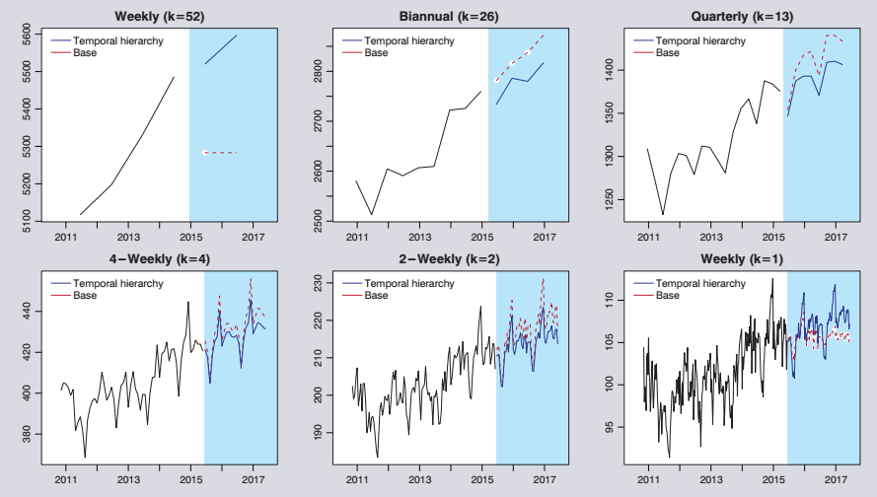
12.3 Operations
Forecasts and Time Aggregation
Question: What are expected advantages from using temporal hierarchies forecasting? Why?

Slide 35
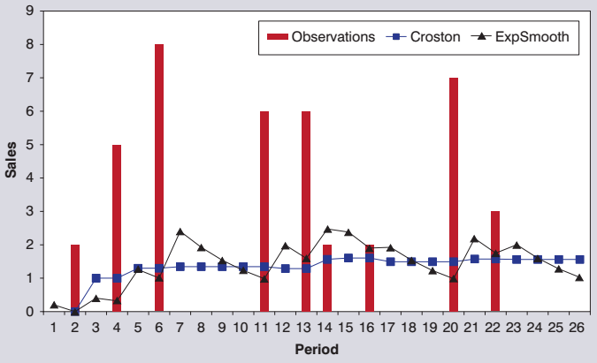
12.3 Operations
Demand Data and Intermittent Demand
Intermittent Demand SKUs frequently have zero sales, and any nonzero demand is often highly variable (so called lumpy demand).
Common for spare parts suppliers and retailers.
Requires special statistical methods.
Question: What the problems of using exponential smoothing in this case?

Slide 36
12.3 Operations
Demand Data and Intermittent Demand
Croston’s method:
The forecast is
$Y_{t}^{′}$ is the exponentially smoothed (or moving-average) forecast of the size of demand, updated only if demand occurs in period.
$p_{t}^{′}$ denotes the exponentially smoothed interdemand interval, updated only if demand occurs in period,
For Croston’s method $c=1$. Syntetos and Boylan (2005) approximation corrects the inherent bias in Croston’s method by $c=1−a_{p}/2$, where $a_{p}$ is the smoothing parameter of inter-demand intervals.

Slide 37
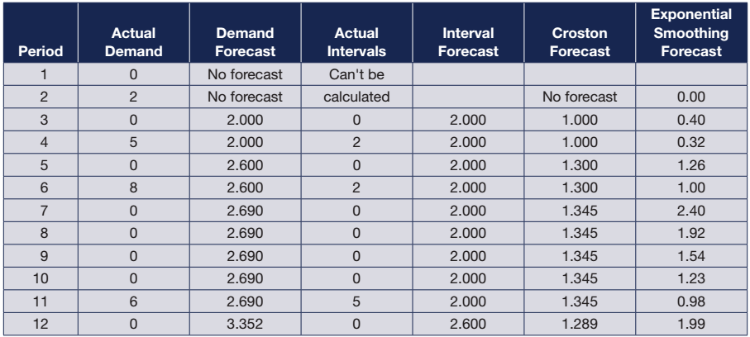
12.3 Operations
Demand Data and Intermittent Demand
Example of calculation
Alternatively we can use temporal aggregation or hierarchies
Question: What are advantages and disadvantages of using temporal aggregation (or hierarchies) for intermittent demand forecasting?

Slide 38
12.3 Operations
Summary
Most common application of forecasting techniques
Usually exponential smoothing based
Intermittent demand items require special treatment
Data falls in natural hierarchies
Temporal aggregation connects short and long term forecasting
Few explanatory variables
Promotions
Shared information from downstream in supply chain
Reliant on managerial judgment
Enhanced by models

Slide 39
Take-Aways for Operations
Consider using information in the product hierarchy
Vertical and cross-sectional info
Overcome the bull-whip effect
Using effective forecasting methods
Using collaborative information (from customers)
Take into account special features of the data
Demand vs. sales
Intermittent demand
Temporal aggregation and hierarchies
Use a ‘forecasting competition’ approach to benchmark current operational method
Gives an upper bound of possible improvements
Take care in choosing error measure

Slide 40
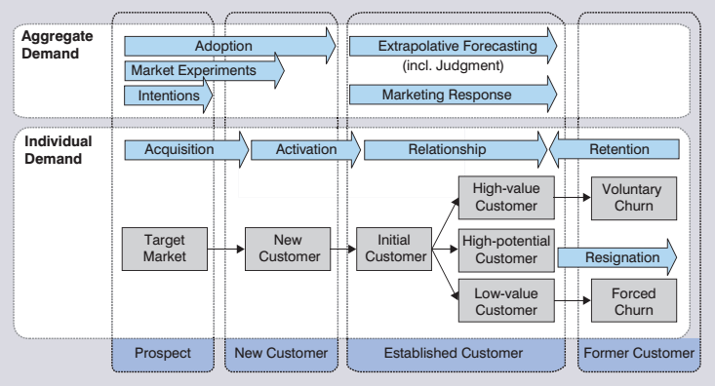
12.4 Marketing
Prediction of Individual and Aggregate Demand in a Customer Life Cycle

Slide 41
12.4 Marketing
Aggregate market forecasts (B2C, B2B)
New products and services
Market response
Sales in an established market
Brand and share
Individual customer behavior
Targeting and attraction of new customers
Retention
Question: How would you go about forecasting the demand for a new airliner (e.g., Airbus 350-1000 or Boeing 787-10) over the next ten years?

Slide 42
12.4 Marketing
New Products and Services
What distinguishes a ‘new product’?
Types of new products
Why is new product forecasting so important?
Judgment used extensively in new product forecasting
Role of statistical modeling
Using analogies

Slide 43
12.4 Marketing
Long-Term Trends
$M$ is the market potential (of the product or service)
$N\left(t\right)$ is the cumulative number of individuals (people, businesses) who have adopted by end-period $t$.
Linear
Exponential
Modified exponential
Gompertz curve
Extended logistic curve
$$N\left(t\right)=a+bt$$
$$N\left(t\right)=aexp\left(bt\right)=ae^{bt}$$
$$N\left(t\right)=M−aexp(−bt)$$
$$N\left(t\right)=Mexp(−aexp\left(−bt\right))$$
$$N\left(t\right)=M\left(\frac{1−cexp(−bt)}{1+dexp(−bt)}\right)$$
For all curves a, b, c, d, M > 0

Slide 44
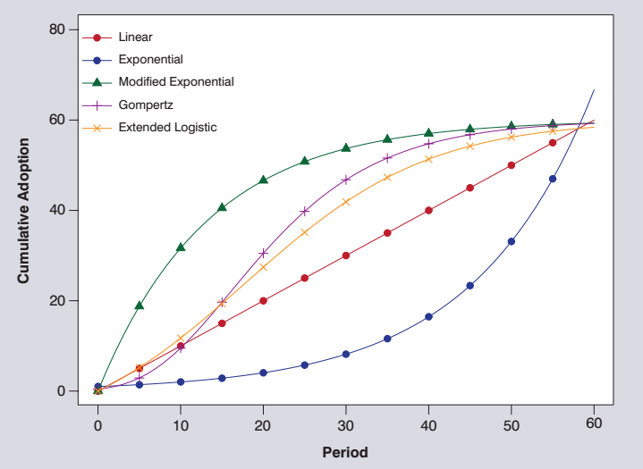
12.4 Marketing
Long-Term Trends
Questions:
What went wrong with Malthus’s forecast of starvation for the planet?
Or is the predicted catastrophe just taking longer than expected?

Slide 45
12.4 Marketing
Long-Term Trends
S-shaped curves (Gompertz and logistic) fit substantially better
Major difference in estimated upper limit
Questions:
What other information might you require before you relied on any of the models shown in the table above to forecast to 2020?
Which model would you use?

Slide 46
12.4 Marketing
Diffusion Curves: Modeling the Adoption of New Technologies and Products
Bass Model
$n\left(t\right)$ represents the number adopting in period t, then
$$n\left(t\right)≡N\left(t\right)−N\left(t−1\right)=g(t)(M−N\left(t−1\right))$$
Various models for $g(t)$.
Bass proposed $g\left(t\right)=p+q(\frac{N\left(t\right)}{M})$
i.e.: the probability of adoption depends on a fixed probability (innovation) but also a probability that increases with the number already adopted (imitation).

Slide 47
12.4 Marketing
Diffusion Curves: Modeling the Adoption of New Technologies and Products
Bass Model
Cumulative adoption
$$N\left(t\right)=M\left(\frac{1−exp⁡(−\left(p+q\right)t)}{1+\frac{q}{p}exp⁡(−\left(p+q\right)t)}\right)+ε_{t}$$
Per period adoption
$$n\left(t\right)=p\left(m−N\left(t\right)\right)+q\left(\frac{N\left(t\right)}{m}(m−N\left(t\right))\right)+ε_{t}$$
Number of new innovators $p(m−N\left(t\right))$
Number of new imitators $q\left(\frac{N\left(t\right)}{m}(m−N\left(t\right))\right)$

Slide 48
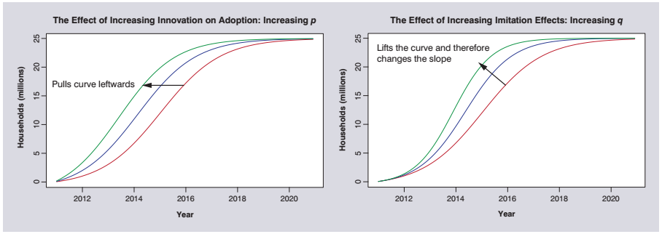
12.4 Marketing
Diffusion Curves: Modeling the Adoption of New Technologies and Products

Slide 49
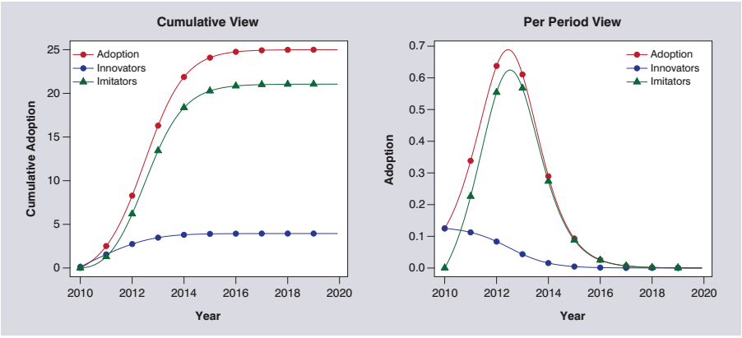
12.4 Marketing
Diffusion Curves: Modeling the Adoption of New Technologies and Products

Slide 50
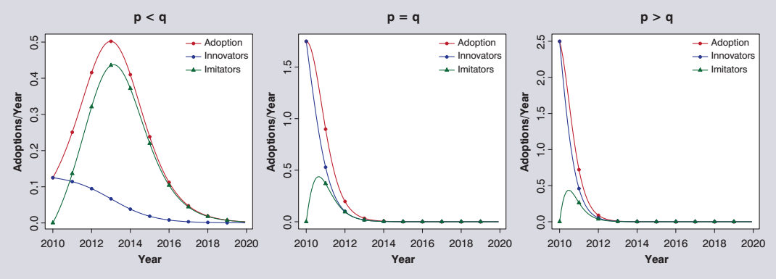
12.4 Marketing
Diffusion Curves: Modeling the Adoption of New Technologies and Products
$p$ coefficient of innovation
$q$ coefficient of imitation
Questions:
What makes consumers innovators or imitators? Consider the example of Virtual Reality entertainment products?
What are the factors that may affect your own purchase decision?

Slide 51
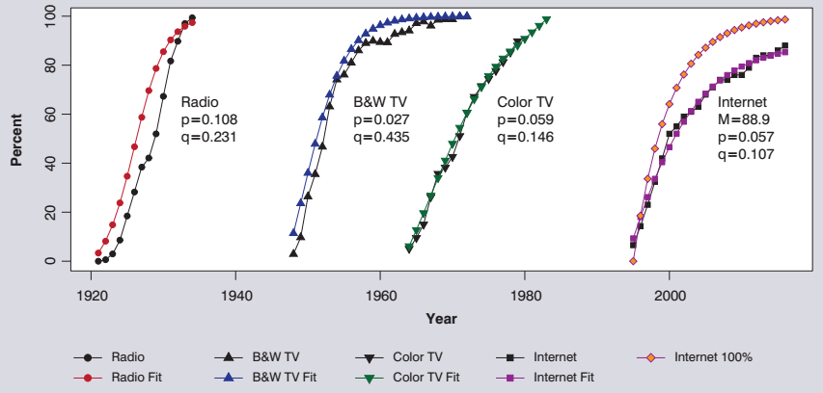
12.4 Marketing
Diffusion Curves: Modeling the Adoption of New Technologies and Products
Penetration levels, diffusion curves, and parameter estimates for various media in the United States

Slide 52
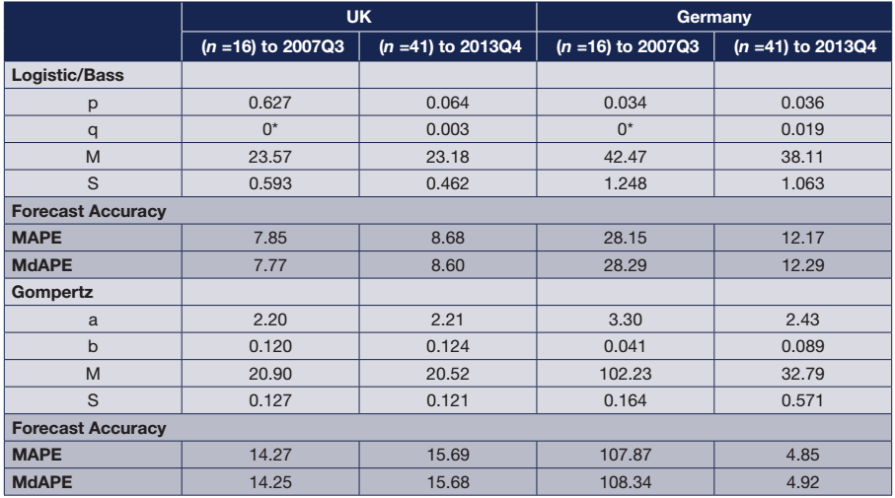
12.4 Marketing
Market Potential of a New Product or Technology
If substantial data is available estimate M
Internet adoption example:
What do you note about the results?
If not, survey potential customers

Slide 53
12.4 Marketing
Market Potential of a New Product or Technology
Survey the potential customers to estimate market potential
The simple approach:
Asking ‘customers’ to choose between products
Simulate the choice environment realistically
Aim for probabilistic estimates of purchase for various market segments
Weight the results to produce the final forecast
But where there are important trade-off to consider (or the ‘product’ is not known to the consumers)
The consumer identifies the important attributes in making the choice
Use conjoint analysis

Slide 54
12.4 Marketing
Market Potential of a New Product or Technology
The Attributes of a product characterize the key features that may distinguish it from its competitors.
Discussion Question
Consider the choice you make when deciding how to communicate with someone at a distance (e.g., mobile, fixed line, IMS, VOIP)
What are the key attributes that affect your choice, and what circumstances affect their relative value to you?
Core assumption:
People value a product by valuing its individual attributes.

Slide 55
12.4 Marketing
Market Potential of a New Product or Technology
A sample of choice scenarios in the Chinese car market
Conjoint Analysis
It assumes a product is made up of some key attributes and each attribute has a number of levels (options) – see table above.
Use only a few important and distinct attributes. Using too many will confuse respondents.
Use only a few, easily distinguishable levels. Intermediate levels can be inferred.
Use attributes and levels that are understandable to survey participants. Noise in decibels will challenge even engineers to related to!
Avoid subjective options. A “long” conversation is not as useful as defining it in minutes.

Slide 56
12.4 Marketing
Market Potential of a New Product or Technology
Valuing a product
Identify key attributes
A_{kj} is a measure of the k^{th} attribute of the j^{th} product (choice)
The overall value of the jth choice to the ith responded V_{ij} is given by
where w_{ijk} is the weight (importance) the i^{th} respondent ascribes to the k^{th} attribute of the jth product.
The preference the i^{th} individual has for the j^{th} product is then:
Estimate weights from survey data (regression).

Slide 57
12.4 Marketing
Market Potential of a New Product or Technology
Use the survey including demographics to estimate the average weights for different market segments.
In the ‘green car’ study, the estimated weight for the electric car compared to the base gasoline car is .27, a 27% chance (other things being equal) of choosing the electric car.
The results of a conjoint choice study:
a set of probability estimates for each segment of choosing the different alternatives
by summing over the expected numbers in each segment we arrive at an estimate of market potential

Slide 58
Discussion Questions
What factors may affect the final uptake of self-drive cars in the United States? In Italy?
Thinking of the latest new major product or service just becoming available, write down an estimate of the percentage of the population (or households) that you expect will adopt the product or service in its final penetration level. What factors may affect its final uptake?
After the class discussion of the final uptake, do you want to revise your estimates?

Slide 59
12.4 Marketing
Market Response Models
Market response models are used to forecast aggregate medium-term movements in product sales or market shares.
also in market planning – e.g. in pricing
When modeling demand,
use a measure of sales volume that removes the effects of price changes and package size
take into account lost sales due to supply shortages.
Question: What do you need to forecast if you are a beer (shampoo) manufacturer?
How do you measure these demand variables?
How do you measure price (of beer)?

Slide 60
12.4 Marketing
Market Response Models
Example: Airline Travel
What variables should we include to model and forecast 1-3 year ahead air traffic from country to country, with annual data e.g. US-UK?
Are lags important?
How do you measure price?
What do you do about 9/11 terrorist attack?
The proposed model:
Growth in number of passengers
Explanatories: International trade & Ticket price

Slide 61
12.4 Marketing
Market Response Models
Example: Soft Drinks
Market response_{ijt} = f (marketing instruments: price, display, feature, store, competition, events, promotion,…; seasonality; exogenous factors),
where i is the i^{th} brand in the j^{th} store, t is time.
A model for Pepsi:
t-statistics in parentheses. R² = 90%.
No indication of autocorrelation in the residuals.
Question: Interpret the coefficients?

Slide 62
12.4 Marketing
Market Response Models
In building a market response model, the key decisions to make are:
Which explanatory variables to include in the proposed model; and
The appropriate level of aggregation at which to build the model.

Slide 63
12.4 Marketing
Market Response Models
Brand Models with different product forms (e.g. pack sizes)
A simple model!!
Where brand b in product form p only competes with one other brand and one other product form
Q_{bp} demanded of product bp (brand b in product form p)
X_{bp} – price of brand b in form p
Assumes to compete with brand 1 product p (X_{1p}) and brand 1 product 1 (X₁₁)
Estimated for different stores (or groups of stores) because stores and their customers are not homogeneous

Slide 64
12.4 Marketing
Market Response Models
Market share models
Capture the share of a product’s sales
or alternatively, a multiplicative model of market share
Market share models should be logically consistent
NB: note formula error in book, p.468

Slide 65
12.4 Marketing
Expert Adjustments and Promotional Effects
Developing models of the complexity described in the previous section can be quite challenging for many organizations that lack specialized stuff (and software)
Tackle with expert adjustments → do they do well?
Quite often fail spectacularly!
Fildes et al. (2009) found an overall positive bias to the adjusted forecasts.
At times adjustments were in the wrong direction, due perhaps to competitive factors being ignored.
Question: How might an FSS be extended beyond the purely statistical to help forecasters take into account promotions and other marketing drivers?

Slide 66
12.4 Marketing
Implementation Issues
Why don’t market response models get implemented (much)?
Too complex
Limited data
No suitable software
No trained staff
Question: What can be done?

Slide 67
Take-Aways for Marketing I
New product forecasting
Use a variety of diffusion models
No single model outperforms all others
Use simpler models with limited data
Short-term forecasting ability is useful in distinguishing between models
Use non-linear least squares to estimate parameters
Beware of using analogies to deliver estimates
In estimating market potential using intentions or choice studies
Identify an appropriate sample of respondents
Identify the product attributes for the product and its competition
Question respondents in a realistic context

Slide 68
Take-Aways for Marketing II
Market response models
Use disaggregate data
Marketing effects are difficult to estimate otherwise
Use regression models for longer term forecasting
Use brand-specific parameters to model a competitive market
Marketing effects differ by brand

Slide 69
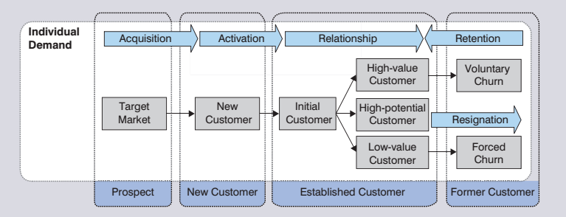
12.5 Forecasting Individual Behavior
The Business Tasks
Prospects (Target marketing)
New customers
Established customers

Slide 70
12.5 Forecasting Individual Behavior
Geodemographic Segmentation Systems (GSS)
A GSS classifies neighborhoods (e.g., census tracts) into segments (e.g., 60 or so in the United States) by grouping tracts with similar demographic characteristics. The basic premise of geodemographic segmentation is that people tend to gravitate toward communities with people of similar backgrounds, interests, and financial means.
Question: Is the use of such targeting methods ethical in considering:
credit approvals
the identification of potential tax evaders, or
the identification of potential terrorists?

Slide 71
12.5 Forecasting Individual Behavior
Types of explanatory data used to predict response:
Data available for modeling depends on their stage in the customer lifecycle

Slide 72
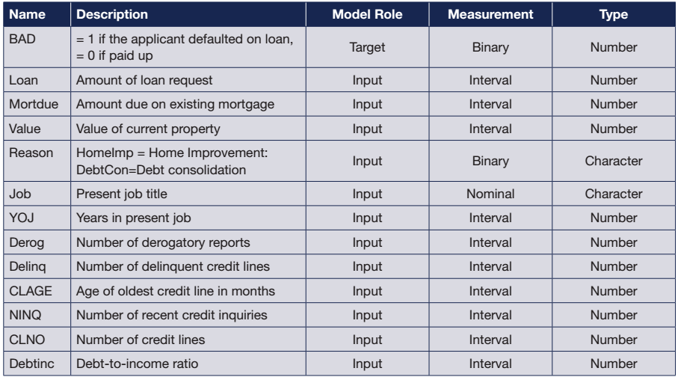
12.5 Forecasting Individual Behavior
Building Consumer Classification Models: The Example of Consumer Loans

Slide 73
12.5 Forecasting Individual Behavior
Building Consumer Classification Models: The Example of Consumer Loans
Percentage of defaulted loans in the 5960 observations is 20%.
Split into Training (50%), Validation (30%) and Test (20%)
Fit alternative classification methods (with specific modelling issues, e.g., number of leaves for decision trees):

Slide 74
12.5 Forecasting Individual Behavior
Making Customer Relationship Management Models Effective
Various issues have been shown to be important in building effective models.
Choosing the sample data
Reweight (oversample) to increase the number of target sample
Use as many observations as practical
Coding of variables
Code interval data as categorical
Replace missing values

Slide 75
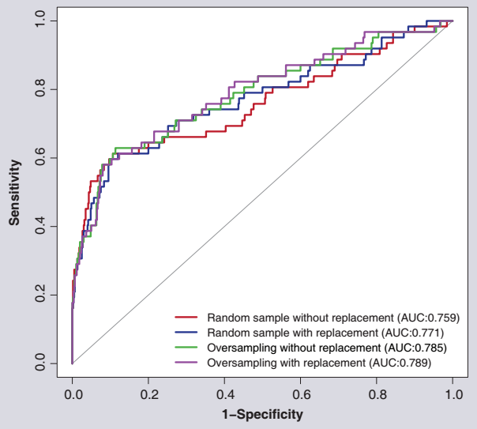
12.5 Forecasting Individual Behavior
Making Customer Relationship Management Models Effective
ROC Curve for Logistic Regression

Slide 76
12.5 Forecasting Individual Behavior
Making Customer Relationship Management Models Effective
Logistic Regression

Slide 77
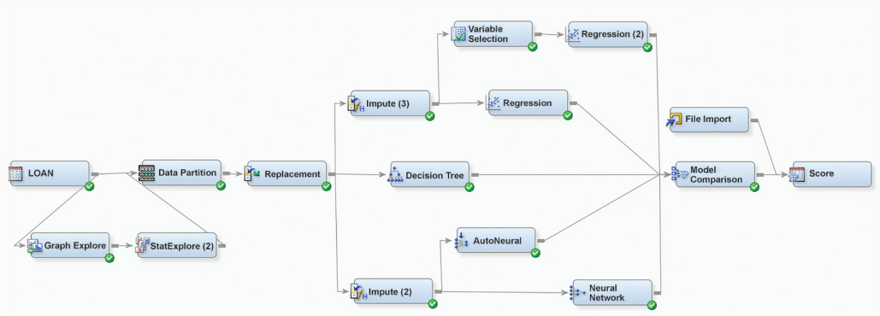
12.5 Forecasting Individual Behavior
Appraising Models of Individual Behavior
An Exploratory Data-Mining Process SAS

Slide 78
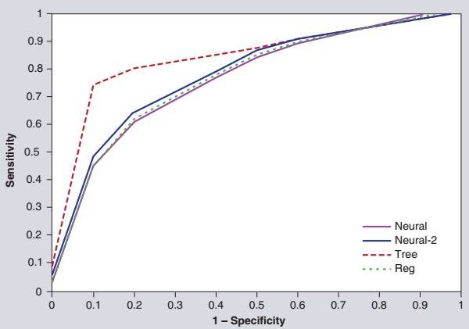
12.5 Forecasting Individual Behavior
Appraising Models of Individual Behavior
The results:
ROC
Misclassification with 30% probability cut-off
Which to prefer?
Why?

Slide 79
Take-Aways for Forecasting Individual Behavior
The process of developing a predictive classification model
Use as many observations as are available and computationally tractable.
Segment the data into training, validation and test sets.
Examine the distribution of variables.
Transform the data where necessary, coding dummy variables.
Replace missing and outlying observations.
Develop an oversampling scheme to ensure equal samples of the target and non-target subpopulations.
Choose a variety of plausible methods.
Use a procedure for eliminating insignificant variables.
Use an ensemble (combination) of the individual methods to overcome limitations of each method.
Compare performance on relevant criteria and cutoff values.
Evaluate performance comparatively on the test data.

Slide 80
12.6 Macroeconomic Forecasting
Macroeconomic forecasting:
Governments and international bodies (IMF).
Focus on aggregates:
Highly inaccurate beyond 1 year ahead.
Large models, VARs or single equation methods used.
Tempered by judgment.
Don’t try to produce your own macro forecast – combine.
Questions:
Using a current example of macroeconomic policy change, how might you forecast the effects? In 2017, Brexit and President Trump’s proposed initiative have provided examples.
Why do you think that macroeconomic forecasting is often no more accurate than a naïve extrapolative model when one is looking more than 12 months out? Why do you think that most macro forecasters failed to forecast the “Great Recession” that started in 2007?

Slide 81
12.7 Other Applications
Many other specialist areas:
Agriculture;
Commodity prices and finance generally;
Energy;
Sports forecasting;
Telecommunications;
Tourism.
Methods used are essentially the same as those developed through the book: Include the specific factors important in particular applications.
Question: If you were to advise a funding agency on whether to support a research project on climate change, what factors would you take into account as the basis of your decision?

Slide 82
12.8 Principles I
Evaluation
Compare the current (or proposed) method against established benchmarks.
Specify the forecasting task.
Use error measures that are appropriate for the problem.
Base comparisons on as large a sample of time series, forecast origins, and out-of-sample forecasts as possible.
When multiple forecasts are available, consider combinations of forecasts from methods that differ substantially.
Use formal procedures to combine forecasts.
Combine models where there is substantial uncertainty.
Select rather than combine when a particular method has consistently performed best on out-of-sample comparisons.

Slide 83
12.8 Principles II
Forecasting Support Systems
Structure judgemental adjustments to a statistical forecast.
Compare the system forecast with the adjusted forecast.
Base the statistical system forecast on regular time periods,
not on periods during which promotions are run and not on unusual periods.
Use well-tested forecasting software.
Operations and Marketing Product Hierarchies
When product hierarchies are available, use hierarchical forecasting approaches to obtain reconciled forecasts with potential accuracy gain.
When available, the combined approach is recommended.
Temporal aggregation can be beneficial for long-term forecasting and side-stepping intermittency.
Using temporal aggregation levels can offer gains in the accuracy and reliability of forecasts, mitigating forecast uncertainty.

Slide 84
12.8 Principles III
New Product Diffusion Models
No single diffusion model is best for all adoption processes.
Use simpler diffusion models.
Short-term forecasting ability is helpful in deciding whether a diffusion model is useful.
Use nonlinear least squares to estimate models.
Market Potential
When estimating market potential, identify an appropriate sample of respondents for an intention or choice-based conjoint study.
Identify a meaningful set of attributes that are potentially important in a choice model of market potential.
Estimate market potential with intentions data that have been modified to take into account possible biases from the respondents.
Question respondents in as realistic a choice context as possible.
Combine approaches with others, such as using analogous products.

Slide 85
12.8 Principles IV
Market Response Models
Use disaggregated data.
When the sample is medium or large, use regression model only when the current effects of the market drivers are strong.
Use brand-specific parameters to model a competitive market.
Forecasting Individual Behaviour
Consider a variety of methods.
Use the largest sample size possible, given the data and computer constraints, but partition into estimation, validation and test samples whenever possible.
Aim for an understandable model.
Replace missing data, and use indicator variables to tag the replacement.
Balance the sample of the target class with the available non-target data.
In the assessment of the different methods, use criteria that reflect the profit and loss in the problem.

Slide 86
12.8 Principles V
Other Applications
Do not try to produce your own macro forecasts.
In all forecasting applications, use the methods, models, and principles laid down.
Make sure you understand the specific factors which are important in the particular application.

Slide 87
Minicase 12.1 Call Center Planning
New manager of the center
Exponential smoothing as a baseline statistical forecast
Expert adjustment with marketing information
Possible carry-over effects of mailings
Seasonality problematic
A 10% MAPE objective – but is that reasonable
Brief
PIVASE?
Analyze the data
Current accuracy?
Develop an improved model
Suggest a new change to the forecasting system

Slide 88
Minicase 12.2 Costume Jewelry
Company marketing costume jewelry
Three product lines
Brief
Develop a hierarchical system by product line
What are the effects on forecast accuracy?
Identify subgroups of items with similar demand patterns
Does segmentation help in improving forecasting accuracy?

