Slide 1
Basic Tools for Forecasting
Chapter 2

Slide 2
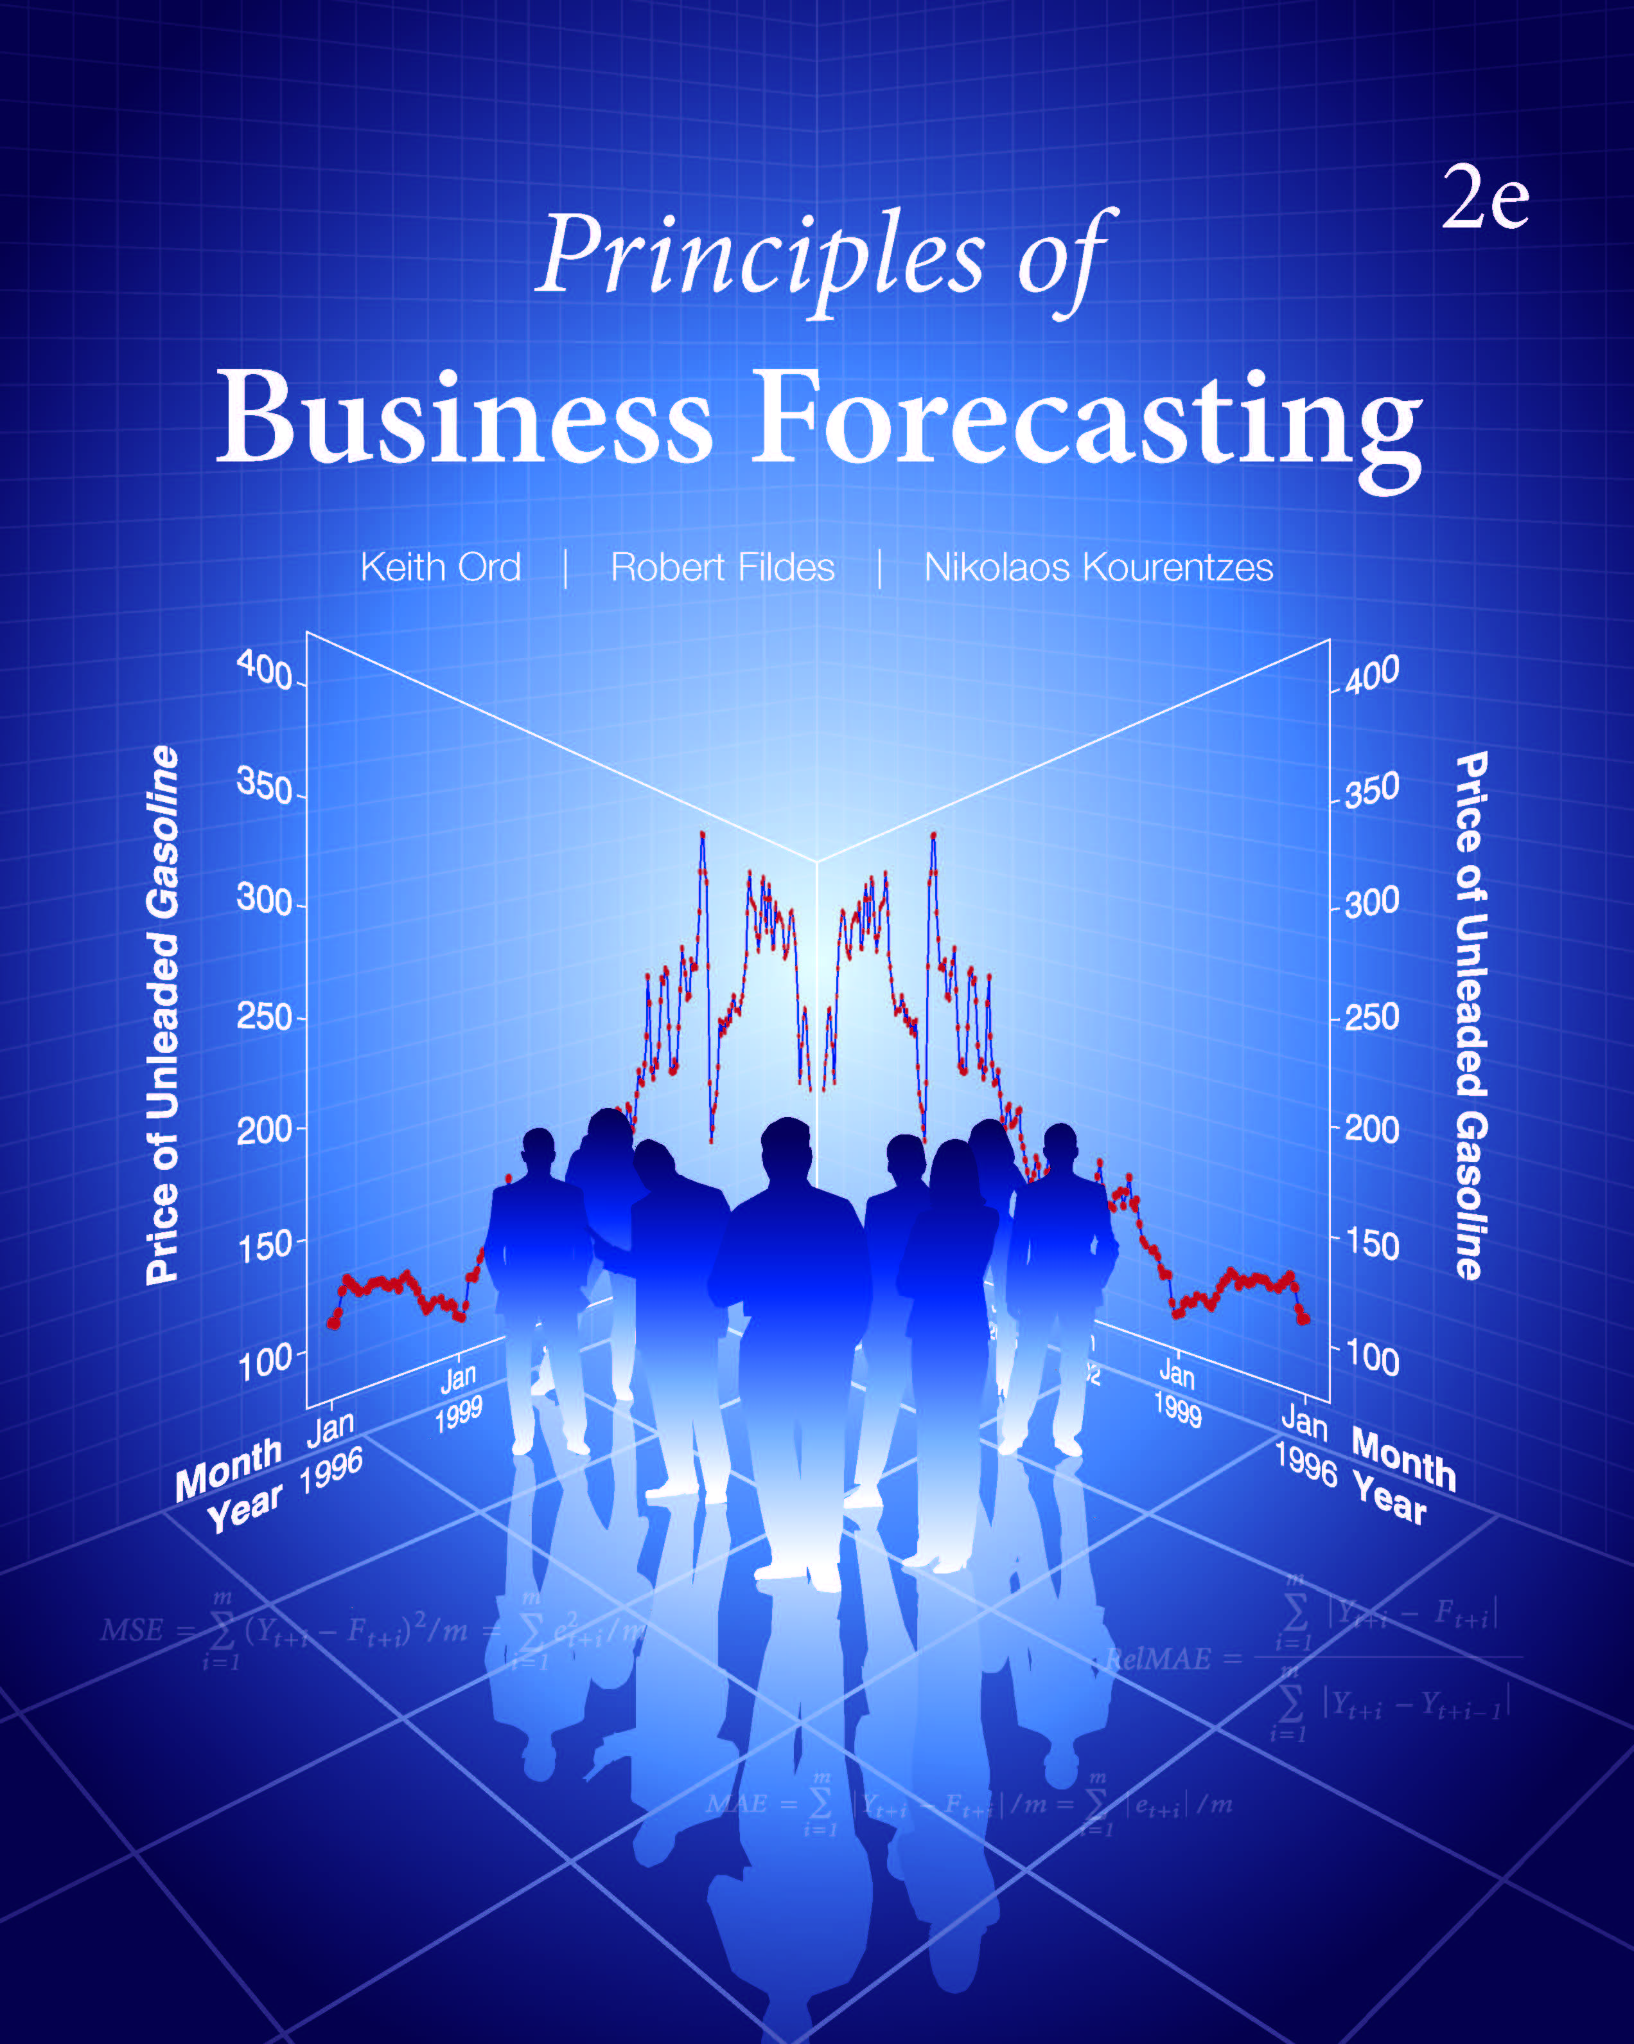
Chapter 2: Basic Tools for Forecasting
2.1 Types of Data
2.2 Time Series Plots
2.3 Scatterplots
2.4 Summarizing the Data
2.5 Correlation
2.6 Transformations
2.7 How to Evaluate Forecasting Accuracy
2.8 Prediction Intervals
2.9 Basic Principles of Data Analysis

Slide 3
2.1 Types of Data
Cross sectional data are measurements on multiple units, recorded in a single time period.
A time series is a set of comparable measurements recorded on a single variable over multiple time periods.
Panel data are cross-sectional measurements that are repeated over time, such as monthly expenditures for a sample of consumers.

Slide 4
2.1 Types of Data
Comparable Data
Data observed over time are not necessarily comparable to each other because:
the time periods may be of differing lengths.
the units of measurement may change.
the definitions of what is being measured may change.
they are incorrectly measured.
data errors may arise from sampling, from bias in the measuring instruments or the responses, or from transcription.
We need to understand how the data are measured,
their weaknesses and biases.

Slide 5
2.1 Types of Data
Data may be:
Categorical (e.g., industrial classification)
Ordinal (e.g., bond ratings, AAA, Aaa, …)
Interval-scaled (e.g., temperature: Fahrenheit or Celsius)
Ratio-scaled (e.g., monthly sales)
Discrete or continuous (e.g., number of commercials shown during a one-hour period vs. time devoted to commercials during that hour)
Time series or cross-sectional (e.g., stock price over time vs. multiple stock prices on a given day)
Stock or flow (e.g., capital vs. income)
Or even:
text

Slide 6
2.1 Types of Data
Notes
All observations are measured to a finite degree of accuracy
Variables may be discrete but conveniently approximated by continuous variables (e.g., monthly sales of automobiles at a national level)
Data Examples
Q: How would you classify these variables?
Weekly sales of refrigerators in a single store
Sales of gasoline
Credit rating of individual consumers
Gross domestic product
Unemployment
Population census data

Slide 7
2.2 Time Series Plots
Time is measured on the horizontal axis; in most applications the time intervals are (at least approximately) equally spaced.
Daily sales
Monthly sales
Stock market closing prices
The (dependent) variable(s) of interest is (are) measured on the vertical axis.
The following slides show the time series plots for WFJ sales and for domestic passengers at Dulles Airport.
Different components of a series may be overlaid and/or coded differently, as shown in Figures 2.3 (A) and (B).

Slide 8
2.2 Time Series Plots
Figure 2.1 Time Series Plot of Weekly WFJ Sales

Slide 9
2.2 Time Series Plots
Figure 2.2 Time Series Plot of Domestic Passengers at Dulles, 1963–2015
Annual numbers of domestic passengers at Dulles (’000s)

Slide 10
2.2 Time Series Plots
Figure 2.3 Seasonal Plots for Airline Revenue Passenger Miles for 2000–2004
A: Scatterplot by month, with years overlaid, of RPM vs. month

Slide 11
2.2 Time Series Plots
Figure 2.3 Seasonal Plots for Airline Revenue Passenger Miles for 2000–2004
B: Time series plot of RMP, with each year identified as a subgroup

Slide 12
2.2 Time Series Plots
Annotating a time series: Number of calls to a health call center (trend removed)

Slide 13
2.3 Scatterplots
Figure 2.4 Seasonal of GDP vs. Government Surplus for
25 Forecasting Organizations

Slide 14
2.3 Scatterplots
Figure 2.5 Matrix Plot of GDP, GFCF, Govsurp, and Unemp for
25 Forecasting Organizations

Slide 15
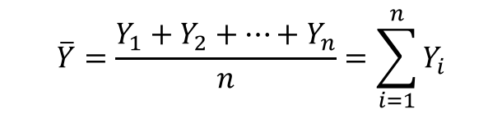
2.4 Summarizing the Data
Measures of Average
Arithmetic Mean:
Order Statistics:
Place the observations in ascending order:
Median:
  If n is odd, n = 2m + 1 and the median is Y_{(m+1)}.
  If n is even, n = 2m and the median is ½[Y_{(m)}+Y_{(m+1)}].
$$\overline{Y}=\frac{Y_{1}+Y_{2}+…+Y_{n}}{n}=\sum_{i=1}^{n}{Y_{i}}$$
$$Y_{\left(1\right)}≤Y_{\left(2\right)}≤…≤Y_{\left(n\right)}$$

Slide 16
2.4 Summarizing the Data
Measures of Average – Example
Suppose the sales of a popular book over a seven-week period are as follows:
Week | 1 | 2 | 3 | 4 | 5 | 6 | 7
Sales (000s) | 15 | 10 | 12 | 16 | 9 | 8 | 14
The mean is
The order statistics are 8, 9, 10, 12, 14, 15, 16.
The median is the fourth value in the sequence, which also happens to be 12.

Slide 17
Discussion Question
How would you describe housing prices in an area is you were
(a) planning to buy a home in the area and
(b) seeking to forecast revenues from the local property tax?

Slide 18
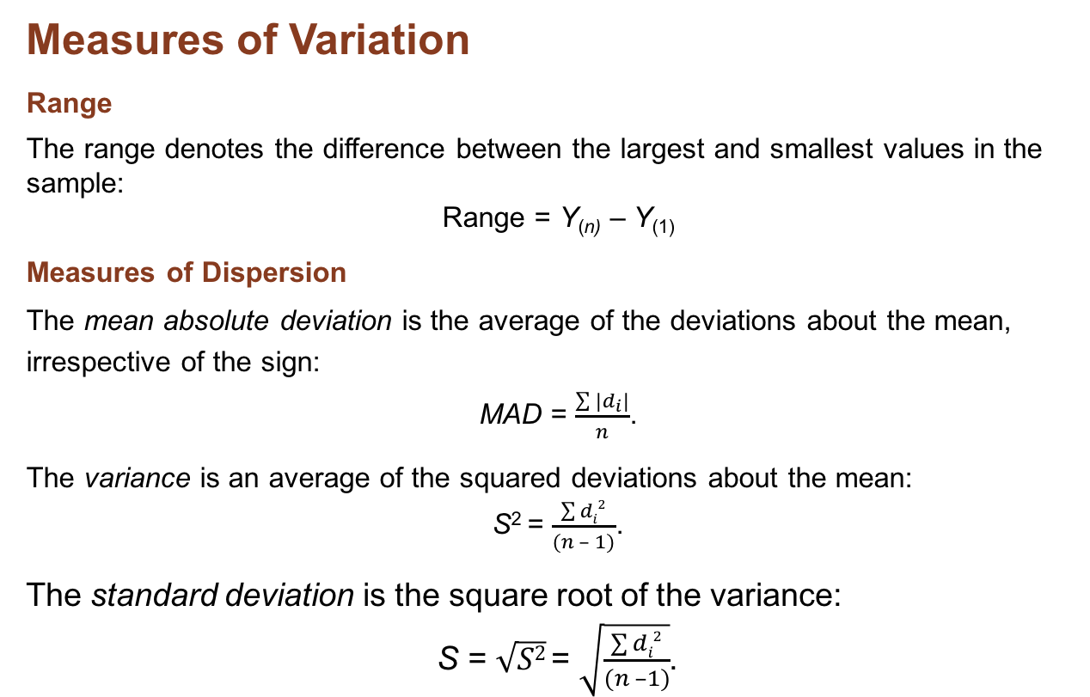
2.4 Summarizing the Data
Measures of Variation
Range
The range denotes the difference between the largest and smallest values in the sample:
Range = Y_{(n)} – Y₍₁₎
Measures of Dispersion
The mean absolute deviation is the average of the deviations about the mean, irrespective of the sign:
MAD = $\frac{\sum{|d_{i}|}}{n}$.
The variance is an average of the squared deviations about the mean:
S² = $\frac{\sum{di2}}{(n – 1)}$.
The standard deviation is the square root of the variance:
S = $\sqrt{S2}$ = $\sqrt{\frac{\sum{di2}}{(n –1)}}$.

Slide 19
2.4 Summarizing the Data
Measures of Variation – Example 2.2
Calculation of measures of variation
Consider the values for the seven weeks of book sales, given in Example 2.1. From the order statistics, we immediately see that the range is:
Range = 16 – 8 = 8.
However, if week 8 is entered with sales = 116, the range shoots up to 116 – 8 = 108. This simple example illustrates both the strength and the weakness of the range: It is very easy to computer, but it is severely affected by extreme values. The vulnerability of the range to extreme values makes it unsuitable for most purposes in forecasting.

Slide 20
2.4 Summarizing the Data
Measures of Variation – Example
Calculation of measures of variation
Range = 16 – 8 = 8
The deviations for the seven weeks are
Week | 1 | 2 | 3 | 4 | 5 | 6 | 7 | Sums
Sales (000s) | 15 | 10 | 12 | 16 | 9 | 8 | 14 | 84
Deviation | +3 | –2 | 0 | +4 | –3 | –4 | +2 | 0
|d| | 3 | 2 | 0 | 4 | 3 | 4 | 2 | 18
d² | 9 | 4 | 0 | 16 | 9 | 16 | 4 | 58
From the table, we have MAD = 18/7 = 2.57, S² = 58/6 = 9.67 and
S = 3.11.

Slide 21

2.4 Summarizing the Data
Assessing Variability
The standardized score (Z-score) is
for the example:
$$Z_{i}=\frac{Y_{i}−\overline{Y}}{S}$$
Week | 1 | 2 | 3 | 4 | 5 | 6 | 7
Sales (000s) | 15 | 10 | 12 | 16 | 9 | 8 | 14
Deviation | +3 | –2 | 0 | +4 | –3 | –4 | +2
Z-score | 0.96 | –0.64 | 0 | 1.29 | –0.96 | –1.29 | 0.64

Slide 22
2.4 Summarizing the Data
German Forecasts
Table 2.4 Descriptive Statistics for Forecasts of the German Economy
Too many figures, too many variables which are interesting?
Interpretation is needed

Slide 23
2.4 Summarizing the Data
German Forecasts
Table 2.5 Z-Scores for Forecasts of the German Economy
The analysis highlights the unusual forecasting groups
and which forecast variables are unusual.

Slide 24
2.5 Correlation
The correlation coefficient measures linear relationships
Ranges over [–1, +1]
A value of +1 indicates a perfect positive (upward sloping) linear relationship between the two variables
A value of –1 indicates a perfect negative (downward sloping) linear relationship between the two variables
A value of zero indicates no linear relationship between the two variables
Unaffected by changes in location and in scale
May be seriously affected by outliers

Slide 25
2.5 Correlation – Examples
Figure 2.6 Plots of Hypothetical Data Against Time

Slide 26
2.5 Correlation – Examples
For Figure 2.6, values of the correlation coefficient:
Variable | Value of r
Y1 | +1
Y2 | –1
Y3 | +0.8
Y4 | –0.8
Y5 | 0
Y6 | 0

Slide 27
2.5 Correlation
The Correlation Coefficient
The correlation coefficient, r, may be calculated from sample data using the following expression:
An alternative, but equivalent expression is the following, where S_{X}, S_{Y} denote the standard deviations and S_{XY} is the covariance:
Discussion Question
How would you measure the relationship between Y6 and time?

Slide 28
2.5 Correlation
Calculation

Slide 29
2.5 Correlation
Correlations for German Economic Forecasts
Table 2.6 Correlations Among Forecasts for the German Economy

Slide 30
2.6 Transformations
Question: In the words of Bob Dylan, “What does it mean?”

Slide 31
2.6 Transformations
Figure 2.2 Time Series Plot of Domestic Passengers at Dulles, 1963–2015

Slide 32
2.6 Transformations
Differences and Growth Rates
The (first) difference of a time series is given by:
The growth rate for a times series is given by:

Slide 33
2.6 Transformations
First Differences and Growth Rates
A: Time Series Plot for the First Differences of the Dulles Passenger Series
B: Time Series Plot for the Growth Rate for the Dulles Passenger Series
Question: What do these plots show?

Slide 34
2.6 Transformations
Descriptive Statistics
Descriptive Statistics: Difference, Growth Rate in Dulles Passengers
Variable | N | Mean | StDev | Minimum | Q1 | Median | Q3 | Maximum
Difference | 52 | 266 | 1463 | –4342 | –213 | 135 | 445 | 5285
Growth Rate | 52 | 7.47 | 17.87 | –26.99 | –3.63 | 4.57 | 16.97 | 84.95

Slide 35
2.6 Transformations
The Log Transform
The log transform may be written as:
The (first) difference in logarithms becomes:
The inverse transformation is:

Slide 36
2.6 Transformations
Log Differences
Figure 2.8 Time Series Plot for the First Difference of Logarithms
for the Dulles Passengers Series

Slide 37
2.7 How to Evaluate Forecasting Accuracy
The E in PIVASE
What do you need from the forecasting activity?
Quantitative accuracy
Timing accuracy
How do we measure these?
Asymmetric measures?
“The thrill of winning is much less than the agony of defeat.”
Michigan State Football Coach [paraphrased]

Slide 38
2.7 How to Evaluate Forecasting Accuracy
Table 2.7 Temperature Forecasts for Washington, DC, June 1–July 4, 2016
Table 2.8 Temperature Forecasts for Washington, DC, June 2–July 5, 2016

Slide 39
2.7 How to Evaluate Forecasting Accuracy
Table 2.9 Structure of Forecasts for 1, 2, 3, … Periods Ahead

Slide 40
Measures of Forecasting Accuracy
Terminology
Forecast origin
  The time at which a forecast is made (time t)
Forecast horizon
  The time period to which the forecast relates
  One-step-ahead forecast F_{t+1} (1)
    Forecast made at time t; also denoted by F_{t+1}
  h-step-ahead forecast F_{t+h}(h)
    Forecast for period t+h made at time t
  One-step-ahead forecast error
  e_{t+1} = Y_{t+1} - F_{t+1}
  h-step-ahead forecast error
  e_{t+h}(h) = Y_{t+h} - F_{t+h}(h)

Slide 41
Measures of Forecasting Accuracy
Rolling Origin Forecasts
Starting at forecast origin t, generate forecasts successively (one-step-ahead) at time origins t + 1, t + 2, …, t + m-1, making m such forecasts in all.
This process is known as rolling origin forecasting. The one-step-ahead forecast error at time t + i may be denoted by

Slide 42
Measures of Forecasting Accuracy
Formulas apply for one-step-ahead forecasts
(Percentage error measures must have Y > 0):

Slide 43
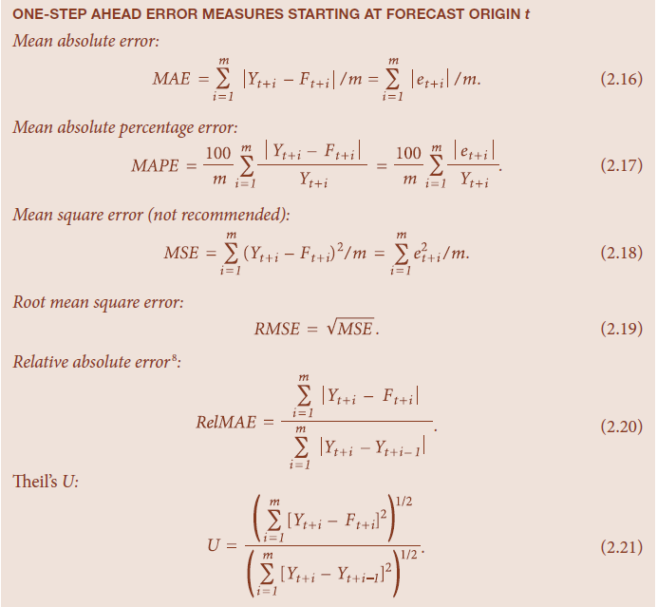
Measures of Absolute Error
All these measures are based upon differences between forecast and actual values.
They are symmetric in that positive and negative forecast errors of the same magnitude contribute equally to the measures.
One-Step-Ahead Error Messages Starting at Forecast Origin t
Mean absolute error
Mean absolute percentage error
Mean square error (not recommended)

Slide 44
Measures of Absolute Error (continued)
Root mean square error
Relative absolute error
Theil’s U

Slide 45
Forecasting Accuracy – An Example
Table 2.10 Analysis of Forecasting Accuracy for Electricity Consumption in a Washington, DC Household
(A) One Year Ahead: Forecast = Actual Value for Same Month in Previous Year

Slide 46
Comparison of Error Measures
Table 2.11 Comparison of Forecasts for Electricity Data

Slide 47
Comparison of Error Measures
Table 2.12 Summary of Forecast Errors for Weather Data
(Values computed over June 6 to July 5, 2016)

Slide 48
How to Measure Forecasting Accuracy
Summary
Select suitable measure(s).
Compute in-sample accuracy, but note that using more predictor variables means a better in-sample fit.
Compute out-of-sample performance by applying measures only to genuine forecasts.
Which measures make sense for the particular application?
ME, MAE, RMSE, MPE, MAPE, RelMAE?

Slide 49
How to Measure Forecasting Accuracy
Discussion Question
How does the type of data you are working with have an impact on the accuracy measures you could employ?
Consider the following examples:
  Temperature
  Company profits
  Sales of a low volume product (e.g. sales might be zero in a given time period)
  Price – earnings ratios

Slide 50
2.8 Prediction Intervals
Normal Prediction Intervals
If Z = value from normal tables, the 100(1-α) percent Prediction Interval for Y is:
Standard values for Z are:
100(1-α) | Z
80 | 1.282
90 | 1.645
95 | 1.960
99 | 2.576

Slide 51
2.8 Prediction Intervals
Normal Example
Suppose RMSE = 4.35
Given point forecast = 42
Use 1-α = 0.95, so Z = 1.96
Then 95% P.I. is 42 ± (1.96) × 4.35
= 42 ± 8.53
The P.I. is [33.47, 50.53]

Slide 52
2.8 Prediction Intervals
Empirical Prediction Intervals
Generate the set of errors from the estimation sample (suppose n = 30)
Form the empirical error distribution, ranking the values from smallest to largest.
Assign the percentage value 100(i – 0.5)/n to the ith smallest observation (100*0.5/30 = 1.67, 100 × 1.5/30 = 5.0, …,
100 × 29.5/30 = 98.33)
Form the prediction interval by selecting an appropriate pair of percentage points [For an 80 percent interval with n = 30, choose the average of the third and fourth smallest (largest) values].
The empirical prediction distribution is then defined by adding each error to the point forecast.

Slide 53
Empirical Prediction Intervals – Example
Table 2.13 Comparison of 80 Percent Prediction Intervals for Weather Data

Slide 54
2.8 Prediction Intervals
Summary
Empirical intervals are:
Not dependent on an assumption of normality
Restricted in terms of the possible probabilities of coverage
Usually not symmetric
Less susceptible to occasional outliers since they rely on percentiles rather than the sample standard deviation
Usually not available in existing software

Slide 55
2.9 Basic Principles of Data Analysis
Ensure that the data match the forecasting situation.
Clean the data.
Use transformations as required by the nature of the data.
Use graphical representations of the data.
Adjust for unsystematic past events (e.g. outliers).
Adjust for systematic events (e.g. seasonal effects).
Use error measures that adjust for scale in the data when comparing across series.
Use multiple measures of performance based upon the observed forecast errors.

Slide 56
Take-Aways
Consider the type of data.
Graph the data.
  Time Series and Scatter plots
  Label the graphs (titles, axes, sources)
  Consider annotating the graphs
Use numerical summaries.
  Not too many decimal places!
Consider transforming the data to give more meaningful interpretations. Measure accuracy.
Develop an accuracy measure suitable for your problem
  Time horizon; cumulative or period?
Use a scale-free measure for comparing across data series
(e.g. MAPE).
Construct prediction intervals to gauge uncertainty.

Slide 57
Minicase 2.1 Baseball Salaries
The purpose of this minicase is to examine the structure of baseball salaries. We focus on the data that relate only to pitchers and their salaries for the 1986 season. Salaries are much (!) higher now but the basic issues in setting salaries are much the same.
The data are included in the file Baseball.xlsx, and we wish to acknowledge StatLib of the Department of Statistics at Carnegie Mellon University for allowing us access to these data.
Assignments
Summarize the data on salaries, using the measures discussed in Section 2.4.
The data file also includes information on the number of years a player has spent in the Major Leagues, his career earned run average (ERA), the number of innings he has pitched, and his career wins and losses. Generate scatterplots of these variables with salary, and examine their correlations.
Older players often accept short-term lower-paid contracts toward the end of their playing careers. To allow for this feature of the data, eliminate players with 12 or more years of experience from the data set and rerun the analysis.
Summarize your conclusions.

Slide 58
Minicase 2.2 Whither Walmart?
As Walmart has grown, its stock has proved to be a solid investment in both good times and bad. To determine whether a future investment in the stock is worthwhile, we need to consider the plans the company has for future growth. The annual reports provide a considerable amount of information (see http://walmartstores.com/investors/).
One aspect of Walmart’s future strategy is its investment in different types of retail outlets, known as Walmart stores, Superstores, and Sam’s Clubs. As the name suggests, the Superstore may be thought of as an upgrade of the Walmart store, being generally larger in size and carrying a wider range of merchandise. The Sam’s Clubs are more oriented toward bulk purchasing. The spreadsheet Walmart_2.xlsx provides annual data on the numbers of each type of store in the United States on March 31, the end of the fiscal year, for the period 1995–2015.
Assignments
Summarize the changes in types of store over the period. What does your summary say about Walmart’s plans for the future?
Compute the growth in sales over time. Is there any evidence that the rate of growth is slowing or increasing?

Slide 59
Minicase 2.3 Length of Recessions
The data in Recessions.xlsx summarize the length of each recession in the period 1929–2015, as determined by the National Bureau of Economic Research.
Assignments
Calculate the average length of a recession, and provide a 95 percent confidence interval for this quantity. Interpret the result.
Calculate the average time between recessions, and provide a 95 percent confidence interval for this quantity. Interpret the result.
Is there any correlation between the length of a recession and the period of growth immediately preceding it, referred to as “Gap” in the table?
Is there any correlation between the length of a recession and the period of growth immediately following a recession?
Comment on your findings.

