Slide 1
Forecasting
Non-Seasonal Series
Chapter 3

Slide 2

Chapter 3: Forecasting Non-Seasonal Series
3.1 Method or Model?
3.2 Extrapolative Methods
3.3 Simple Exponential Smoothing
3.4 Linear Exponential Smoothing
3.5 Exponential Smoothing with a Damped Trend
3.6 Other Approaches to Trend Forecasting
3.7 The Use of Transformations
3.8 Prediction Intervals
3.9 Method Selection
3.10 Principles of Extrapolative Methods

Slide 3
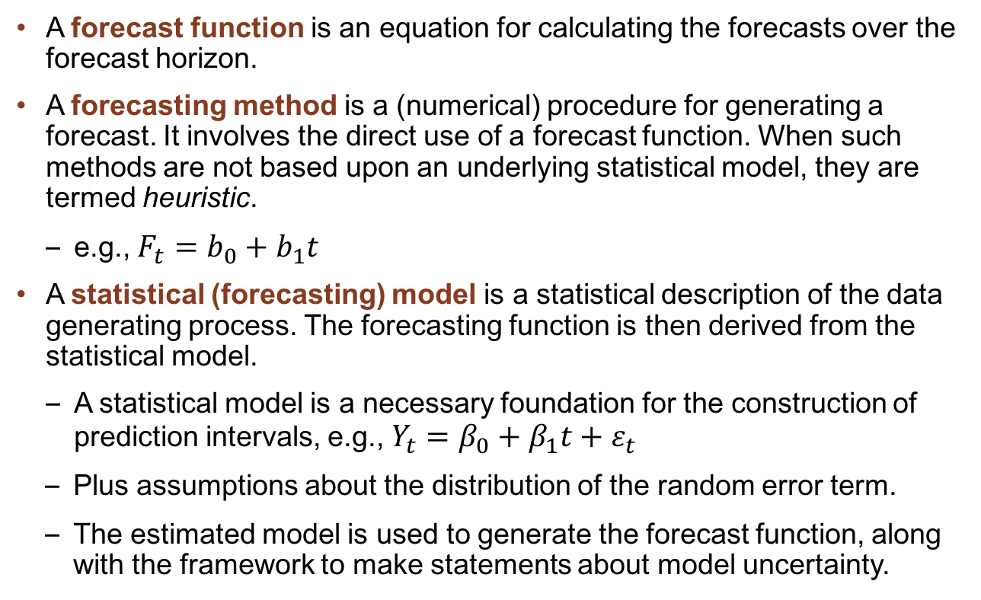
3.1 Method or Model?
A forecast function is an equation for calculating the forecasts over the forecast horizon.
A forecasting method is a (numerical) procedure for generating a forecast. It involves the direct use of a forecast function. When such methods are not based upon an underlying statistical model, they are termed heuristic.
e.g., $F_{t}=b_{0}+b_{1}t$
A statistical (forecasting) model is a statistical description of the data generating process. The forecasting function is then derived from the statistical model.
A statistical model is a necessary foundation for the construction of prediction intervals, e.g., $Y_{t}=β_{0}+β_{1}t+ε_{t}$
  Plus assumptions about the distribution of the random error term.
  The estimated model is used to generate the forecast function, along with the framework to make statements about model uncertainty.

Slide 4
3.2 Extrapolative Methods
Past, Present, & Future
Figure 3.1 General Framework for Forecasting with a Single Series

Slide 5
3.2 Extrapolative Methods
Figure 3.2 Plot of Actual Sales for Periods 1–12 and a
Range of Possible Values for Periods 13–20

Slide 6
3.2 Extrapolative Methods
Table 3.1 Notation for Forecasts Made at Different Forecast Origins
and for Varying Forecast Horizons
Forecast Origin | 12 | 13 | 14
Forecast for period 13 | F₁₃(1)
Forecast for period 14 | F₁₄(2) | F₁₄(1)
Forecast for period 15 | F₁₅(3) | F₁₅(2) | F₁₅(1)

Slide 7

3.2 Extrapolative Methods
Locally Constant Forecasts
A series is locally constant if the mean level changes gradually over time but there is no reason to expect a systematic increase or decrease in the future. The forecast function is:
That is, the plot showing future forecasts is a horizontal line. When a new observation becomes available, the constant is updated.
$$F_{t+h}(h)=\text{constant}$$

Slide 8
3.2 Extrapolative Methods
Locally Constant Forecasts
Figure 3.4 Time Series Plot for Weekly Sales for WFJ for the First 26 Weeks, Compared with the Average

Slide 9
3.2 Extrapolative Methods
Use of Moving Averages
The moving average of order K evaluated at time t is denoted by MA(t|K):
At each point in time, we drop the oldest observation and add a new one.
Large values of K produce smoother plots but are slower to adapt to changes.
We then forecast the time series at time (t+1) using the formula:

Slide 10
3.2 Extrapolative Methods
Calculation of Moving Averages
Table 3.2 Calculation of Moving Averages for WFJ Sales

Slide 11
3.2 Extrapolative Methods
Use of Moving Averages
Figure 3.5 WFJ Sales for First 26 Weeks, with Moving Averages of
Lengths 3 and 7

Slide 12
3.3 Simple Exponential Smoothing
When the (n+1)th observation is added, the mean may be expressed as:
A verbal description of this expression is:

Slide 13
3.3 Simple Exponential Smoothing
Simple (or Single) Exponential Smoothing follows the same general idea but makes a smooth transition from one period to the next.
We select a smoothing constant α, such that 0<α<1 making for a partial adjustment.
We denote the mean level at time t by L_{t}.
New mean = Old mean + α × (Difference between new observation and old mean)
By repeated substitution, we obtain the extended form showing the declining weights that give rise to the name exponential smoothing:

Slide 14
3.3 Simple Exponential Smoothing
This expression simplifies to the Error Correction form:
  where α is known as the smoothing constant
  e_{t} is the 1-step ahead forecast error = Y_{t} – F_{t}
A smaller value of α gives a smoother trend line:
  α = 0.1 gives slow adjustment
  α = 0.9 gives rapid adjustment

Slide 15
3.3 Simple Exponential Smoothing
Developed by R.G. Brown in 1940s & 50s.
For each series, only need to record last forecast, latest observation and smoothing constant.
Useful for short-term forecasting [especially for a large number of series].
Local level model, so h-step ahead point forecast is same as 1-step ahead:
Uncertainty increases as the forecasting horizon increases.

Slide 16
3.3 Simple Exponential Smoothing
Weights
Figure 3.6 Weights on Different Lags in an Exponentially
Weighted Moving Average

Slide 17
3.3 Simple Exponential Smoothing
Forecasting with the EWMA: Calculations
Table 3.3 Illustration of Spreadsheet Calculations for
SES Smoothing Constant: Alpha ($α$) = 0.3
Choosing the Smoothing Parameter
When forecasting with exponential smoothing, estimate the optimal smoothing parameters, rather than using preset values.

Slide 18
Discussion Question
If you had to make a subjective choice for the value of the smoothing constant, what value would you choose for (a) a product with long-term steady sales and (b) a stock price index?

Slide 19
3.3 Simple Exponential Smoothing
The Exponential Smoothing Macro (ESM)
The ESM is available on the book’s website. It is designed to generate forecasts from a wide selection of exponential smoothing models.
Features include:
  No trend, trend or damped trend
  Additive or multiplicative seasonality, for any length of seasonal pattern
  Box-Cox or logarithmic transformations
  Separate summary statistics for estimation and hold-out samples
  Seasonality checks
  Rolling origin analysis for non-seasonal series
  Fitting by nonlinear least squares using Excel Solver

Slide 20
3.3 Simple Exponential Smoothing
Exponential Smoothing Macro – An Example
Figure 3.7 SES Forecasts for WFJ Sales: The Effects of
Different Smoothing Constants

Slide 21
3.3 Simple Exponential Smoothing
The Use of Hold-Out Samples
For model development purposes, a time series is typically divided into two parts:
  The first part, the estimation or fitting sample, is used to estimate the parameters of the forecast function.
  The second part, the hold-out or test sample is used to check the performance of the forecasting method.
Measures of performance based upon the estimation sample are known as in-sample measures.
Measures of performance based upon the holdout sample are known as out-of-sample measures.

Slide 22
3.3 Simple Exponential Smoothing – Example
Table 3.5 Summary Error Measures for One-Step-Ahead Forecasts of
WFJ Sales Data (Hold-out sample, weeks 27–62)

Slide 23
3.3 Simple Exponential Smoothing
Use of a Rolling Origin
Figure 3.8 The Rolling Origin Process

Slide 24
3.3 Simple Exponential Smoothing
Use of a Rolling Origin
Figure 3.9 Rolling Origin Analysis for the WSJ Sales Series

Slide 25
3.3 Simple Exponential Smoothing
Choice of Estimation Criterion
The ESM uses nonlinear least squares, but parameter estimation could also proceed by minimizing the sum of the absolute errors or the sum of the absolute percentage errors.
Table 3.6 Effects of Fitting SES by Minimization of RMSE, MAE, or MAPE

Slide 26
3.4 Linear Exponential Smoothing
When a time series has a long-term trend (e.g. increases in GDP or sales) the forecasting method must accommodate such features. There are two main approaches:
  Convert the series to rates of change (growth rates, either absolute or percentage) then predict the rate of change, OR
  Develop forecasting methods that account for trends.
The method that accounts for trends directly is known as Linear Exponential Smoothing (LES) or as Holt’s Method.
  LES has both local level and local trend terms
  When the local trend is zero, LES reduces to SES

Slide 27
3.4 Linear Exponential Smoothing
Use of Trend Lines
Figure 3.10 Linear (A) and Quadratic (B) Trend Lines for Netflix
Sales Revenues (2000Q1–2015Q4) [Time = 1, 2, …, 64]

Slide 28
3.4 Linear Exponential Smoothing
Forecast function includes local trend:
  L_{t} is local estimate of level at time t
  T_{t} is local estimate of trend at time t
One-step-ahead:
SES corresponds to T_{t} = 0

Slide 29
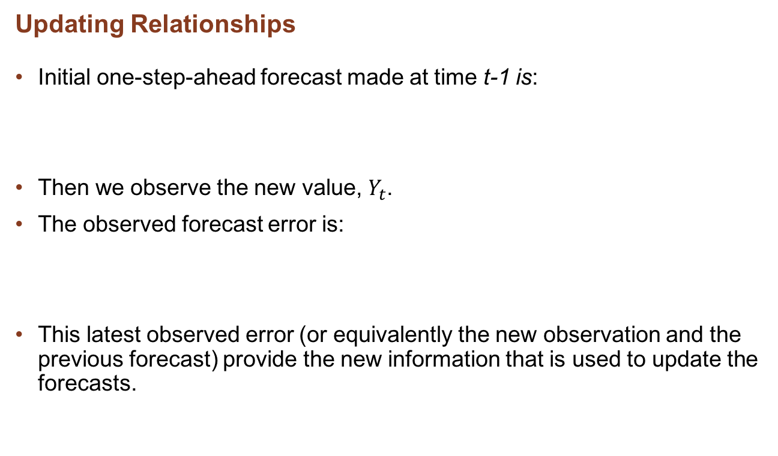
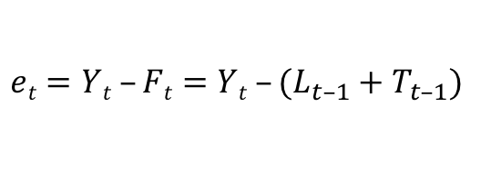
3.4 Linear Exponential Smoothing
Updating Relationships
Initial one-step-ahead forecast made at time t-1 is:
Then we observe the new value, $Y_{t}$.
The observed forecast error is:
This latest observed error (or equivalently the new observation and the previous forecast) provide the new information that is used to update the forecasts.
$$et=Yt –Ft=Yt –(L_{t–1}+T_{t–1})$$

Slide 30
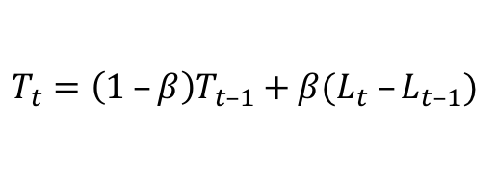


3.4 Linear Exponential Smoothing
Updating Relationships
Update local level, allowing for a one-period change due to the trend:
Update local trend as a combination of the previous trend and the change in level:
New forecast, one-step-ahead is:
New forecast, h-steps-ahead:
$$T_{t}=\left(1 –β\right)T_{t–1}+β(L_{t} –L_{t–1})$$
$$F_{t+1}=F_{t+1}\left(1\right)=L_{t}+T_{t}$$
$$F_{t+h}\left(h\right)=L_{t}+{hT}_{t}$$

Slide 31
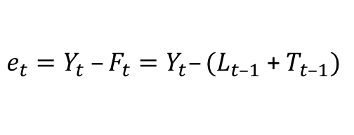
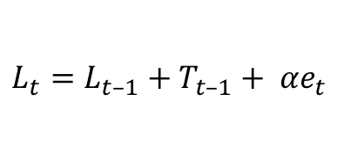



3.4 Linear Exponential Smoothing
Initial one-step-ahead forecast made at time t-1 is:
Forecast error:
Update local level, in terms or one-step-ahead error:
Update local trend after substituting for level:
New forecasts, as before:
$$F_{t}=F_{t}\left(1\right)=L_{t–1}+T_{t–1}$$
$e_{t}=Y_{t} –F_{t}=Y_{t}–(L_{t–1}$ + $T_{t–1})$
$$L_{t}=L_{t–1}+T_{t–1}+ {αe}_{t}$$
$$T_{t}=T_{t–1}+{αβe}_{t}$$
$$F_{t+h}(h)=L_{t}+{hT}_{t}$$

Slide 32
3.4 Linear Exponential Smoothing
LES: Spreadsheet Calculations
Table 3.7 LES Calculations for Hypothetical Sales Data
[Alpha ($α$) = 0.3, Beta ($β$) = 0.1]

Slide 33
3.4 Linear Exponential Smoothing
LES: An Example
Table 3.8 Estimation Sample and Hold-Out Sample Results for WFJ Sales
(Fitted by minimizing the MSE over weeks 1–26)

Slide 34
3.4 Linear Exponential Smoothing
Netflix Example
Figure 3.11 Netflix Revenues and One-Step-Ahead Forecasts for
Observations 53–64 from (A) Single Exponential Smoothing
and (B) Linear Exponential Smoothing
When there is a trend, single exponential smoothing lags behind the data.

Slide 35
3.4 Linear Exponential Smoothing
Netflix Example
Table 3.9 Summary Measures of SES and LES for Netflix Sales
Discussion Question
How would you choose among SES, LES, or a fitted straight line for use with a given series?

Slide 36
3.5 Exponential Smoothing with a Damped Trend
Use the updating equations:
New forecasts:
The effect of using damped trend is that the long-term forecast levels out and approaches the steady value:

Slide 37
3.5 Exponential Smoothing with a Damped Trend
Netflix Example
Table 3.10 One-Step-Ahead Fitted Values and Forecasts for
Netflix Sales Under the Damped Trend Method

Slide 38
3.5 Exponential Smoothing with a Damped Trend
Choice of Method: Possible Trend Patterns
Figure 3.12 Possible Trend Patterns Showing Trend/No Trend
and Additive/Multiplicative Trend

Slide 39
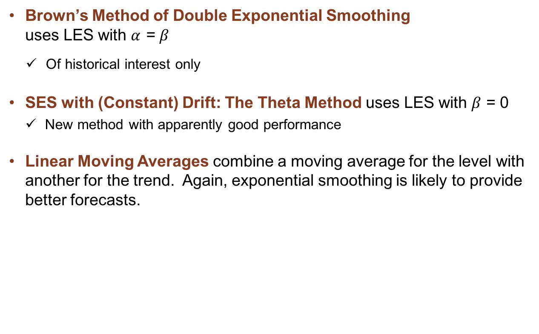
3.6 Other Approaches to Trend Forecasting
Brown’s Method of Double Exponential Smoothing
uses LES with $α$ = $β$
Of historical interest only
SES with (Constant) Drift: The Theta Method uses LES with $β$ = 0
  New method with apparently good performance
Linear Moving Averages combine a moving average for the level with another for the trend. Again, exponential smoothing is likely to provide better forecasts.

Slide 40
3.6 Other Approaches to Trend Forecasting
Tracking Signals
Use time dependent smoothing parameters. For SES, use the parameter:
E_{t} and M_{t} are smoothed values of the error and the absolute error:

Slide 41
3.7 The Use of Transformations
Growth rates and differences are ways to remove trends, as discussed in Section 2.6
Logarithmic and power transforms are ways to stabilize the variance and may also produce a transformed process that is more nearly linear.
Discussion Question
Suppose you carry out an extensive analysis and conclude that the best forecasting model involves a Box-Cox transform with c = ¹/₃ . Would you feel comfortable using this transform and reporting the results to management? Why or why not?

Slide 42


3.7 The Use of Transformations
Use of Growth Rates
Define the growth rate as:
After forecasting the growth rate as g_{t+1}, convert back to the original series:
Growth rates often produce results that are similar to the analysis with differences of logarithms; the latter provide simpler results for prediction intervals.
$$G_{t}=100 × \frac{Y_{t} – Y_{t–1}}{Y_{t–1}}$$
$$F_{t+1}\left(1\right)= F_{t+1}= Y_{t} ×\left[\frac{g_{t+1}}{100}\right]$$

Slide 43
3.7 The Use of Transformations
Growth Rates: Netflix Example
Table 3.12 Growth Rate Analysis of Netflix Quarterly Sales, 2000–2015

Slide 44
3.7 The Use of Transformations
Growth Rates: Netflix Examples
Q1:2000 to Q4: 2015

Slide 45
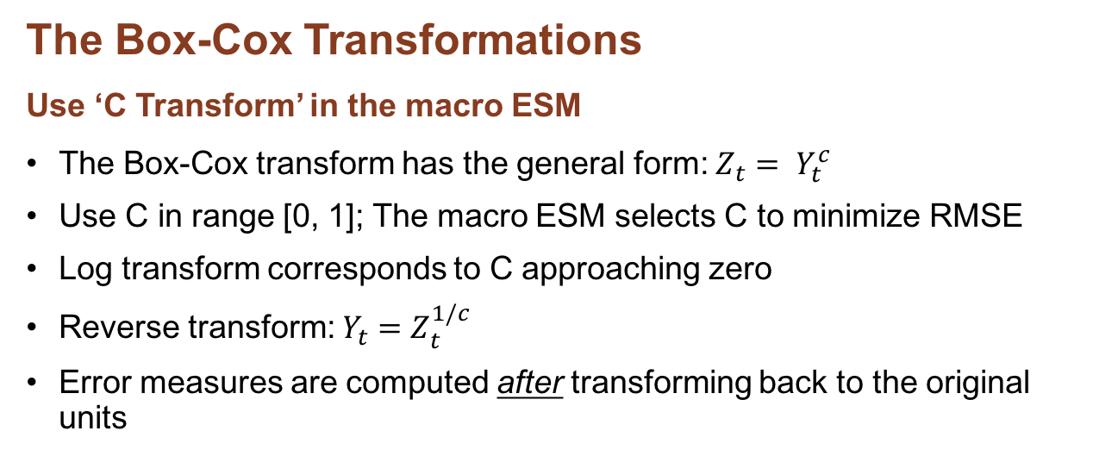
3.7 The Use of Transformations
The Box-Cox Transformations
Use ‘C Transform’ in the macro ESM
The Box-Cox transform has the general form: $Z_{t}= Y_{t}^{c}$
Use C in range [0, 1]; The macro ESM selects C to minimize RMSE
Log transform corresponds to C approaching zero
Reverse transform: $Y_{t}=Z_{t}^{1/c}$
Error measures are computed after transforming back to the original units
WHEN TO TRANSFORM
Do not use complex transforms unless they are supported by both theory and data.
Always compared transformed methods with a benchmark by transforming the forecasts back to the data series of interest.

Slide 46
The Box-Cox Transformations
Netflix Example
Figure 3.14 Plots of Transformed Netflix Data

Slide 47
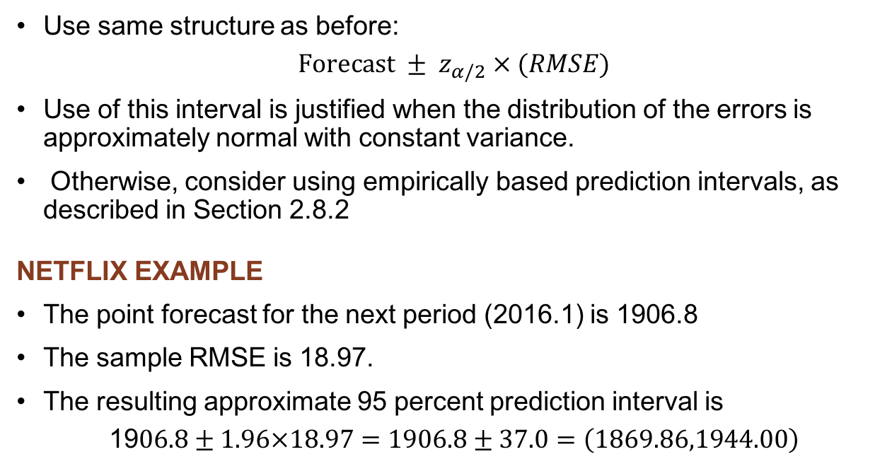
3.8 Prediction Intervals
Use same structure as before:
$$Forecast ± z_{α/2} × (RMSE)$$
Use of this interval is justified when the distribution of the errors is approximately normal with constant variance.
Otherwise, consider using empirically based prediction intervals, as described in Section 2.8.2
NETFLIX EXAMPLE
The point forecast for the next period (2016.1) is 1906.8
The sample RMSE is 18.97.
The resulting approximate 95 percent prediction interval is
$$\text{19}0\text{6}.\text{8}±\text{1}.\text{96}×\text{18}.\text{97}=\text{19}0\text{6}.\text{8}±\text{37}.0=\left(\text{1869}.\text{86},\text{1944}.00\right)$$

Slide 48
3.8 Prediction Intervals
WFJ Sales Examples
Table 3.14 One-Step-Ahead Prediction Intervals for WFJ Sales Series

Slide 49
3.9 Method Selection
Does the series display a trend? Do we expect the trend to continue into the future? If so, then
  Use a method that includes a local trend.
Do the observations tend to be more (or less) variable over time? If so, then
  Transform the data to obtain roughly constant variability.
Check for conformity with the principles for extrapolative methods

Slide 50
3.10 Principles of Extrapolative Methods
Plot the series.
Clean the data.
Use transformations as required by expectations about the process.
Select simple methods, unless convincing empirical evidence calls for greater complexity.
Evaluate alternative methods, preferably using out-of-sample data.
Update the estimates frequently.

Slide 51
Take-Aways
Always start by plotting (at least a subset of) the data series to identify past and likely future behavior as well as unusual observations.
The adaptive features of local methods are typically preferable for short-term forecasting.
Keep it simple, unless the data (strongly) indicate the need for a more complex approach.
Always evaluate forecasting performance, ideally using a hold-out sample.

Slide 52
Minicase 3.1 Job Openings
The monthly employment reports issued by the U.S. Department of Labor are eagerly monitored by investors as indicators of the health of the overall economy. The file Job_openings.xlsx contains the monthly figures for total nonfarm openings, from January 2001–December 2015, seasonally adjusted.
To provide investing insights, develop a forecasting procedure for this series, using 2001–2012 as the estimation sample and 2013–2015 as the hold-out sample. You should consider all the options described in the chapter: SES, LES, damped LES, Log and Box-Cox transformations. All these options may be explored via the ESM.

Slide 53
Minicase 3.2 The Evolution of Walmart
Consider the data on Walmart stores described in Chapter 2 (Minicase 2.2) and available in Walmart_2.xlsx. In Minicase 2.2, we used basic statistical tools to examine the changing composition of store types and the company’s growth. The objective now is to use exponential smoothing methods to generate the following forecasts:
Store composition for the next three years.
Sales for the next eight quarters.
In each case, plot the fitted and observed values of the series and identify any possible shortcomings in your forecasts. What steps, if any, might be taken to improve the forecasts without collecting any new data?

Slide 54
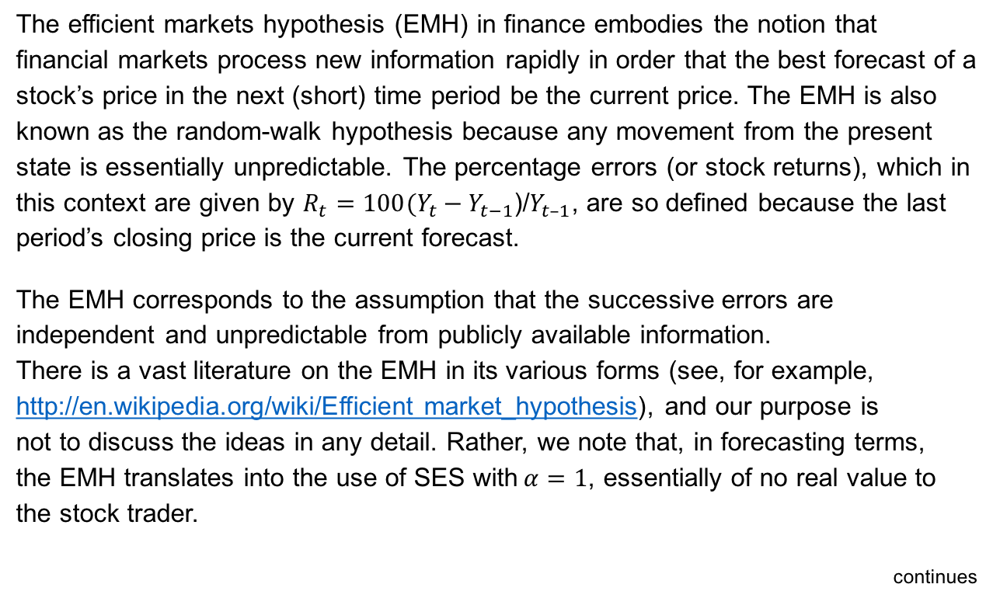
Minicase 3.3 Volatility in the Dow Jones Index
The efficient markets hypothesis (EMH) in finance embodies the notion that financial markets process new information rapidly in order that the best forecast of a stock’s price in the next (short) time period be the current price. The EMH is also known as the random-walk hypothesis because any movement from the present state is essentially unpredictable. The percentage errors (or stock returns), which in this context are given by $R_{t}=100(Y_{t}−Y_{t−1}$)/$Y_{t–1}$, are so defined because the last period’s closing price is the current forecast.
The EMH corresponds to the assumption that the successive errors are independent and unpredictable from publicly available information.
There is a vast literature on the EMH in its various forms (see, for example, http://en.wikipedia.org/wiki/Efficient market_hypothesis), and our purpose is
not to discuss the ideas in any detail. Rather, we note that, in forecasting terms,
the EMH translates into the use of SES with$α=1$, essentially of no real value to the stock trader.
continues

Slide 55
Minicase 3.3 Volatility in the Dow Jones Index
Despite many efforts to the contrary, it is essentially impossible for any purely statistical forecasting method to beat the random walk for any long period of time. Insider information can, of course, be of considerable value, but those forecasters tend not to be at liberty to talk about their methods. Nevertheless, some interesting questions can be answered that relate to volatility. Toward that end, we can examine the pattern of the forecast errors to determine whether the inherent variability in those forecasts varies over time. When variability is high, considerable opportunities exist for traders to buy or sell options (Hull, 2002). Conversely, when variability is very low, there is little room in the market for such contracts.
The spreadsheet DowJones_2.xlsx provides daily closing prices for the period 2011–2016, along with the values of the returns and their absolute values.
Examine the validity of the EMH for this series.
Use the SES to develop a forecasting method for the absolute values of the returns. Is volatility predictable, at least to some extent?

