Slide 1
Simple Linear Regression for Forecasting
Chapter 7

Slide 2
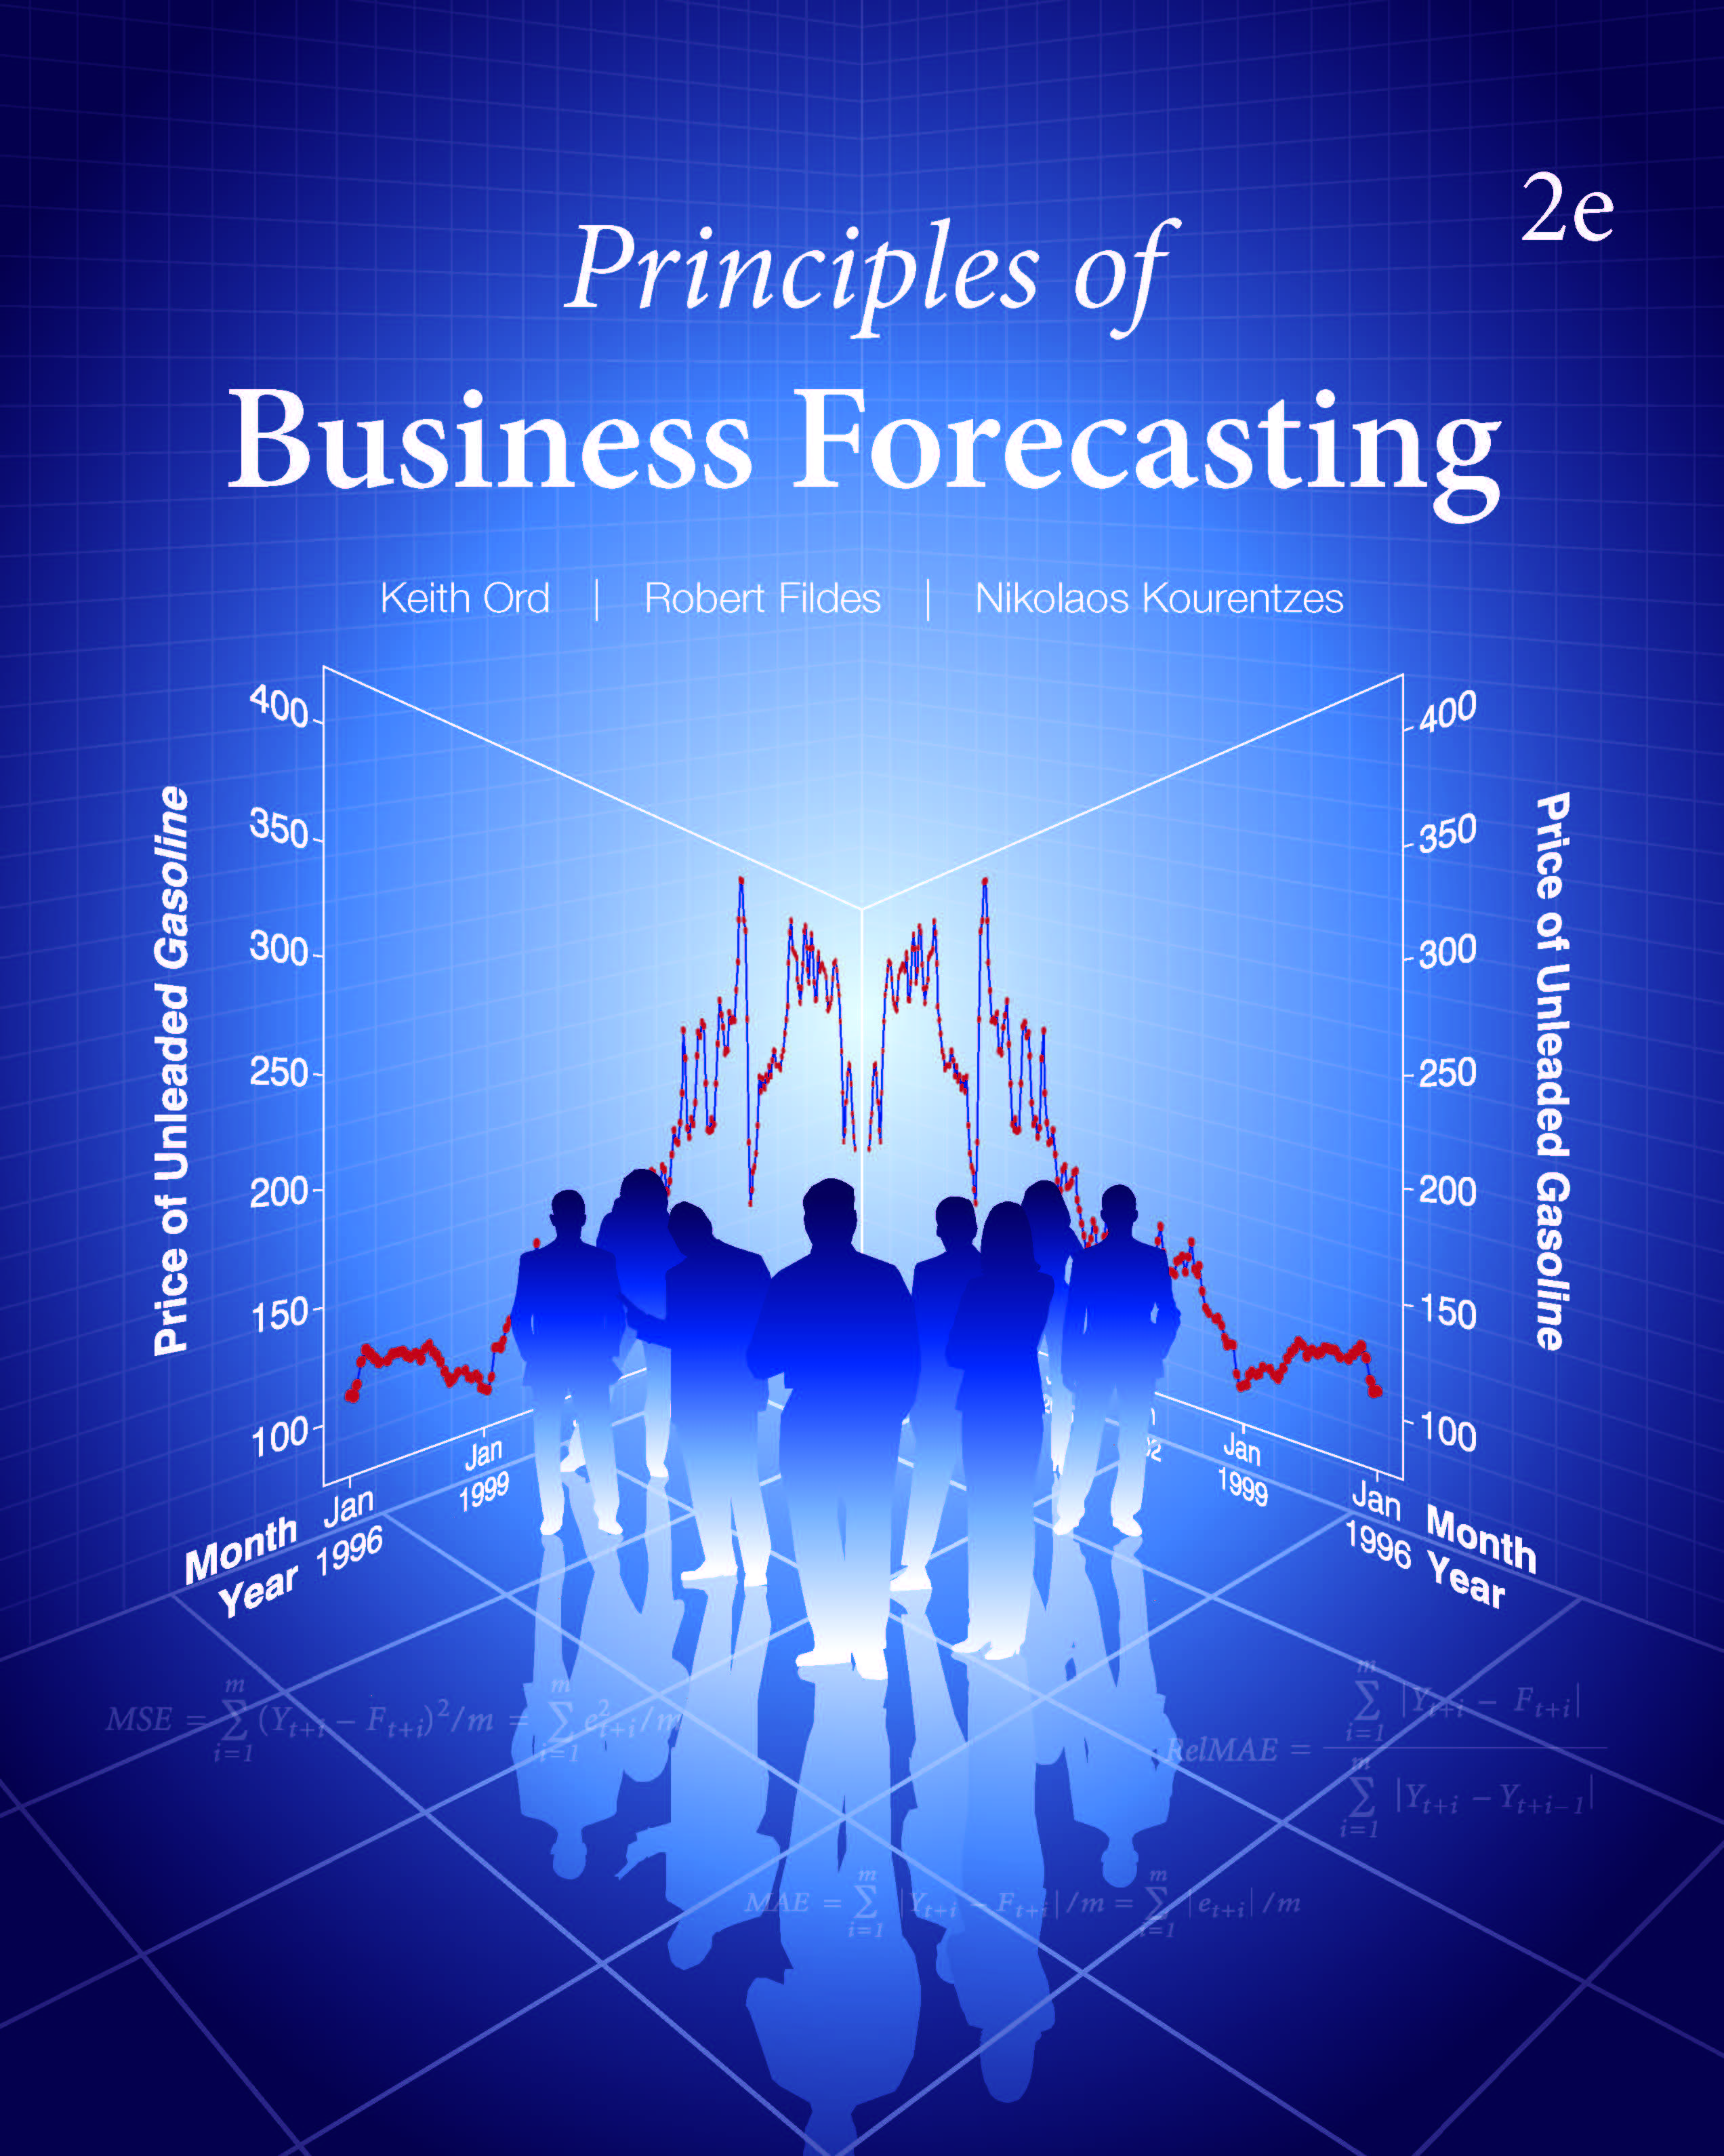
Chapter 7: Simple Linear Regression for Forecasting
7.1 Relationship between Variables: Correlation and Causation
7.2 Fitting a Regression Line by Ordinary Least Squares (OLS)
7.3 A Case Study on the Price of Gasoline
7.4 How Good is the Fitted Line?
7.5 The Statistical Framework for Regression
7.6 Testing the Slope
7.7 Forecasting Using Simple Linear Regression
7.8 Forecasting Using Leading Indicators

Slide 3
7.1 Relationships between Variables:
Correlation and Causation
In a causal model we are able to identify the known factors that determine future values of the dependent variable (denoted by Y), apart from the unknown random error.
Statistical correlation implies an association between two variables, but does not imply causality
Variables may be correlated because of a mutual connection to other variables.
Question: The following pairs of variables are correlated. Is there a causal relationship? If so, which variable has a causal effect on the other?
Height and Weight
Knowledge of Statistics and Number of Cars Owned
Advertising and Sales
Down Jones Index and Gross Domestic Product

Slide 4
7.1 Relationships between Variables:
Correlation and Causation
Regression analysis involves relating the variable of interest (Y), known as the dependent variable, to one or more input (or predictor or explanatory) variables (X).
The regression line represents the expected value of Y, given the value(s) of the inputs.
Figure 7.1 The Terms of the Line Y = b₀ + b₁X

Slide 5
7.1 Relationships between Variables:
Correlation and Causation
The regression relationship has a predictable component (the relationship with the inputs) and an unpredictable (random error) component. Thus, the observed values of (X, Y) will not lie on a straight line.
Figure 7.2 Plot of Electricity Consumption Against
Household Size with a Fitted Regression Line

Slide 6
7.1 Relationships between Variables:
Correlation and Causation
Forecasting with a regression model may take one of several forms depending upon the information that is used as input to the forecasting process.
  An ex ante, or unconditional, forecast uses only the information that would have been available at the time the forecast was made (i.e., at the forecast origin).
  An ex post, or conditional, forecast uses the actual values of the explanatory variables, even if these would not have been known at the time the forecast was made.
  A what-if forecast uses assumed values of the explanatory variables to determine the potential outcomes of different policy alternatives or different possible futures.

Slide 7
7.2 Fitting a Regression Line by
Ordinary Least Squares (OLS)
In Simple Linear Regression we assume that the relationship between X and Y is linear within the range of interest. That does not mean it is linear for all values of X!
Figure 7.3 Relationship Between Sales and Advertising
Question: Why might we only be interested in the (nearly) linear part of the curve?

Slide 8
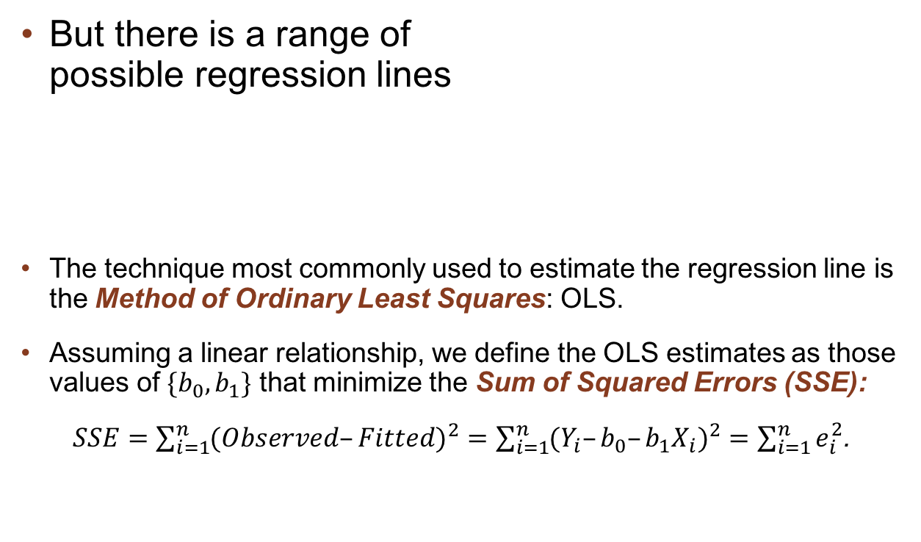
7.2 Fitting a Regression Line by
Ordinary Least Squares (OLS)
But there is a range of
possible regression lines
The technique most commonly used to estimate the regression line is the Method of Ordinary Least Squares: OLS.
Assuming a linear relationship, we define the OLS estimates as those values of $\{b_{0},b_{1}\}$ that minimize the Sum of Squared Errors (SSE):
$SSE=\sum_{i=1}^{n}{(Observed–Fitted)^{2}=\sum_{i=1}^{n}{(Y_{i}–b_{0}–b_{1}X_{i})^{2}=\sum_{i=1}^{n}{e_{i}^{2}}}}$.
The method of ordinary least squares determines the intercept and slope of the regression line by minimizing the sum of squared errors (SSE).

Slide 9
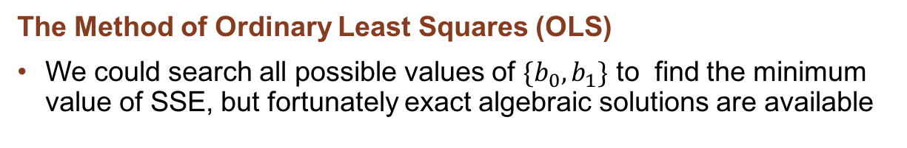
7.2 Fitting a Regression Line by
Ordinary Least Squares (OLS)
The Method of Ordinary Least Squares (OLS)
We could search all possible values of $\{b_{0},b_{1}\}$ to find the minimum value of SSE, but fortunately exact algebraic solutions are available
Figure 7.5
Minitab Plot of SSE against
Different Intercept and
Slope Parameters

Slide 10
7.2 Fitting a Regression Line by
Ordinary Least Squares (OLS)
The Method of Ordinary Least Squares (OLS)
Table 7.1 Spreadsheet for Regression Calculations Using Equation (7.5)

Slide 11
7.2 Fitting a Regression Line by
Ordinary Least Squares (OLS)
The Method of Ordinary Least Squares (OLS)
Example 7.3: Baseball Salaries: Scatterplot and Regression Line
Questions:
Is a linear relationship appropriate?
What do you observe from the scatterplot?
Salary ($000s) = 224 + 43.6 years in majors.

Slide 12
7.3 A Case Study on the Price of Gasoline
Suppose we are interested in predicting the price of (unleaded regular) gasoline (at the pump), given the price of crude oil at the refinery.
We examine monthly data; see the text for definitions of the variables.
The price of crude oil takes some time to have its effect on the pump price, so we lag the price of crude by one month.
Define the variables: Y = Unleaded
X = L1_crude_price
Questions:
What other variables might we include in the model?
Why else might we use a lagged value for the X variable?

Slide 13
7.3 A Case Study on the Price of Gasoline
Observe Unleaded and L1_crude_price over n time periods,
t = 1, 2, …, n
Step 1: Plot Y = Unleaded against time
Step 2: Generate a scatter plot of Y against X = L1_crude_price
Step 3: If several explanatory variables are available, plot Y against each of them to identify the most promising relationship
Step 4: Identify any unusual features in the data that may require special attention [A topic to which we return later]

Slide 14
7.3 A Case Study on the Price of Gasoline
Figure 7.7 Time Plot of U.S. Gasoline Prices, in Cents per Gallon
(Jan 1996–Dec 2008)
Question: What do you notice about this plot?

Slide 15
7.3 A Case Study on the Price of Gasoline
Possible input variables that could relate to Unleaded:
  The price of crude oil (“L1_crude_price”; in dollars per barrel)
  Unemployment (“L1_Unemp”; Overall percentage rate for the United States)
  The S&P 500 Stock Index (“L1_SP500”).
  Total disposable income (“L1_PDI”; in billions of current dollars)
Question: What other variables might be important in the short term
(i.e., over the next few months)?

Slide 16
7.3 A Case Study on the Price of Gasoline
Figure 7.8 Matrix Plot: Gasoline Prices Against Price of Crude Oil, the S&P Index, Personal Disposable Income (current prices), the Consumer Price Index (CPI), Retail Sales (RR_sales), and Demand (all lagged one period)

Slide 17
7.3 A Case Study on the Price of Gasoline
Correlation Analysis
Table 7.2 Correlations of Lagged Predictor Variables with Unleaded Price, and Intercorrelations (Jan 1996–Dec 2008)

Slide 18
7.3 A Case Study on the Price of Gasoline
Regression Analysis
Figure 7.9 Plot of Unleaded Prices Against Lagged Crude Oil Prices (L1_Crude_price)
Question: How is
this fitted line to be interpreted?
Fitted regression line: Unleaded = 0.688 + 0.0271 L1_crude_price

Slide 19
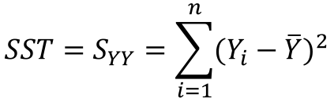



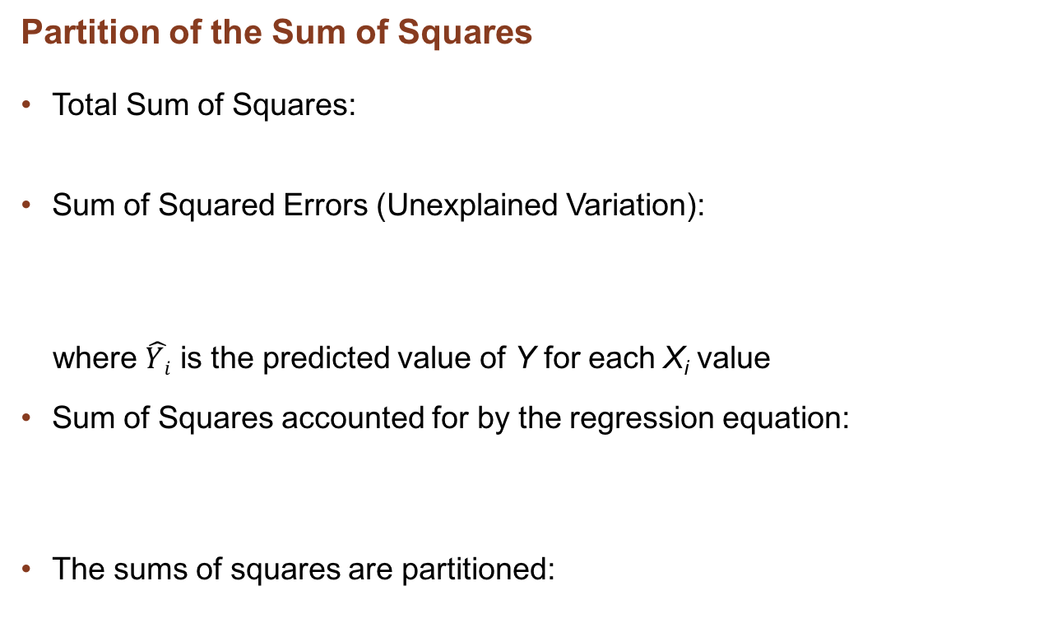
7.4 How Good is the Fitted Line?
Partition of the Sum of Squares
Total Sum of Squares:
Sum of Squared Errors (Unexplained Variation):
where $\hat{Yi}$ is the predicted value of Y for each X_{i} value
Sum of Squares accounted for by the regression equation:
The sums of squares are partitioned:
$$SST=S_{YY}=\sum_{i=1}^{n}{(Y_{i}−\overline{Y})^{2}}$$
$$SSE=\sum_{i=1}^{n}{(Y_{i}−\hat{Yi})^{2}}$$
$$SSR=\sum_{i=1}^{n}{({\hat{Y}}_{i}−\overline{Y})^{2}}$$
$$SST=SSR+SSE$$

Slide 20

7.4 How Good is the Fitted Line?
The Standard Error of Estimate
Denoted by S:
The denominator has (n-2) rather than (n-1) because we are estimating two parameters. “Two points define a straight line” so we need at least three observations to get any estimate of the standard error.
S is the standard deviation of the errors, defined as the differences between the observed values and the point on the regression line with the same value of X.
$$S=\sqrt{\frac{SSE}{n−2}}$$

Slide 21
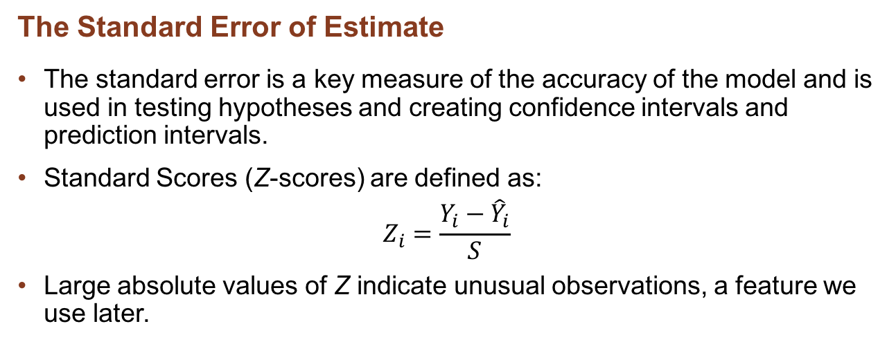
7.4 How Good is the Fitted Line?
The Standard Error of Estimate
The standard error is a key measure of the accuracy of the model and is used in testing hypotheses and creating confidence intervals and prediction intervals.
Standard Scores (Z-scores) are defined as:
$$Z_{i}=\frac{Y_{i}−{\hat{Y}}_{i}}{S}$$
Large absolute values of Z indicate unusual observations, a feature we use later.

Slide 22
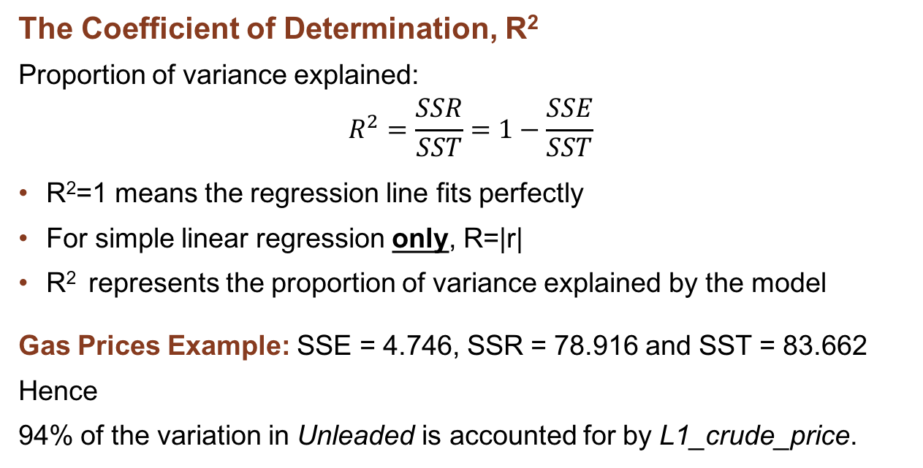
7.4 How Good is the Fitted Line?
The Coefficient of Determination, R²
Proportion of variance explained:
$$R^{2}=\frac{SSR}{SST}=1−\frac{SSE}{SST}$$
R²=1 means the regression line fits perfectly
For simple linear regression only, R=|r|
R² represents the proportion of variance explained by the model
Gas Prices Example: SSE = 4.746, SSR = 78.916 and SST = 83.662
Hence
94% of the variation in Unleaded is accounted for by L1_crude_price.
R², the coefficient of determination, measures the proportion (percentage) of the variation in the dependent variable, Y, explained by the regression model.

Slide 23
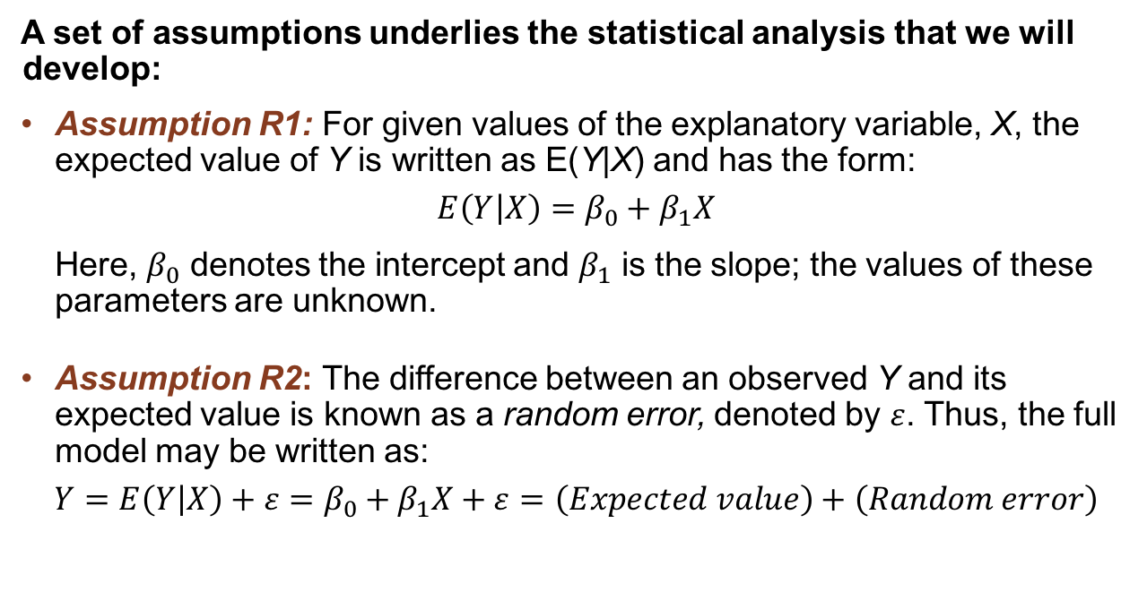
7.5 The Statistical Framework for Regression, I
A set of assumptions underlies the statistical analysis that we will develop:
Assumption R1: For given values of the explanatory variable, X, the expected value of Y is written as E(Y|X) and has the form:
$$E\left(Y | X\right)=β_{0}+β_{1}X$$
  Here, $β_{0}$ denotes the intercept and $β_{1}$ is the slope; the values of these parameters are unknown.
Assumption R2: The difference between an observed Y and its expected value is known as a random error, denoted by $ε$. Thus, the full model may be written as:
$$Y=E\left(Y | X\right)+ε=β_{0}+β_{1}X+ε=\left(Expected value\right)+\left(Random error\right)$$

Slide 24
7.5 The Statistical Framework for Regression, II
Assumption R3: The expected value of each error term is zero. That is, there is no bias in the measurement process.
Assumption R4: The errors for different observations are uncorrelated with other variables and with one another.
When examining observations over time, this assumption corresponds to a lack of autocorrelation among the errors.
Otherwise, the errors are (auto)correlated.
Assumption R5: The variance of the errors is constant. That is, the error terms come from distributions with equal variances.
This common variance is denoted by σ² and when the assumption is satisfied we say that the error process is homoscedastic. Otherwise, we say that it is heteroscedastic.
Assumption R6: The random errors are drawn from a normal distribution

Slide 25
7.5 The Statistical Framework for Regression, III
Assumptions R3 – R6 are typically combined into the statement that the errors are independent and normally distributed with zero means and equal variances
  Independent of each other and also the explanatory variables
Note that Assumptions R3 – R6 are exactly the same as those made in the developments of state-space and ARIMA models in Chapters 5 and 6.
RANDOM ERRORS AND RESIDUALS
The random error represents the difference between the expected and observed values. In a valid model, the random error for a particular observation is completely unpredictable, in that it is unrelated to either the explanatory variable(s) or the random errors in other observations.
Because the intercept and slope are unknown, we must estimate the error from the fitted model; we refer to this estimate as a residual.

Slide 26
7.5 The Statistical Framework for Regression
Parameter Estimates
The parameters and the corresponding estimates are defined as follows:
The sample estimates of the intercept and slope are defined as:

Slide 27
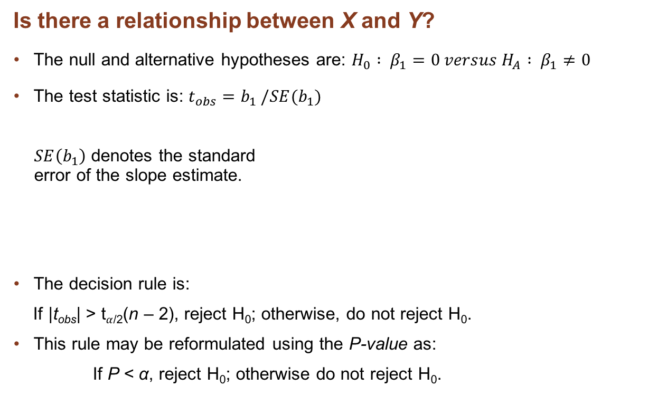
7.6 Testing the Slope
Is there a relationship between X and Y?
The null and alternative hypotheses are: $H_{0} : β_{1}=0 versus H_{A} : β_{1}≠0$
The test statistic is: $t_{obs}=b_{1} /SE(b_{1})$
$SE\left(b_{1}\right)$ denotes the standard
error of the slope estimate.
The decision rule is:
If |t_{obs}| > t$α$_{/2}(n – 2), reject H₀; otherwise, do not reject H₀.
This rule may be reformulated using the P-value as:
If P < α, reject H₀; otherwise do not reject H₀.

Slide 28
7.6 Testing the Slope
Example 7.5: Test and confidence interval for gasoline prices
The Summary results are (as from Minitab output; you should not use so many decimal places when reporting the results):
Note the P value for the slope: Using any reasonable value of α, clearly reject H₀ [No need for tables!]
Note that Minitab records the P-value to 3 decimal places so that P=0.000 really means P < 0.0005 [Much less in this case]
Typically there is no point in testing the intercept unless you have reason to believe that the intercept should be zero

Slide 29
Discussion Questions
An increase of one unit in the value of X produces an increase of β₁ units in the expected value of Y.
    Does the size of β₁ measure the importance of X in forecasting Y?
In the Gas Price example the estimated slope is 2.707: an increase of $1 in the price of crude produces an expected increase of 2.71 cents in the price at the pump.
    What is the impact on the standard error of a change in the units in which X is measured? In which Y is measured? Does R² change?

Slide 30
7.6 Testing the Slope
Interpreting the Slope Coefficient
Elasticity
The elasticity is defined as the proportionate change in Y relative to the proportionate change in X and is measured by
where ΔY is the change in Y and ΔX is the change in X.
In November 2008, the price of crude was $57.31 per barrel, yielding an expected December price of unleaded of $2.239. The elasticity of the price of unleaded to the price of crude is estimated as

Slide 31
7.6 Testing the Slope
Transformations
Consider a logarithmic transform of both Unleaded and L1_crude_price.
The resulting regression output is:
Transforming back to the original units:
Unleaded = exp(2.8971) x (L1_Crude_price)^{0.62815}
The elasticity for the log-log model is constant and given by the slope. Interpret this result.

Slide 32
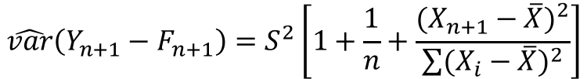
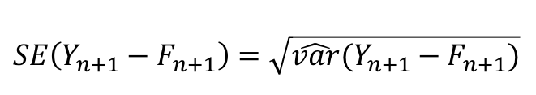

7.7 Forecasting by Using Simple Linear Regression
The forecast for Y, given the value X_{n+1} is
The estimated forecast variance is
The standard error of the forecast is the square root of the forecast variance
$${\hat{Y}}_{n+1}=F_{n+1}=b_{0}+b_{1}X_{n+1}$$
$$\hat{var}\left(Y_{n+1}−F_{n+1}\right)=S^{2}\left[1+\frac{1}{n}+\frac{(X_{n+1}−\overline{X})^{2}}{\sum{(X_{i}−\overline{X})^{2}}}\right]$$
$$SE\left(Y_{n+1}−F_{n+1}\right)=\sqrt{\hat{var}(Y_{n+1}−F_{n+1})}$$

Slide 33
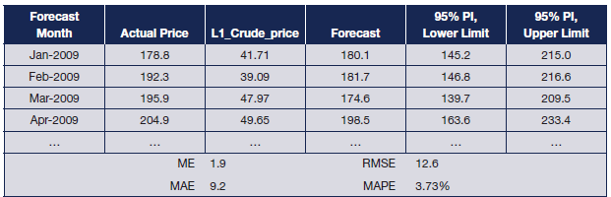
7.7 Forecasting by Using Simple Linear Regression
Prediction Intervals
The prediction interval for a forecast measures the range of likely outcomes for the unknown actual observation, for a specified probability and for a given X value.
The prediction interval for the forecast is
Here, t denotes the percentage point of the Student’s t-distribution.
Question: The confidence interval for the slope gets narrower and narrower as the sample size increases. Does the same apply to the prediction interval for a future observation? Why or why not?

Slide 34
7.7 Forecasting by Using Simple Linear Regression
Prediction Intervals
Example 7.7
We continue our consideration of the forecasts for May 2009, begun in Example 7.6. The various numbers we need are
The standard error is:
Thus the prediction interval is:

Slide 35
7.7 Forecasting by Using Simple Linear Regression
Graphical Display of the Prediction Interval
Figure 7.13 Plot of Actual Values with One-Step-Ahead Forecasts and 95% Prediction Intervals for Price of Unleaded Gasoline (Jan 2009–Dec 2010)

Slide 36
7.7 Forecasting by Using Simple Linear Regression
An Approximate Prediction Interval
When the sample size is large the standard error approaches S.
The prediction interval is then approximately equal to:
Since n is large the t-value is close to the limiting value from the normal distribution. So, for a back-of-the-envelope calculation, the 95% prediction interval is approximately:
Something to keep in mind in a planning meeting!

Slide 37
7.7 Forecasting by Using Simple Linear Regression
Forecasting More than One Period Ahead
There are two principal approaches:
  Generate forecasts for X and apply these to the original model.
  Reformulate the model so that X is lagged by two (or more) periods, as appropriate.
Results for forecasting gas prices: which approach is better?

Slide 38
7.8 Forecasting Using Leading Indicators, I
Consider the relationship between Unemployment [Un] and Consumer Sentiment [CS]
  Monthly data available in Unemp_conconf_2.xlsx for January 1981 through December 2012; Un is a percentage and CS is measured on the scale (0, 100)

Slide 39
7.8 Forecasting Using Leading Indicators, I
The regression for current Un on current CS is:
Un = 13.70 - 0.0840 CS
Interpret the result.

Slide 40
7.8 Forecasting Using Leading Indicators, II
This regression equation is of limited value for forecasting because it involves current values of CS.
Consider lagged values of CS to provide advance information.
The data set provides lags 1, 2 and 3 – Which is best? How do we decide?
Questions:
Does Consumer Sentiment drive Unemployment or does Unemployment drive Consumer Sentiment?
Or perhaps there is a feedback loop between the two?
How do such issues affect our ability to forecast?

Slide 41
Take-Aways
Correlation does not imply causation; always try to select explanatory variables that have an economic (business or scientific) justification
A regression relationship may be linear within only a limited range of the observations,
  we may not sensibly extrapolate outside that range without justification that the model still holds
It is good practice to check that the underlying assumptions are at least approximately valid.

Slide 42
Appendix 7A: Derivation of Ordinary Least Squares
Minimize the Sum of Squared Errors:
Leads to the pair of equations:
Set
Final estimates:

Slide 43
Minicase 7.1 Gasoline Prices Revisited
Use the data in Gas_prices_1.xlsx.
Using data up to December 2012, re-estimate the model, contrasting your results with those discussed in the text. Comment on your results.
Use the data for 2013–2015 as the hold-out sample to test the forecasting performance of your model.
Repeat the analysis, using the log transformed series, and compare your results.
Use the Consumer Price Index (CPI) to create real (constant-dollar) prices rather than observed prices for both variables. Repeat the analysis described in steps 1 and 2. Does this approach lead to improved forecasts? Do any economic arguments suggest using a constant-price model?
If you were to conduct the analysis using weekly data from the same source, how long a lag would you use?
In some countries, tax on fuel is a major component of the retail price of gasoline. How would you include the effects of changes in the tax?
Summarize your findings.

Slide 44
Minicase 7.2 Consumer Confidence and Unemployment
Measures of consumer confidence are readily available from sample surveys and often serve as useful leading indicators when data on causal macroeconomic variables are not yet available.
Use the data in the spreadsheet Unemp_conf_2.xlsx for January 1981 to December 2012 to estimate the regression for U.S. unemployment on the University of Michigan Consumer Confidence Index. Unemployment is seasonally adjusted but the Index is not. Try the current month as the predictor variable and also try the Index of Consumer Confidence at lags one, two and three. Which model provides the best fit?
Generate forecasts for each month of 2013–2015 using each model.
Compare the forecasting performance of each model, using the measures developed in Chapter 2.
Summarize your findings.

Slide 45
Minicase 7.3 Baseball Salaries Revisited
Use the data in Baseball.xlsx. It is evident from Example 7.3 that salaries start to level off or even decline once players’ careers extend beyond 12 years or so. Also, the spread of salaries increases considerably as the number of years played increases. To allow for these features of the data,
Eliminate players with 12 or more years of experience from the data set and rerun the analysis. Compare your results with those reported in Example 7.3.
Transform the salaries by taking logarithms and determine whether the regression assumptions outlined in Section 7.5 seem to be better approximations to the transformed data.
Generate 95 percent prediction intervals for all players, and check to see how many actual salaries fall within those intervals.
What conclusion do you draw from eliminating the unusual observations?

