Slide 1
Model Building
Chapter 9

Slide 2
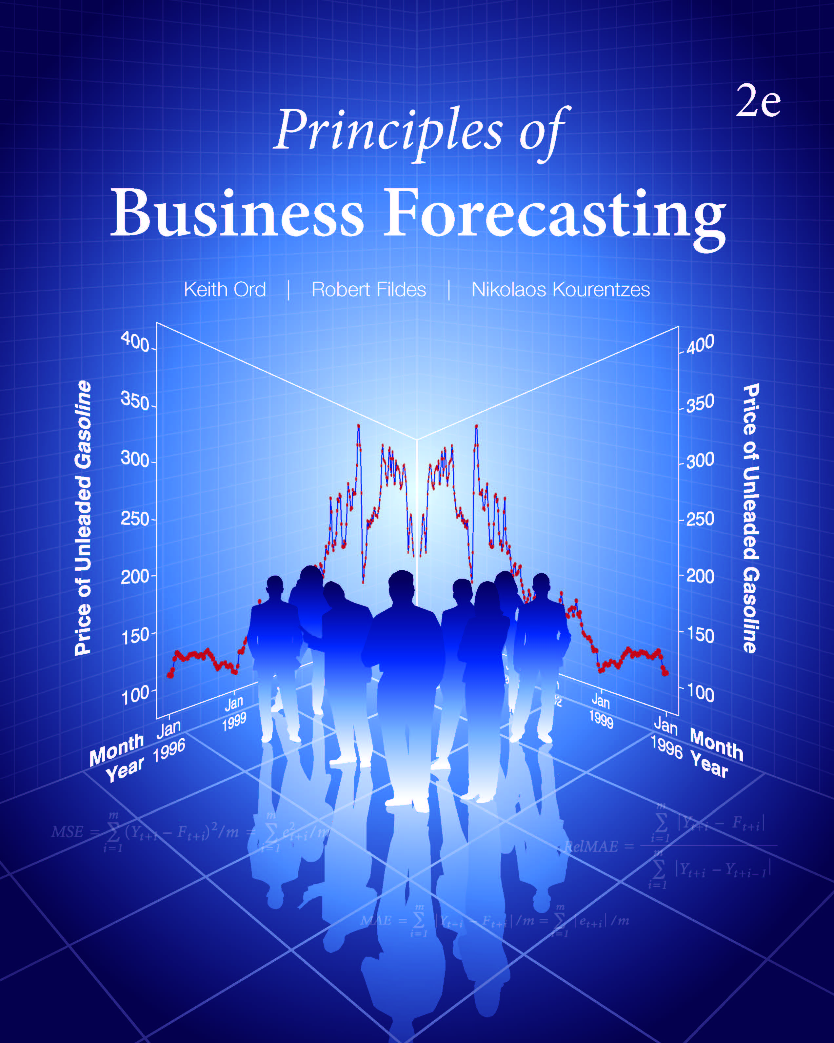
Chapter 9: Model Building
9.1 Indicator (Dummy) Variables
9.2 Autoregressive Models
9.3 Models with Both Autoregressive and
Regression Components
9.4 Selection of Variables
9.5 Multicollinearity and Variable Selection
9.6 Nonlinear Models
9.7 Outliers and Leverage
9.8 Intervention Analysis
9.9 Structural Change and Model Simplification
9.10 An Update on Forecasting
9.11 Principles of Regression Model Building

Slide 3
9.1 Indicator (Dummy) Variables
When observations fall into one of two categories, we distinguish them by means of an indicator (or dummy) variable, defined as
X = 1 if the observation falls into category A;
X = 0 if the observation falls into category B.
In general, when there are H categories, we need only (H – 1) indicator variables, which can be defined as follows:
X_{i} = 1 if the observation falls into the ith category;
X_{i} = 0 otherwise, for i = 1…(H – 1).
For example:
[X₁ = 1, if female and X₁ = 0, if male]
achieves the same purpose in model building as
[X₂ = 1, if male and X₂ = 0, if female]

Slide 4
9.1 Indicator (Dummy) Variables
Example 9.1
Suppose Y = salary
  X₁ = years of experience
  X₂ = gender (F =1, M = 0)
The expected value of salary, given experience and gender is
For males, X₂ = 0 so the expected value is
For females, X₂ = 1 so the expected value is
That is, parallel lines with different intercepts.

Slide 5
9.1 Indicator (Dummy) Variables
Expected Salaries for Each Gender, by Years of Experience
Figure 9.1 Expected Salaries for Each Gender, By Years of Experience
What is the difference in salaries?

Slide 6
9.1 Indicator (Dummy) Variables
Use of Indicators
  If there are H classes, use (H – 1) indicators e.g. just 1 for gender.
  WFJ Sales has 5 possible categories of TV advertising, so use 4 indicators. Which 4?
  When you use indicators, keep the full set in the model (or redefine the categories but you must also redefine the indicators)

Slide 7
9.1 Indicator (Dummy) Variables
Version 1: Uses first four indicator variables
WFJ Sales = 34488 – 8019 X1 + 119 X2 – 305 X3 – 1356 X4
Version 2: Uses last four indicator variables
WFJ Sales = 26470 + 8138 X2 + 7714 X3 + 6663 X4 + 8019 X5
Which model is better? Interpret the results.

Slide 8
9.1 Indicator (Dummy) Variables
Example 9.2: WFJ Sales, Some Further Questions
The two models are identical. The summary statistics are:
S = 4688.03 R-Sq = 31.9% R-Sq(adj) = 27.1%
Substitute the values of the indicator for each classification to confirm that the regression lines are the same for each case.
How might you arrive at a clearer idea of what is happening by defining a new (simpler?) set of indicators?
How much improvement do you see in the model as the result of adding the indicator variables? How might you measure the extent of the improvement?

Slide 9
9.1 Indicator (Dummy) Variables
Seasonal Indicators
Generate 4 (use 3) indicators for quarterly data [or 12 (use 11) for monthly].
Consider Walmart sales relative to GDP; GDP is deseasonalized.
Residual plots show seasonal patterns exist.
Figure 9.3 Residual Plots for Walmart Sales on Lagged GDP
Figure 9.4 ACF of Residuals (from the regression of Walmart Sales on Lagged GDP)

Slide 10
9.1 Indicator (Dummy) Variables
Seasonal Indicators
Define seasonal indicators as follows:
Comparison of the two models:
 | X₁ | X₂ | X₃
if the observation pertains to the first quarter | 1 | 0 | 0
if the observation pertains to the second quarter | 0 | 1 | 0
if the observation pertains to the third quarter | 0 | 0 | 1
if the observation pertains to the fourth quarter | 0 | 0 | 0
Statistic | Model 1 | Model 2
S | 7.047 | 4.909
R² | 86.50 | 93.85
R²(adj) | 86.22 | 93.31
Question: Which measure provides the clearest indication of the improvement produced by Model 2?

Slide 11
9.2 Autoregressive Models
In exponential smoothing, based forecasts of series upon its own past history. How can we do this in the context of regression?
We incorporate autoregressive terms into the model. That is:
  We create lagged values of the dependent variable and run the regression analysis using these lagged values along with the other variables.
Question: How should we decide which lags to use?

Slide 12
9.2 Autoregressive Models
Selecting lagged values for the Walmart example
There appeared to be a carry-over from one period to the next in the original series
  Include lag 1
Our analysis of the residuals clearly identified a seasonal pattern
  Include lag 4
Walmart Analysis
  Model 3: Include both lags
  Model 4: Include only lag 4
  Model 5: Include both lags and the seasonal indicators
  Model 6: Include lag 4 and the seasonal indicators

Slide 13
9.3 Models with Both Autoregressive and
Regression Components
Table 9.2 Summary Statistics for Different Models for Walmart Sales
Question: Which measure provides a better indication of performance? S or R²(adj)?

Slide 14
9.4 Selection of Variables
Ideally, model selection would be based upon a full knowledge of the relevant variables, BUT
  Understanding of the process may be incomplete (or close to non-existent!)
  Data may not be available in time to be useful (e.g. delay in producing macroeconomic measures)
  The structure of time lags may be unknown
Question: A soft drinks company increases its spending on TV advertising by 20 percent during a three week campaign. Spending then reverts to normal.
For how long after the campaign will their market share be higher than usual?

Slide 15
9.4 Selection of Variables
Forward selection starts by including the variable that has greatest explanatory power (and most significant t-value). Next, those variables not yet included in the model are evaluated, and the variable that adds most to the model’s explanatory power is added to the model. This step is then repeated.
Backward selection starts by including all the variables in the model and then deleting the variable with least explanatory power (and least significant t-value). This step is then repeated for the variables remaining in the model.

Slide 16
9.4 Selection of Variables
Stepwise regression alternately adds a new variable to the model and then evaluates existing variables for possible deletion. When the same variable is successively deleted and immediately added back, the search considers additional variables. The aim is to achieve the highest value of R² at each stage.
Best subsets regression considers all possible subsets of the variables and so guarantees the largest possible R² (or some other preselected criterion). This approach is computationally more expensive than the other ones.

Slide 17
9.4 Selection of Variables: Forward and
Backward Selection Procedures Compared
Note: Dependent Variable: Unleaded. Data: Gas_Prices_2.xlsx; adapted from SPSS output.

Slide 18
9.4 Selection of Variables
Searching All Possible Models: Best Subset Regression
Partial Results

Slide 19
9.4 Selection of Variables
Model Comparison Using a Hold-Out Sample to Compare Models
Whenever the sample size is sufficient to allow the use of a hold-out sample this approach should be employed
Table 9.5 Summary Measures of One-Step-Ahead Forecast Performance for the ARIMA Scheme and the Selected Models, 2009–2010
Question: Why does the ARIMA model (the model for simple exponential smoothing) work so much better?

Slide 20
9.4 Selection of Variables
A Regression Model with Autoregressive Errors
Cochrane-Orcutt Model
Include an error term that depends on the previous error(s):
Gas Prices [Example 9.4]
We arrive at the model:
Error measures for hold-out sample:

Slide 21
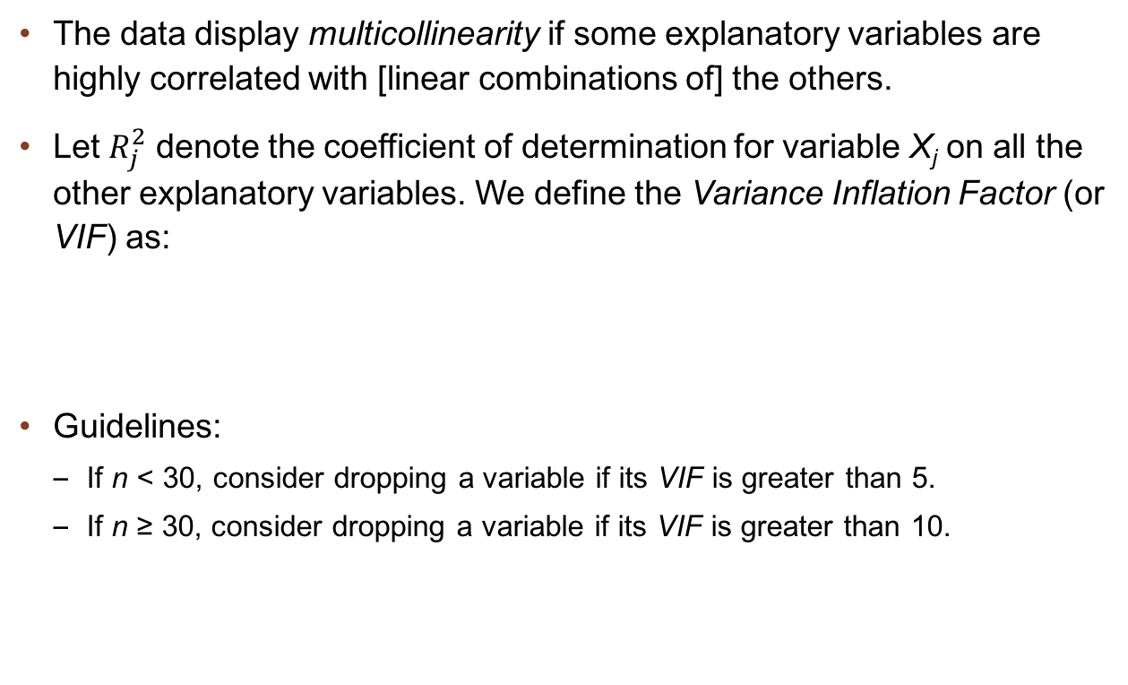
9.5 Multicollinearity and Variable Selection
The data display multicollinearity if some explanatory variables are highly correlated with [linear combinations of] the others.
Let $R_{j}^{2}$ denote the coefficient of determination for variable X_{j} on all the other explanatory variables. We define the Variance Inflation Factor (or VIF) as:
Guidelines:
  If n < 30, consider dropping a variable if its VIF is greater than 5.
  If n ≥ 30, consider dropping a variable if its VIF is greater than 10.

Slide 22
9.5 Multicollinearity and Variable Selection
Table 9.6 VIF Values for the Gas Price Models Obtained by Forward and Backward Selection (Database: Jan1996–Dec2008)

Slide 23
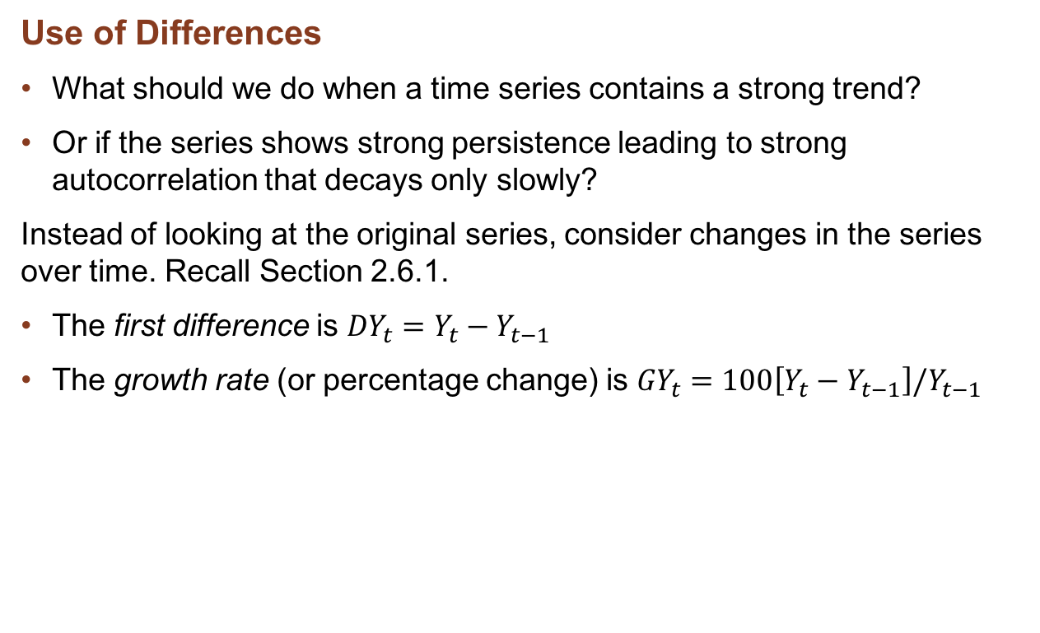
9.5 Multicollinearity and Variable Selection
Use of Differences
What should we do when a time series contains a strong trend?
Or if the series shows strong persistence leading to strong autocorrelation that decays only slowly?
Instead of looking at the original series, consider changes in the series over time. Recall Section 2.6.1.
The first difference is ${DY}_{t}=Y_{t}−Y_{t−1}$
The growth rate (or percentage change) is ${GY}_{t}=100\left[Y_{t}−Y_{t−1}\right]/Y_{t−1}$
Compare the ACF and PACF for the Dulles passengers series (Figure 2.2) and its first differences.

Slide 24
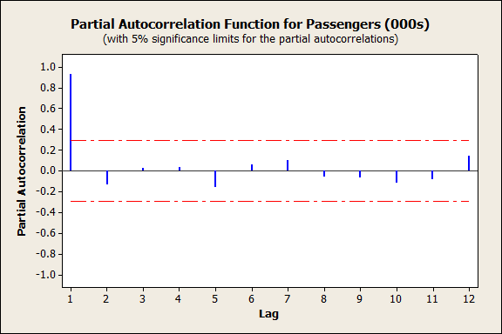
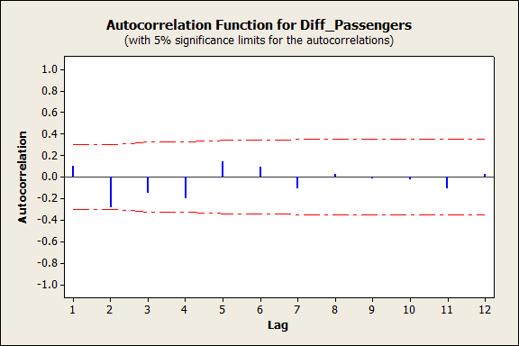
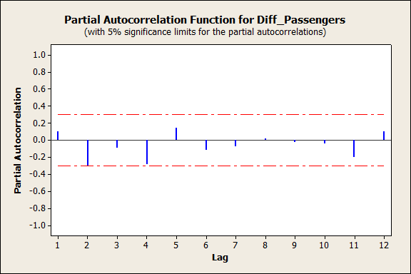
9.5 Multicollinearity and Variable Selection
ACF and PACF for Dulles Series

Slide 25
9.5 Multicollinearity and Variable Selection
Use of Differences
If we switch to DY_{t} for the dependent variable, we should also consider using differences for the input variables.
ALWAYS ask: does X have an effect on the level of Y, or on the change in Y?
Table 9.7 Summary Results for Selection Models for Unleaded Gasoline Prices, Based Upon Differenced Series (Data: Jan1996–Dec2008)

Slide 26
9.5 Multicollinearity and Variable Selection
The Lasso Method in Model Selection
Aim: To simplify and stabilize the model when there are many potential explanatory variables
Steps
Standardize variables
Impose constraint on coefficients
  This drives coefficients towards zero
Select metaparameter T₀
  Interpretable, simplified model with good out-of-sample characteristics
  T₀ may be selected optimally; the range of values in the table shows the effects of making the lasso more restrictive

Slide 27
9.5 Multicollinearity and Variable Selection
Lasso – Application to Unleaded Priced
Group Lasso applies constraints separately to groups of variables
  Here, 3 groups: lagged Crude, lagged Unleaded, the seven other variables
Regular and Group Lasso Analyses of Unleaded Gasoline Prices Data
Table 9.9 Results of Regular and Group Lasso Analyses of Unleaded Gas Prices

Slide 28
9.6 Nonlinear Models
Some relationships are nonlinear –
example: Sales vs. Advertising in Figure 9.9. Why?
Fit a polynomial scheme (e.g., quadratic in X = Advertising)

Slide 29
9.6 Nonlinear Models
Polynomial Schemes
Example 9.7: Linear vs. quadratic models for Sales on Advertising
Question: Interpret the coefficients. Does the model work for very high advertising expenditures?

Slide 30
9.6 Nonlinear Models
Nonlinear Transformations
Rather than a polynomial scheme we could transform both Sales and Advertising to logarithms.
Question: Which model is better: quadratic or logarithmic?

Slide 31
9.6 Nonlinear Models
Intrinsically Nonlinear Models
Some models cannot be transformed into a form that is linear in the parameters.
Such models may still be fitted by the method of Ordinary Least Squares. See the spreadsheet Trend.xlsm for an example.
Question: What are the principal features of this plot?

Slide 32
9.7 Outliers and Leverage
An outlier is an unusual observation that lies far away from its expected or forecast value (e.g. lower sales due to bad weather).
A leverage point is an observation that has a substantial impact upon the analysis.

Slide 33
9.7 Outliers and Leverage
The Effects of Outliers
We can adjust for outliers using indicator variables
Example: Unleaded [Differences of logs]
Notes: Coefficients don’t much change. Summary stats: S=.059 falling to .053. Residual plot much improved.
Lagged LN (Crude) Model
Lagged LN (Crude) Model with Indicator
Model | Unstandardized Coefficients |  | t | Sig.
 | B | Std. Error
(Constant) | 0.837 | 0.154 | 5.440 | 0.000
L1_ln_Unleaded | 0.703 | 0.055 | 12.836 | 0.000
L1_ln_Crude_price | 0.195 | 0.037 | 5.289 | 0.000

Slide 34
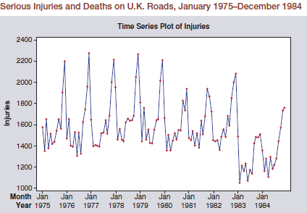
9.8 Intervention Analysis
Structural changes are common:
  temporary: a strike, bad weather
  permanent: entry of competitor, change in law
Short-term, single period effects, known as Additive Outliers [AO], model with a pulse function:
Permanent effects result in a
change in the level of the series
[Level shift, LS], model with a
step function:
Serious Injuries and Deaths on UK Roads,
Jan 1975–Dec 1984

Slide 35
Minicase 9.2 The Effectiveness of
Seat-Belt Legislation
Figure 9.17 Serious Injuries and Deaths on UK Roads, Jan 1975–Dec 1984
Question: What are the principal features of this series?

Slide 36
9.9 Structural Change and Model Simplification
A halving of crude oil prices – how might it affect your forecasting model?
Suppose the series of interest undergoes a major change (.e.g. Banking crisis, outbreak of war). Does the model structure change? Formulate the model up to and after the change as:
Set
Test versus

Slide 37
9.9 Structural Change and Model Simplification
Structural Change
Test is an ANOVA known as the Chow Test
Example 9.6: Gas prices up to and after December 2008
Set
Question: Are there changes in the model?

Slide 38
9.9 Structural Change and Model Simplification
Stability and Structural Change
What happened to retail unleaded after the “Great Recession”?
Dramatic Fluctuations!
Past data now contains much more information
But is our new model stable?
Stability in a model’s parameters a key requirement for
successful forecasting

Slide 39
9.9 Structural Change and Model Simplification
Understanding Stability – Rolling Regression
Define a starting sample
  [1,T₀]
Estimate the regression
model
Update the sample
  [1, T₀₊₁]
Re-estimate model
Alternatively, keep sample size fixed:
a moving window
Examine how parameters change
Changing relationships:
with crude
with SP500: increasing importance

Slide 40
9.9 Structural Change and Model Simplification
Model Simplification
Consider two models, M₀ and M₁
M₀ is a simplification of M₁ with
To test whether the model can be simplified
Uses: Testing for seasonality, additional lags,
nonlinear terms and structural change

Slide 41
9.10 An Update on Forecasting, I
Pure forecasts or ‘what-if’ forecasts?
  Policy making using possible values of controllable variables
  Decision-making in face of uncontrollable variables [specify set of possible actions]
  Time considerations – when will data be available?
    An imprecise quickly available indicator may be more useful for forecasting, but less useful for explanation e.g. weekly help wanted advertisements in newspapers.

Slide 42
9.10 An Update on Forecasting, II
One-step or multi-step ahead?
  On average, forecasts made (h-1) steps ahead will be more accurate than forecasts made h steps ahead. [Recall weather example in Section 2.7.1]
Given the fitted model, we must specify values for each X-variable. The standard error of the forecast will depend upon whether the X-values are known:
  all X_{j} known, SE of forecast given.
  some X_{j} known, others forecast, SE of forecast of Y will increase beyond the usual value.
  some X_{j} unknown, but specified on a “what-if” basis SE is OK, conditionally upon the values specified.

Slide 43
9.11 Principles of Regression Model Building
Rely upon theory and domain expertise to select explanatory variables. Use all important variables.
Plot, inspect, and test the residuals for departures from the assumptions,
  including departures such as outliers and leverage points.
Aim for a relatively simple model specification.
When theory provides a guide to functional form or when data strongly suggest a functional form that is compatible with theory follow the theory,
  e.g., when you know that there is an upper limit to the market penetration level of a new technology

Slide 44
9.11 Principles of Regression Model Building
If the date of a possible structural break is known, test whether the parameters remain constant.
Test all models for performance with data not used in the estimation process, comparing the results with baseline extrapolative or judgmental alternatives.
Apply the same principles to forecasts of the explanatory variables.
Aim for an interpretable model with adequate forecasting capabilities that captures the key data characteristics.
Consider the use of Lasso when there are many plausible variables to consider for inclusion

Slide 45
Take-Aways
Start the modeling process by reviewing available theory. Carry out preliminary graphical and numerical data analysis.
Look for time dependence and consider the use of autoregressive lag terms in the model,
  an autoregressive error structure may help
Always use diagnostics to check model performance, and check forecasting performance,
  preferably using a hold-out sample.
Look for systematic factors (e.g. seasonality) and for unusual factors such as interventions that may require special terms in the model.
Not all relationships are linear.
  Where theory and data suggest a nonlinear structure, build models accordingly.

Slide 46
Selecting a Causal Forecasting Model

Slide 47
Class Assignment
You are asked to produce forecasts for the call center of a satellite broadcasting company. Calls may refer to technical support or new subscriptions, each of which is recorded separately by the company. Both series refer to daily data over a period of 7 weeks (2 May until 19 June inclusive). You are asked to produce point forecasts for each of the next 14 days (20 June until 3 July inclusive) for both technical support calls and new subscription calls. The company is interested in the effect of causal variables in forecasting new subscriptions. Owing to confidentiality reasons, these are labelled only as X1, X2, and X3. Data series for these three variables have been provided for you over the same 7-week period as the call data. Also, note that an international sport event is due to commence on 23 May and will finish on 26 June.
Your objective is to develop, for technical support calls and new subscription calls, the most accurate statistical forecasting models, demonstrating your modeling and forecasting skills.

Slide 48
Class Assignment
Grading Scheme and Hints
Data exploration
Model building
Accuracy assessment and forecasts
Presentation and summary

Slide 49
Minicase 9.1 An Econometric Analysis of
Unleaded Gasoline Prices
(Data for Minicase 9.1 can be found in file Gas_prices_2.xlsx.)
Revisit the models of unleaded gasoline prices developed so far
using an extended data set
using contemporaneous variables and longer lags
In addition, the data set includes variables relations to the availability of crude oil and unleaded. These are
Production
Stocks
Imports
Do the ‘supply’ variables add any explanatory power to the models you propose? Does the inclusion of contemporaneous input variables provide a clearer understanding of the pricing process?
Consider different time periods when modelling
Test your chosen model(s) out-of-sample conditional forecasting performance

Slide 50
Minicase 9.2 Effectiveness of Seat-Belt Legislation
(Data for Minicase 9.2 can be found in file Road_accidents.xlsx.)
Harvey and Durbin (1986) provided a classic illustration of the value of intervention analysis to determine the effectiveness of new legislation that required drivers to wear seat belts. The data represent monthly totals of deaths and serious injuries (labeled DSI) on roads in the UK over the period from Jan. 1975 to Dec. 1984. The legislation became effective on Feb. 1, 1983, although drivers began to comply in increasing numbers during January of that year. The data clearly exhibit a strong seasonal pattern but little trend.
Develop a model for this series, using only 11 seasonal indicators, plus a step function defined as:
X_{t} = 1, if February 1983 or later
= 0.5, for January 1983
= 0, prior to January 1983
(continues)

Slide 51
Minicase 9.2 Effectiveness of Seat-Belt Legislation
(continued)
The value 0.5 for Jan. .1983 is somewhat arbitrary but seems intuitively reasonable given that drivers were using seat belts in increasing numbers during that month. Because the model uses only indicator variables, forecasting is straightforward, but longer term projections would clearly need to take into account other safety measures, total traffic volumes and similar variables. Such forecasts are clearly important in guiding policy makers.
Did the legislation achieve the desired effect of reducing deaths and serious accidents? By how much?
If you were a policy maker in 1985 (when the study was conducted), would you support similar requirements for passengers? Why?

